Slide 1
SESRI
Workshop on
Survey-based
Experiments
Session 6: Substantive Experiments
April 18, 2017
Doha, Qatar

Slide 2
Outline: Session 6
Compare and contrast methods-focused and substantive survey experiments
Explore several common approaches with examples from various social science fields
Notes:
What kinds of resources and assistance to seek and where; we will give you vocabulary to be able to discuss issues around program evaluation.

Slide 3
Methods vs. Substantive Experiments
Methods: goal is to improve the survey process
  Identify sources of survey error, explore ways to reduce that error
Substantive: goal is to test causal hypotheses about social science phenomena using population-based surveys
Often the lines are blurry, many studies combine elements of each

Slide 4
Common Approaches to Conducting Substantive Survey Experiments
Framing/information treatments
Priming/activating
Vignettes/conjoint/factorial designs
List experiments

Slide 5
Framing Experiments
Researcher manipulates the information provided to respondents to test hypotheses about framing
Researcher’s motivations may be primarily substantive (i.e., how do people respond to certain types of news or information?).
Or they may be methodological (i.e., do we get different survey responses when we frame questions different ways?).

Slide 6
Framing Theory
“Framing refers to the process by which people develop a particular conceptualization of an issue or reorient their thinking about an issue.” Chong and Druckman 2007, p. 104.
“...framing effects... occur when (often small) changes in the presentation of an issue or an event produce (sometimes large) changes of opinion.” C&D 2007, p. 104.

Slide 7
Examples of Framing Effects
40% of survey respondents support increasing “welfare” while 80% support increasing “assistance to the poor.”
Support for reconfiguring Doha’s traffic patterns increases when respondents are provided information about likely reductions in traffic accidents relative to when they are provided with information about likely reductions in congestions or no additional information at all.
Other examples?

Slide 8
Framing Experiments
Framing experiments typically involve randomly assigning different frames to survey respondents and comparing their responses to public opinion questions.

Slide 9
Framing Example:
Opposition to Immigration
Study: Brader et al. 2008, “What Triggers Public Opposition to Immigration?” AJPS
Question: do group cues shape how the public weighs information about the costs of immigration?
Approach: random assignment of news excerpts combined with visual cues.

Slide 10
Opposition to Immigration
Hypothesis: salience of immigrant groups will affect the impact of information about immigration on respondents’ favorability towards immigration.
  Images of Latino immigrants will trigger greater opposition to lenient immigration policy than images of European immigrants.

Slide 11
Opposition to Immigration
Treatment: exposure to news stories and ethnic cues
  2x2 design that produced four experimental conditions
    Manipulate mock New York Times news story to emphasize positive/negative consequences of increasing immigration
    Manipulate group cue by altering the picture and name of an immigrant (white European vs. Latino)
    Pos/Lat, Pos/Euro, Neg/Lat, Neg/Euro
  Control group read a mock NYT story about cell phone use and car crashes.
Sample: web-based nationally representative sample of 354 white, non-Latino adults.

Slide 12
Opposition to Immigration
Dependent Variables:
  Do you think the number of immigrants from foreign countries who are permitted to come to the United States to live should be increased a lot, increased a little, left the same as it is now, decreased a little, or decreased a lot?
  Do you favor a law making English the official language of the United States, meaning government business would be conducted in English only, or do you oppose such a law? (Strongly Favor, Favor, Oppose, Strongly Oppose)

Slide 13
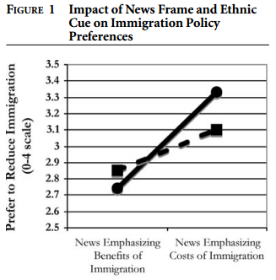
Opposition to Immigration
Brader, Valentino, Suhay (2008)

Slide 14

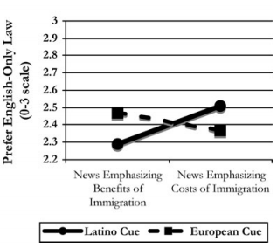
Opposition to Immigration
Brader, Valentino, Suhay (2008)

Slide 15
Opposition to Immigration
Implications
  Follow-up questions indicate that specific group cues (in this case, Latinos), trigger emotions of anxiety that lead to less support for immigration overall.
Limitations
  External validity (i.e., artificiality of the experimental setting)
  Internal validity (i.e., temporary vs. lasting effects)
  Mediating factors
  Statistical power (i.e., small cell sizes)
  Generalizability (i.e., culturally context specific)
  Other

Slide 16
Clicker Question 7
Indicate which you believe is the most important limitation of the Brader et al. study:
  External validity (i.e., artificiality of the experimental setting)
  Internal validity (i.e., temporary vs. lasting effects)
  Statistical power (i.e., small cell sizes)
  Generalizability (i.e., culturally context specific)
  Other

Slide 17
Priming Experiments
Priming refers to increasing the salience of a category or criterion in people’s evaluations.
In priming experiments, researcher provides information before the experiment to trigger concepts that the respondent then uses to make judgements or evaluations.
Related to framing, more indirect.

Slide 18
Clicker Question 8
Which of the following are examples of priming effects?
  People prefer a female municipal council candidate (F) over a male candidate (M).
  People interviewed by female interviewers are more likely to prefer female municipal council candidates than those interviewed by men.
  More people prefer the female candidate after reading a news story about family issues.
  People believe women candidates are better able to make policies dealing with family issues.

Slide 19
Priming Example:
Emotions and Medical Information
Study: Persky et al, “Genomic Information may Inhibit Weight-Related Behavior Change Inclinations Among Individuals in a Fear State,” Annals of Behavioral Medicine.
Question: Does emotional state condition how people interpret and apply medical information about the causes of disease?
Hypothesis: Activating fear will make subjects more receptive to messages about behavioral underpinnings of obesity.
Approach: priming emotion through mild emotion generation tasks.

Slide 20
Emotions and Medical Information
Treatment: activation of emotions and exposure to physician-provided medical information
3x2 design that produced six experimental conditions
  Elicitation of anger, fear or neutral emptions
  Manipulation of messages from a simulated doctor emphasizing genetic/behavioral causes of obesity
  Anger/Gen, Anger/Beh, Fear/Gen, Fear/Beh, Neutral/Gen, Neutral/Beh
Sample: 555 overweight/obese women
Respondents told they were participating in two separate studies (life events, patient-doctor interactions)

Slide 21
Priming Task
Anger prompt: write for five minutes about a situation that had made them feel very angry such that someone reading the story would also feel that emotion.
Fear prompt: write for five minutes about a situation that had made them feel very fearful such that someone reading the story would also feel that emotion.
Neutral prompt: write for five minutes describing a room in their house.

Slide 22
Information Manipulation
Simulated doctor talking to a patient
After noting that the “patient” is overweight, doctor talks about the relationship between excess weight and the increased risk of breast cancer
Then in the “genetic information version,” he explains that genetics can have a big impact on body weight.
In the “behavioral information version,” he explains that one’s own behavior and the environment around them can have a big impact on body weight.

Slide 23
Emotions and Medical Information
Dependent Variables:
  Combined two questions into a “diet index”
    I intend to make changes to my diet in the next six months (7 points, strongly disagree to strongly agree)
    How likely is it you will try to change your diet in the next six months (7 points, very unlikely to very likely)
  Combined two questions into an “exercise index”
    I intend to get more exercise in the next six months (SD-SA)
    How likely is it you will try to get more exercise in the next six months (VU-VL)

Slide 24
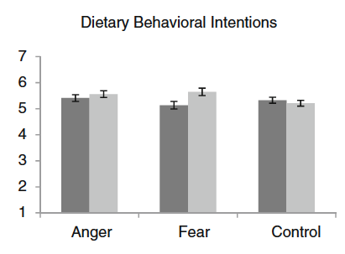

Emotions and Medical Information
Persky et al (2016)

Slide 25
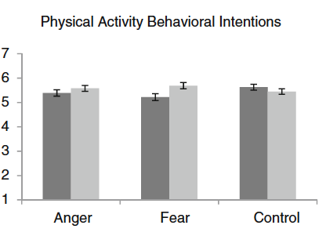
Emotions and Medical Information
Persky et al (2016)

Slide 26
Emotions and Medical Information
Implications
  Some emotions shape how people process and respond to information differently than other emotions
  Fear may be an especially important factor in health/ medical situations
Limitations
  Generalizability (non-representative sample)
  Internal Validity (messages delivered by a simulated doctor)
  Internal Validity (messages directed to a third person, not the respondent herself)
  Other

Slide 27
Clicker Question 9
Indicate which you believe is the most important limitation of the Persky study:
  Generalizability (non-representative sample)
  Internal validity (messages delivered by a simulated doctor)
  Internal validity (messages directed to a third person, not the respondent herself)
  Other

