Slide 1
SESRI
Workshop on
Survey-based
Experiments
Session 4: Methods Experiments (Continued)
April 17, 2017
Doha, Qatar

Slide 2
Outline: Session 4
Continuation of experimental methods examples:
  Nonresponse error
  Processing error
  Inferential error
  Questionnaire design
  Mode effects
Notes:
What kinds of resources and assistance to seek and where; we will give you vocabulary to be able to discuss issues around program evaluation.

Slide 3
Outline: Session 4
Continuation of the discussion of methodological experiments within the TSE model of the survey process
By the end of this session, you should have an understanding of how methodological experiments can improve the measurement in your surveys

Slide 4
TSE Model: Nonresponse Error
Two potential types of nonresponse:
  Unit nonresponse: missing respondents
  Item nonresponse: missing answers to questions

Slide 5
TSE Model: Nonresponse Error
Unit nonresponse: missing respondents
Evaluate alternative sample designs (SRS vs. Stratification)
Evaluate impact of (various) administrative approaches like incentives or advance letters

Slide 6
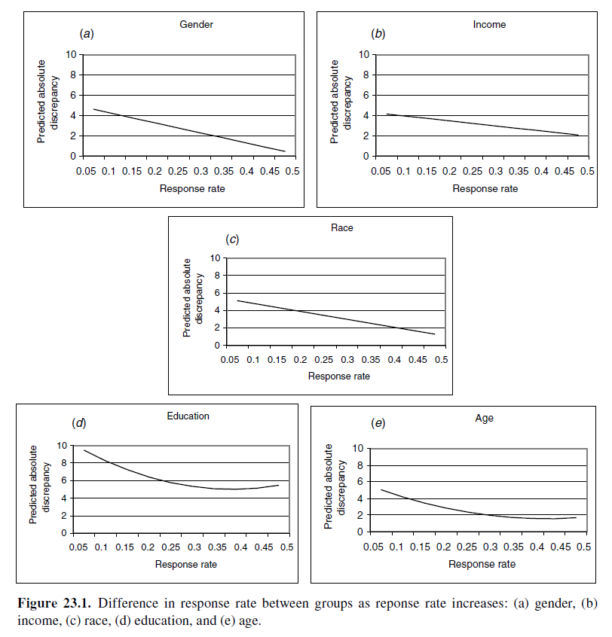
Reducing Nonresponse Rates through Incentives
Unit nonresponse and demographic representativeness
Difference in response rate between groups as response rate increases:
Holbrook, Krosnick & Pfent (2008)
Notes:
For gender, income, and race, the association was significantly negative and linear; response rate accounted for less than 10 percent of the variance in demographic discrepancy in each case. (Holbrook, Krosnick & Pfent 2008, pg 525)

Slide 7
Reducing Nonresponse Rates through Incentives
Unit nonresponse and demographic representativeness
Difference in response rate between groups as response rate increases:
Holbrook, Krosnick & Pfent (2008)
Notes:
For education and age, the effect of response rates on demographic discrepancies was nonlinear. Education and age demographic discrepancies were greater as response rate dropped below .30, but increases in response rates above .30 were not associated with further reductions in education and age discrepancies. (Holbrook, Krosnick & Pfent 2008, pg 525-526)

Slide 8
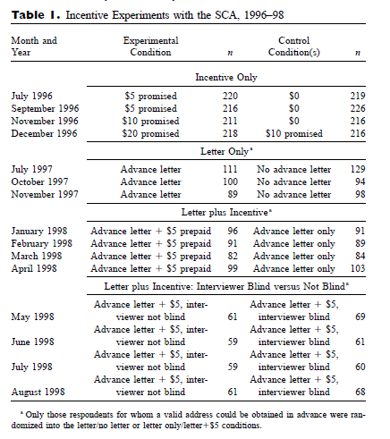
Reducing Nonresponse Rates through Incentives
How complex can an experiment be?
Singer, Van Hoewyk, Maher (2000)

Slide 9
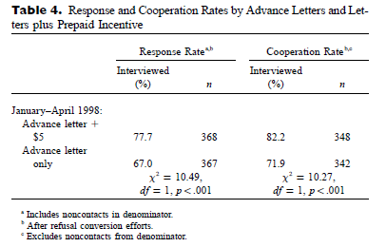
Reducing Nonresponse Rates through Incentives
It makes a difference whether interviewers know about the experiment
Singer, Van Hoewyk, Maher (2000)

Slide 10
TSE Model: Nonresponse Error
Item nonresponse: missing answers to questions
Evaluate alternative question wordings
Evaluate alternative response categories, including explicit “Don’t know”

Slide 11
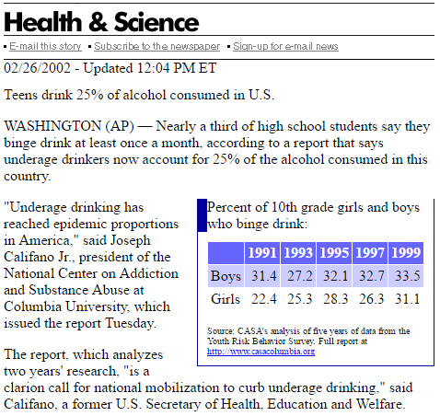
TSE Model: Processing Error
The National Center on Addiction and Substance Abuse, “Teen Tipplers” Study
Oversample of people age 12-20
Initial report: 25% of all alcohol consumed in the U.S. is consumed by people in this age group
Subgroup of young people had not been weighted back to the population
Proper weighting resulted in estimate of 11.4% of alcohol being consumed by teenagers

Slide 12
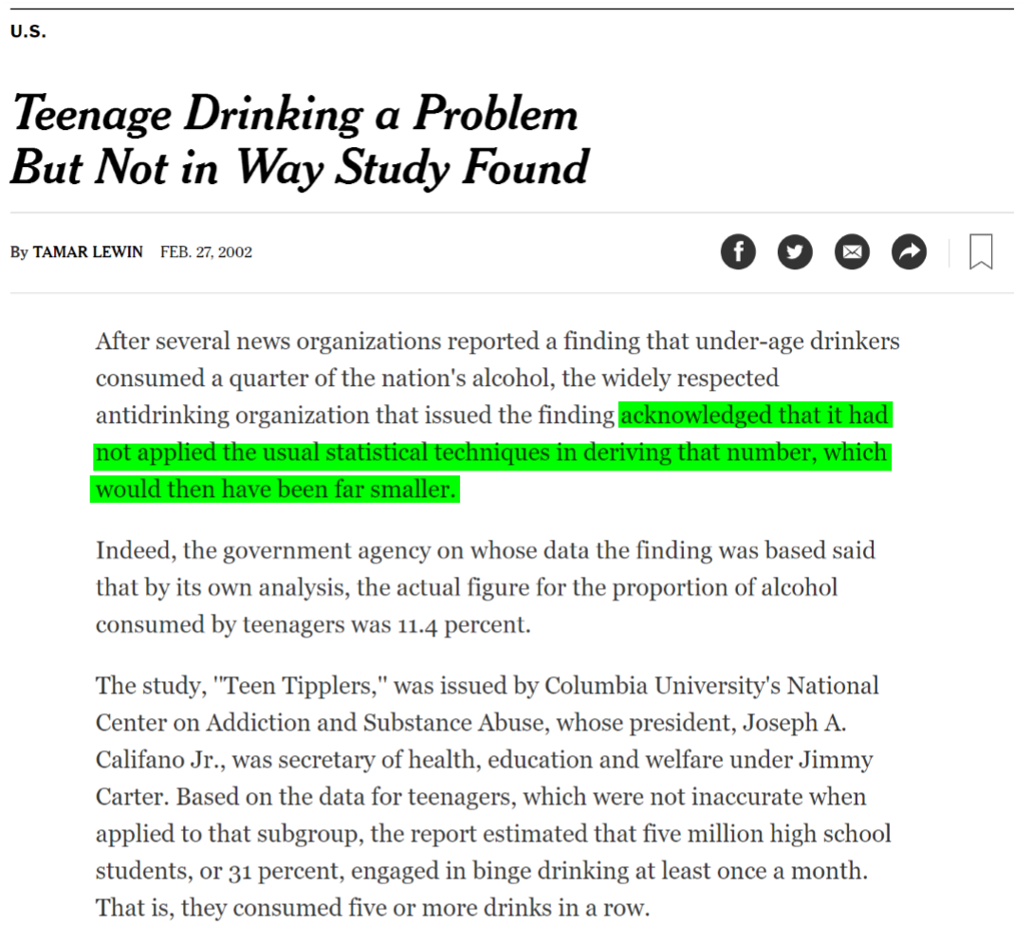
TSE Model: Processing Error
Proper weighting resulted in estimate of 11.4% of alcohol being consumed by teenagers

Slide 13
TSE Model: Inferential Error
What is the meaning/operationalization of “consumer confidence in Qatar”?
How would the concept be measured?
For whom would the measurements be made?
In a typical sample drawn in Qatar, how would the data from different strata be combined?

Slide 14
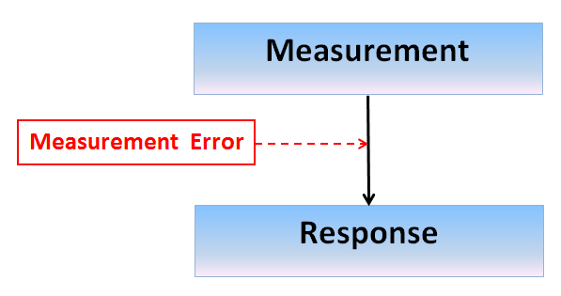
Experiments in Measurement
Question wording & order
Response alternatives
Response scales

Slide 15
Measurement Experiments: Wording
Holocaust denial controversy in 1992
Does it seem possible to you that the Holocaust never happened?
Does it seem possible or impossible to you that the Holocaust never happened?
Results suggested that half of Americans were Holocaust “deniers” or “doubters” compared to 5-10% in other surveys
Smith (1995)

Slide 16
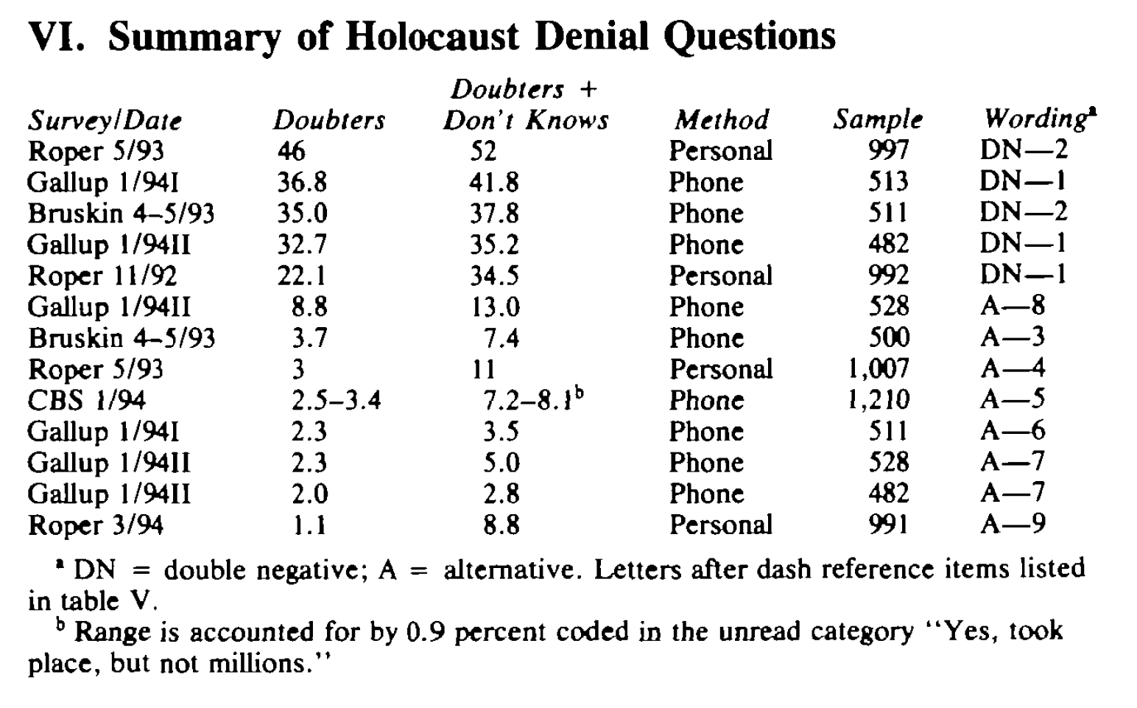
Measurement Experiments: Wording
Smith (1995)

Slide 17
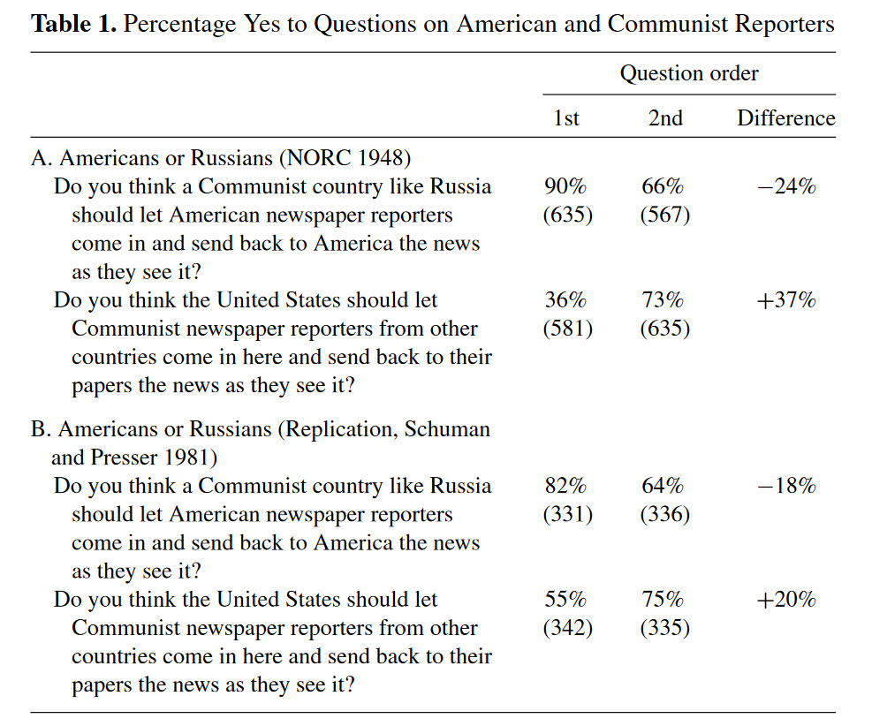
Measurement Experiments: Order
Reciprocity effect: Can results be replicated over time?
Schuman (2009)

Slide 18
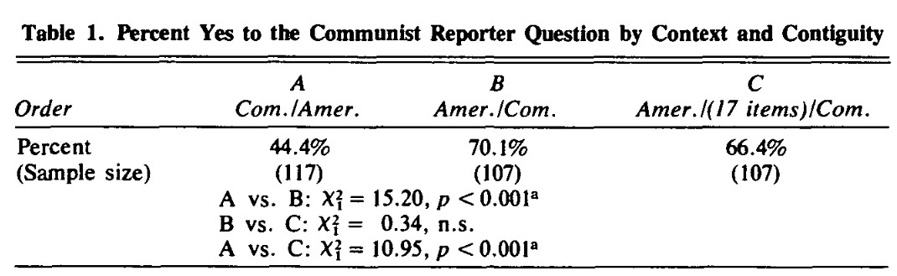
Measurement Experiments: Order
Reciprocity Effect: Can results be replicated over time?
Schuman & Ludwig (1983)

Slide 19
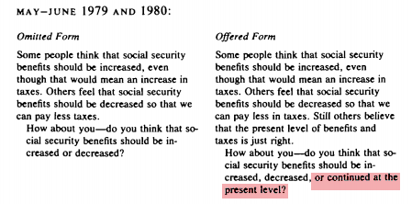
Measurement Experiments: Response Alternatives
(Explicit Middle Alternative)
An experiment offering an explicit middle alternative:
Measurement
Bishop (1987)

Slide 20
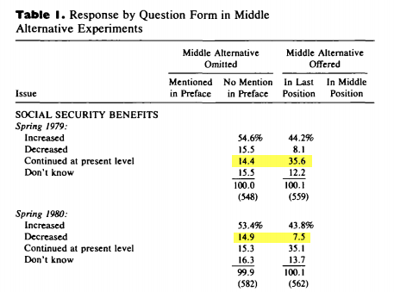
Measurement Experiments: Response Alternatives
(Explicit Middle Alternative)
An experiment offering an explicit middle alternative:
Bishop (1987)

Slide 21
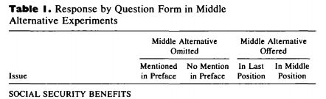
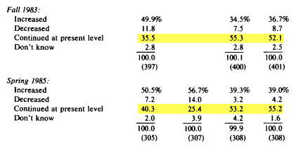
Measurement Experiments: Response Alternatives
(Explicit Middle Alternative)
Variations on an experiment offering an explicit middle alternative:
Bishop (1987)

Slide 22
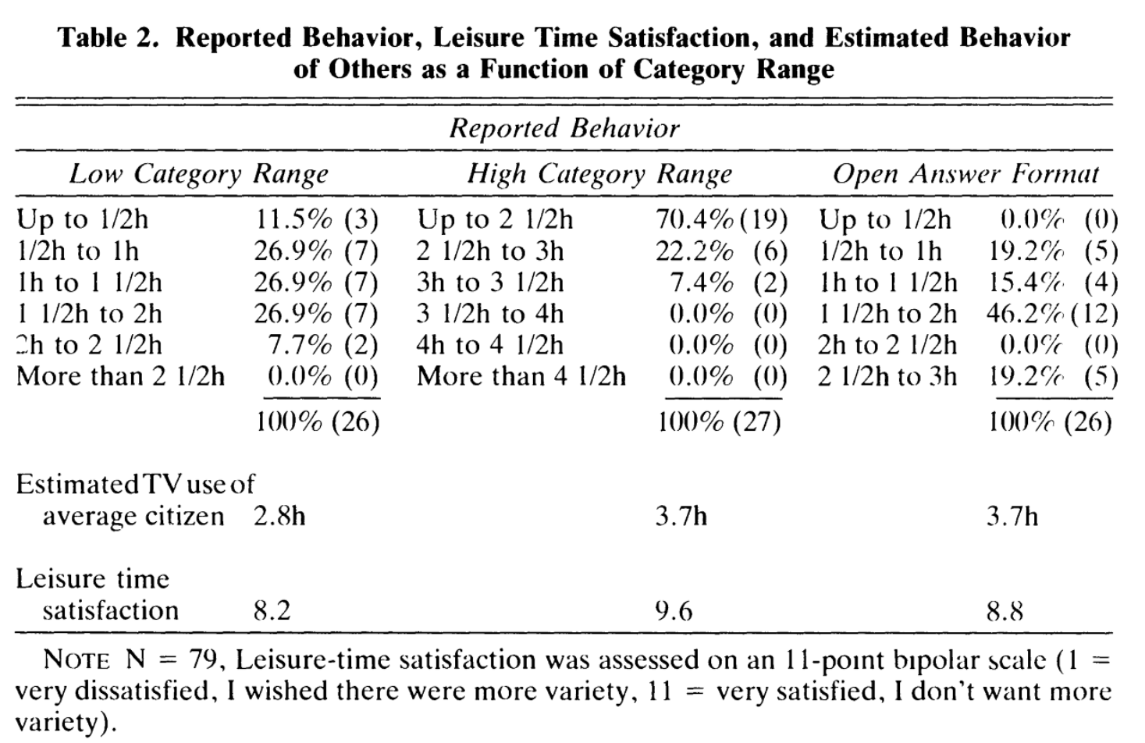
Measurement Experiments: Response Scales
Schwarz, Hippler, Deutsch, Strack (1985)

Slide 23
TSE Model: Mode Effects
Mode is the form of administering or delivering a questionnaire or interview
Self-administered surveys
Mail/written
Internet
Interviewer Assisted
Phone (cell and landline)
Face-to-face

Slide 24
Mail/Written Mode
ADVANTAGES DISADVANTAGES
Low cost Response rate (<50%)
Large groups Data quality (motivation)
Avoids potential researcher bias Limited length
Less reactance to other person Can’t control question order
Less pressure for quick response Can’t control context (others)
Feelings of anonymity higher Can’t help respondent interpret
No homeless

Slide 25
Telephone Mode
ADVANTAGES DISADVANTAGES
Cheaper than face-to-face Some interviewer bias
High response rate (almost as high as f-t-f) No visual aids
Better supervision of interviewers Complex questions may be difficult
Quick Technical problems (nonworking or ineligibles)
Can hear interviewers (cues) Can’t see reactions
Random digit dialing Caller ID, other technologies
Broad populations
Relatively anonymous
Can follow up, motivate with less researcher bias than f-t-f (good quality data)

Slide 26
Face-to-Face (f-t-f) Mode
ADVANTAGES DISADVANTAGES
Can control, probe, correct, answer Interviewer effects
Visual aids High cost ($ and time)
Can see reaction Not anonymous
Data quality high (over 80% response)
Can motivate and establish rapport
Can be longer than other types
Know who they are

Slide 27
Internet Mode
ADVANTAGES DISADVANTAGES
Low cost Population may be biased
Very large samples possible Honesty
Low cost Motivation
Little human input needed Requires some skill, equipment
Anonymity? Get less detailed answers
Avoid researcher bias No knowledge of who respondent is
Visual and audio aids
Can use multiple languages and/or have links to more information
Can get large geographic region/cross-national

Slide 28
Mixed Mode Designs and Mode Effects
Concerns about response rates and costs drive interest in mixed mode designs
But will the data from different modes be comparable?
The problem of observational data

Slide 29
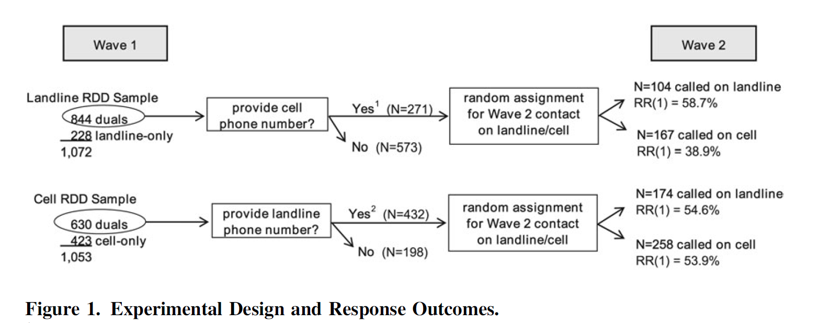
TSE Model: Mode Effects
A way to deal with random assignment in an evaluation of cell phone and landline samples
Kennedy and Everett (2011)

Slide 30
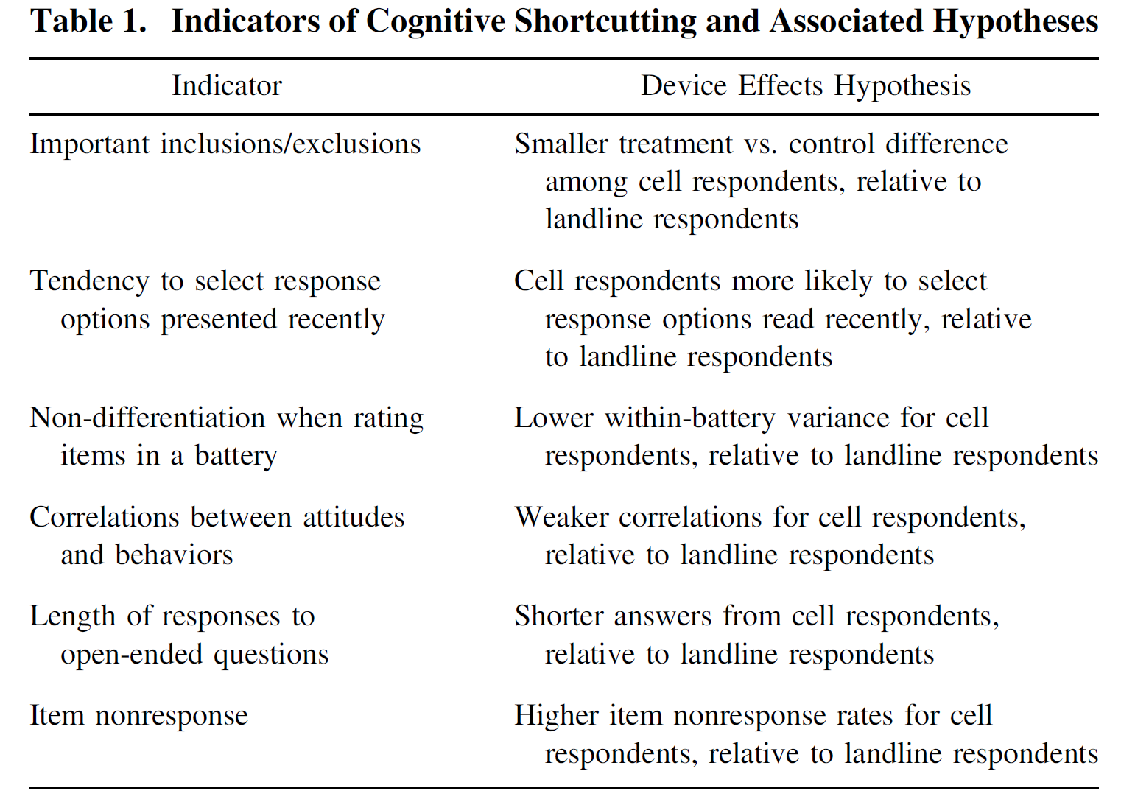
TSE Model: Mode Effects
Main hypotheses
Kennedy and Everett (2011)

Slide 31
TSE Model: Mode Effects
Partial
Partial
Partial
Partial
Partial
Partial
Kennedy and Everett (2011)

Slide 32
Clicker Question 5
Which of the following modes would you choose if you were to conduct a nationally representative survey of adults on a sensitive health-related topic?
  Mail
  Telephone
  Face-to-face
  Internet
  Mixed-Mode

