Slide 1
SESRI
Workshop on
Survey-based
Experiments
Session 3: Experiments in Survey Design and Implementation
April 17, 2017
Doha, Qatar

Slide 2
Outline: Session 3
Beginning to discuss methodological experiments within the TSE model of the survey process
By the end of this session, you should have an understanding of how methodological experiments can improve the design of your surveys

Slide 3
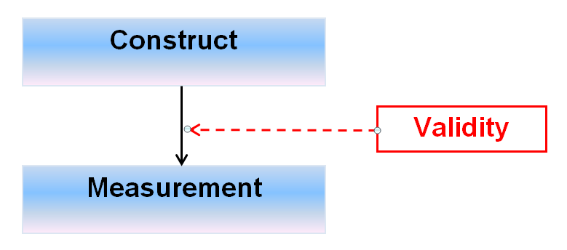
Experiments in Construct Validation
Do the measures capture the concept?
Two key concepts involved here:
Tests to validate new measures
Efficient survey design to maximize the number of tests within a given budget

Slide 4
The Concept of Validity
Validity relates to the congruence or "goodness of fit" between an operational definition and the concept it is purported to measure.
A highly unreliable measure cannot be valid if measurements cannot be taken consistently.
But a highly reliable measure can also be invalid if the operational link to the underlying concept is not there.

Slide 5
In order to assess validity, we can make:
1) A subjective evaluation of whether the variable is measuring what is supposed to (no correlations)
AND/ OR
2) Compare the variable to other measures of the same concept with which it should or should not be related (use correlations)

Slide 6
The Concept of Intelligence
Suppose I am interested in the concept of “intelligence”? What is that concept?

Slide 7
The Concept of Intelligence
Suppose I am interested in the concept of “intelligence”? What is that concept?
Sometimes researchers are interested in developing completely new measures of a concept because they don’t think the current measure is valid.
In order to be considered valid, my measure must at least seem to be measuring the right concept.

Slide 8
The Concept of Intelligence
Suppose I use a survey and ask the following questions:
What is the Emir’s name?
Who is the Prime Minister?
How many members are there on the Doha City Council?
Do answers to these questions measure “intelligence”?

Slide 9
The Concept of Intelligence
Are there any standard measures of intelligence? (Stanford-Binet test)
Gale Encyclopedia of Medicine: Stanford-Binet intelligence scales
If there are and those measures have been well evaluated and validated, then my new measure of the concept must be correlated with that measure

Slide 10
Convergent Validity
An evaluation of a measure based upon other known research using the concept.
If a measure is valid, it should correlate with other measures of the same concept, such as previously validated ones.

Slide 11
Discriminant Validity
There are some variables with which a measure should not be correlated
Intelligence should not be correlated with age
A concept may have different meanings for different groups or subsets of units, so scores should differ among them as well

Slide 12
Criterion-related Validity
If there is another well-validated measure of the concept, and the values are related to another (criterion) variable, i.e., women have higher IQ scores than men:
1. Concurrent validity: can the new measure also distinguish the present standing of units on the criterion variable?
Does my new test of intelligence show women with higher scores than men?

Slide 13
Experimental Validity Testing
Suppose we have a new measure of a concept involving 5 questions and want to compare it to three well-validated measures of the same concept:
Measure A: 6 questions
Measure B: 5 questions
Measure C: 5 questions
How can we organize the convergent validity test?
Notes:
One survey with 21 questions administered to the entire sample: with a sample of 1,000, you get 21,000 items administered
Random assignment to one-third of the sample with 11, 10, and 10 questions in each (5+6), (5+5), and (5+5): with 1/3 samples you get 3,663 items + 3,300 + 3,300 = 10,263 items administered (about half as many)
With random assignment to one-quarter of the sample (21, 11, 10, and 10 item), you get 5,250 + 2,750 + 2,500 + 2,500 = 13,000 items administered

Slide 14
Experimental Validity Testing
Suppose the sample size is 1,000
One survey with 21 questions (5 + 6 + 5 + 5) = 21,000 items administered
Random assignment of each validated measure to 1/3 of the sample of 11, 10, and 10 items = 3,663 + 3,330 + 3,330 = 10,323 items administered
Random assignment to ¼ of the sample of 21, 11, 10, and 10 items = 5,250 + 2,750 + 2,500 + 2,500 = 13,000 items administered
Notes:
One survey with 21 questions administered to the entire sample: with a sample of 1,000, you get 21,000 items administered
Random assignment to one-third of the sample with 11, 10, and 10 questions in each (5+6), (5+5), and (5+5): with 1/3 samples you get 3,663 items + 3,300 + 3,300 = 10,263 items administered (about half as many)
With random assignment to one-quarter of the sample (21, 11, 10, and 10 item), you get 5,250 + 2,750 + 2,500 + 2,500 = 13,000 items administered

Slide 15
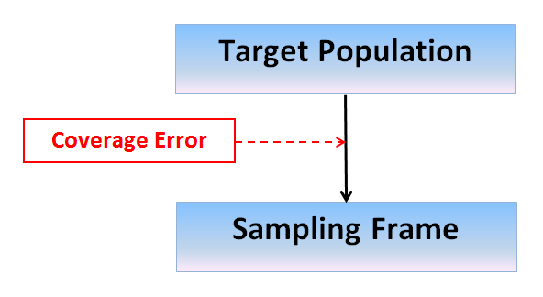
Experiments in Frame Selection
Comparison of alternative frames
Comparison of an existing frame to a constructed frame
Examples of alternative frames: Landline, Cell phone, Address-based, Registration-based

Slide 16
Frame Problems
Typical frame problems that may differ by frame:
Non‐coverage (missing elements)
Blanks (ineligible elements)
Duplicates
Clusters (more than one population element associated with a single list element)

Slide 17
Experiments in Frame Selection
What would be the key tradeoffs/differences?
Coverage
Response rates
Costs

Slide 18
Experiments in Frame Selection
Comparison of an RDD phone frame (or dual frame design) and an Address Based Sample (ABS) frame for completeness of coverage
Link et al. (2008). “A Comparison of Address-Based Sampling (ABS) versus Random Digit Dialing (RDD) for General Population Surveys.” Public Opinion Quarterly 72: 6-27.

Slide 19
Experiments in Frame Selection:
Coverage and Response Rates
Basic design elements:
Take a large-scale national survey (Behavioral Risk Factor Surveillance System – BRFSS) conducted at the state level using RDD-CATI and in 6 states with low response rates; use a split-half sample to include a mail questionnaire with ABS

Slide 20
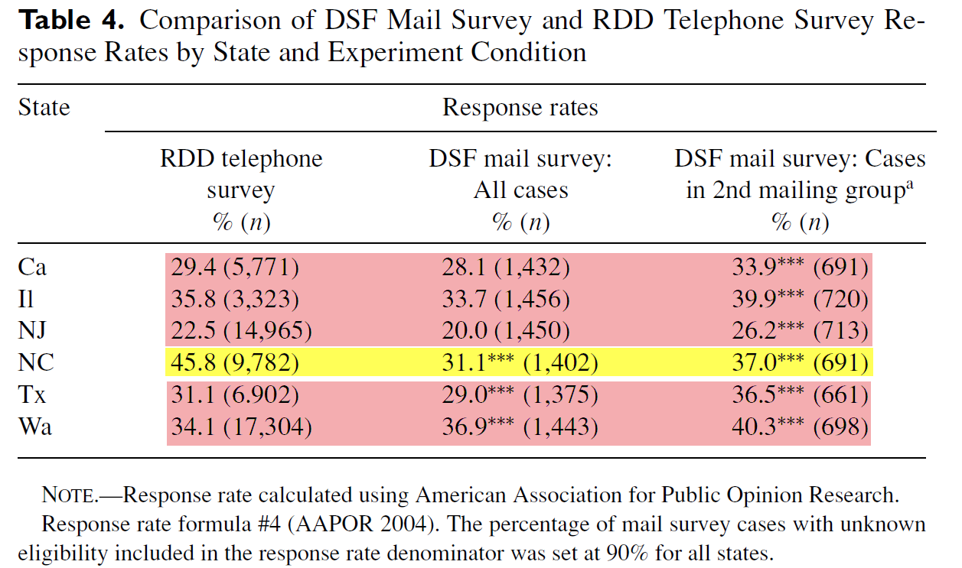
Experiments in Frame Selection:
Coverage and Response Rates
Link et al (2008)

Slide 21
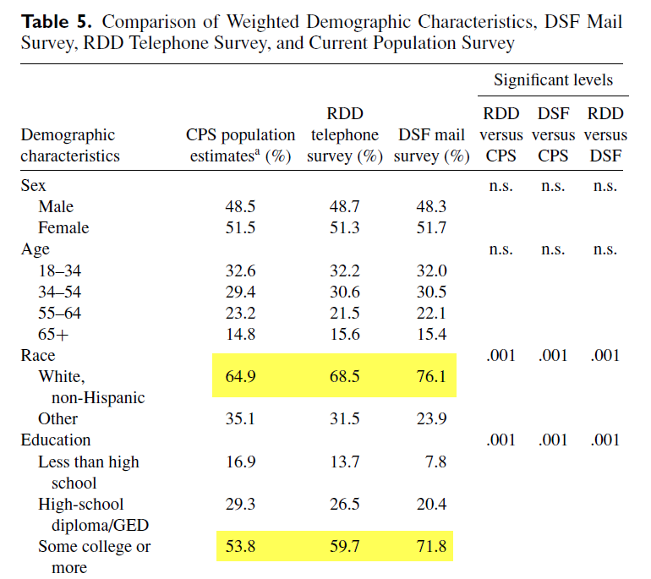
Experiments in Frame Selection:
Coverage and Response Rates
Link et al (2008)

Slide 22
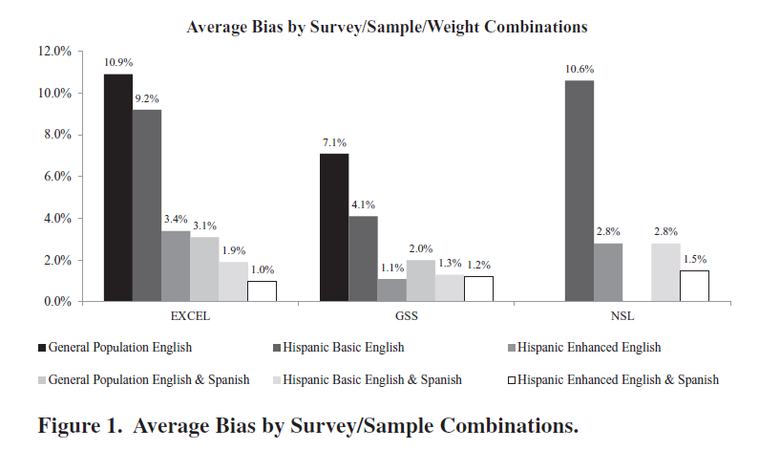
TSE Model: Sampling Error
Dutwin & Lopez (2014)

Slide 23
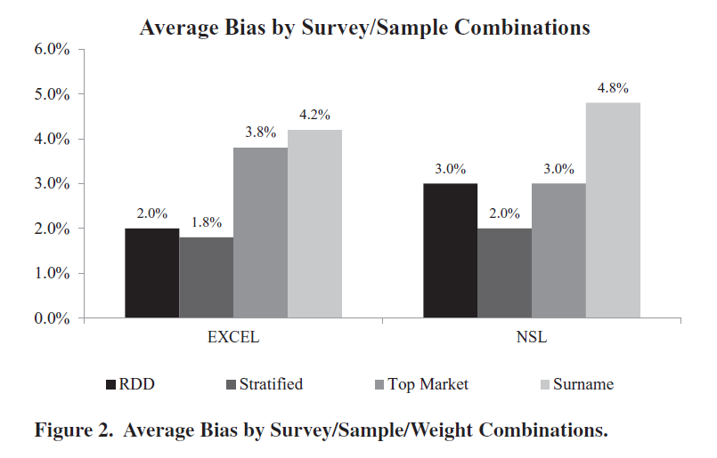
TSE Model: Sampling Error
Dutwin & Lopez (2014)

