Slide 1
SESRI
Workshop on
Survey-based
Experiments
Doha, Qatar
April 16-20, 2017

Slide 2
Organization of the Workshop
Lecture sessions, two per day
  Will run from 9 to 12 with a short break
  Occasional group work based on prepared exercises
iClicker exercises

Slide 3
Outline: Session 1
Workshop objectives
Introductions
Overview of experimental possibilities in the Total Survey Error (TSE) perspective on the survey process
Definitions: survey-based experiments
Notes:
What kinds of resources and assistance to seek and where; we will give you vocabulary to be able to discuss issues around program evaluation.

Slide 4
By the end of this workshop, you should be able to:
Understand the purpose of using experiments in surveys
Identify the primary components of well-designed experiments
Appreciate different ways that experiments can be used to improve survey design or to test substantive hypotheses
Manage and analyse data resulting from such experiments

Slide 5
Who are we?
Michael Traugott (Mike)
Elisabeth Gerber (Liz)

Slide 6
Who are you?
Name
Affiliation
Interest in this workshop

Slide 7
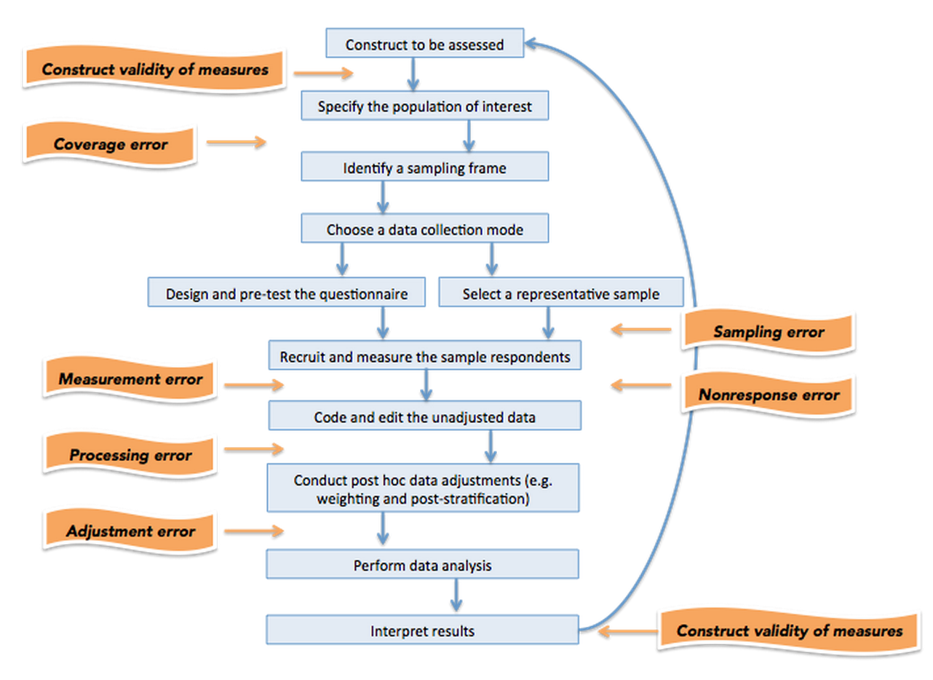
The Total Survey Error (TSE) Model

Slide 8
The Total Survey Error (TSE) Model
Generally, we are concerned about two types of error:
  Representation (Internal and external validity) Representativeness
  Measurement (Reliability and validity)
The TSE perspective ensures that we investigate as many sources of error as resources permit, with an eye toward minimizing errors in terms of those we expect are most likely to occur

Slide 9
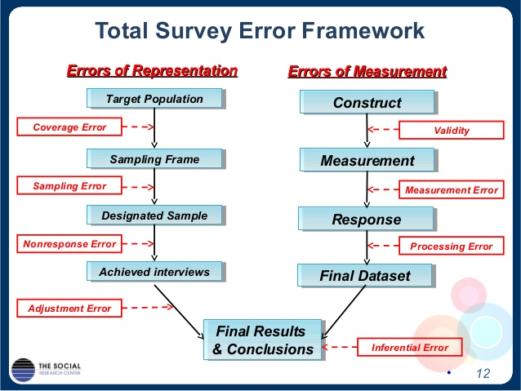
Alternative Total Survey Error (TSE) Model

Slide 10
What are Experiments?
At least two groups - treatment and control
Participants randomly assigned to each group
  Ensures they are otherwise identical
Administer treatment, then compare outcomes
  May measure outcomes pre-treatment as well
Any statistically significant differences in outcomes attributed to/ caused by the treatment

Slide 11
What Are Survey-based Experiments?
Involve randomly assigned conditions, treatments, or elements to establish causality with regard to observed effects or differences
Provide confidence about the suitability or effectiveness of alternative design choices

Slide 12
What are NOT Survey Experiments?
Comparing results of different surveys that are not administered to different groups based on randomization
Comparing pre- and post-outcomes but not varying the survey
Administering surveys to different subsamples, reconceptualization of groups of respondents, combinations of measures
Others examples (land line/cell phone users)?

Slide 13
Elements of an Experimental Design
1. Researcher designs and controls the treatment
2. Respondents are randomly assigned to treatments
3. Dependent variable is measured (before and) after the treatment

Slide 14
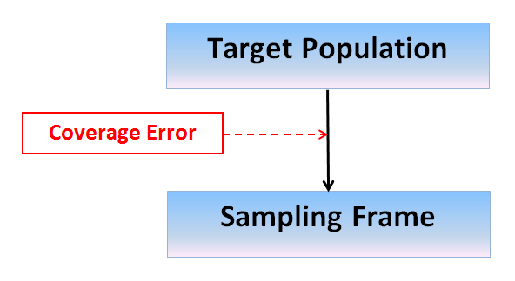
Experiments in Frame Selection
Comparison of alternative frames
Comparison of an existing frame to a constructed frame

Slide 15
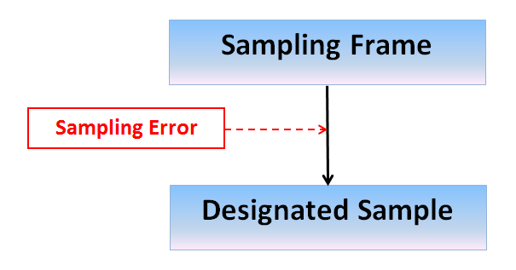
Experiments in Sample Design
Comparison of alternative sample designs to:
Increase response rates
Evaluate mode effects
Increase representativeness

Slide 16
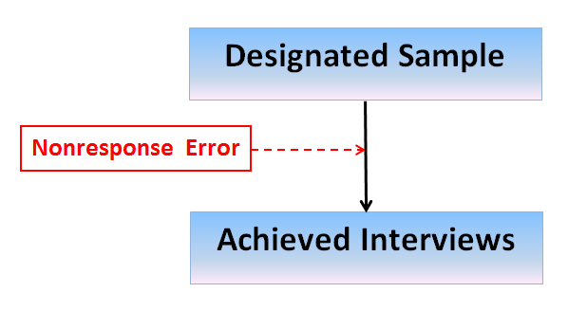
Experiments in Nonresponse Reduction
Use of incentives
Mixed mode designs
Variation in interview length

Slide 17
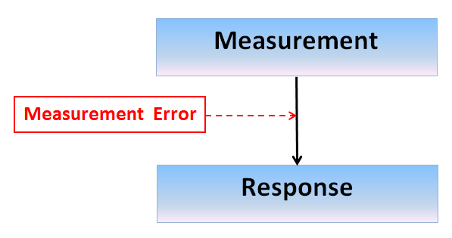
Experiments in Measurement
Question wording and order
Response alternatives
Response scales

Slide 18
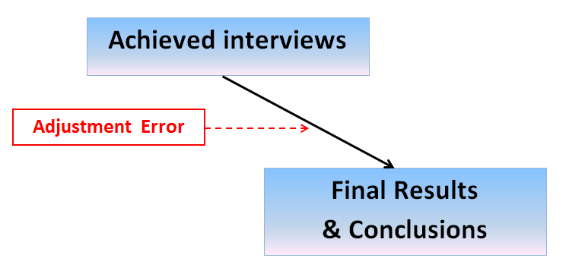
Experiments in Adjustment Error
Weighting
Imputation
Propensity scores

Slide 19
Difference between Experimental and Observational Data
Involve randomly assigned conditions, treatments, or elements to establish causality with regard to observed effects or differences
Provide confidence about the suitability or effectiveness of alternative design choices
Notes:
Turn to your neighbor and discuss: Whose problem is this? A problem of individual drivers? Of people in accidents? A problem for truckers? For the businesses along February 22nd St? What makes it a public problem?

Slide 20
Experimental vs. Observational Data
Design a survey to be administered by an experienced interviewing staff
There is a focus on attitudes toward family planning
When data are available for analysis, an analysis of attitudes is run by gender of the interviewer
  Men’s attitudes don’t differ by interviewer gender
  Women’s attitudes do differ by interviewer gender
Can the researcher be confident that the gender of the interviewer affected survey responses?

Slide 21
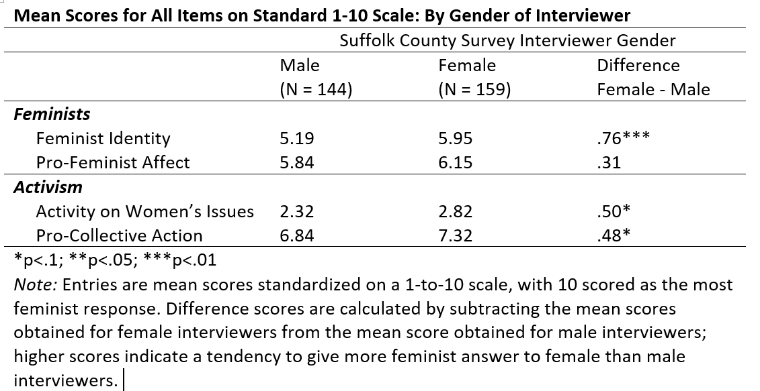
Attitudes by Interviewer Gender
Huddy et al (1997)

Slide 22
Clicker Question 1
What is the best way to deal with the observed differences in attitudes about family planning?
Only interview female respondents
Only send female interviewers into the field for the study
Both a and b
Randomly assign interviewers to respondents according to interviewer gender

Slide 23
Clicker Question 2
Which of the following would be considered a survey-based experiment?
A survey measuring knowledge of a sample of students before and after a course
A controlled lab study to determine the effects of different interviewing styles on attitudes about health care
A national survey in which respondents are randomly assigned to two different versions of a question, differing in one phrase
A mixed-mode national survey with both web and mail interviewing

