Slide 1




Analysis of Complex Sample Data
Overview: How we plan to manage the course
Lecture & discussion
  Principles
  Preparation
  Analysis
  Design
    Weighting
    Strata
    Clusters
    Nonlinear statistics
    Variance estimation
    Design effects
    Multiple imputation
Notes:
2005 CP: In last bullet uses word “design” instead of “surveys”

Slide 2
Variance estimation - 1
Several devices are employed to reduce computational burden.
  Ultimate cluster sampling as a model for more complex designs
  Sampling Error Computing Units (SECU's) formed to make computation possible
Resampling methods simplify variance estimation for nonlinear estimators.

Slide 3
Variance estimation - 2
Stratum | Collapsed stratum | PSU | SECU
1 2 3 4 5 6 7 8 9 10 | 1 2 3 4 5 6 7 8 9 10 | 169 106 125 156 197 83 108 61 89 119 | 2 2 2 2 2 2 2 2 2 2
11 12 … 59 60 | 11 11 … 35 35 | 1 1 … 1 1 | 2 … 2

Slide 4
Variance estimation - 4
Self-representing PSU | Selection | Combining implicit strata …Too many PSU’s for variance estimation
1 | 1 2 3 4 … 169 | Form 2 SECU’s from 169, systematically from the ordered list of segments
2 | 1 2 … 106 | Form 2 SECU’s from 106, systematically from the ordered list of segments

Slide 5
Variance estimation - 5
Stratum | Collapsed stratum | PSU | SECU
1 2 3 4 5 6 7 8 9 10 | 1 2 3 4 5 6 7 8 9 10 | 169 106 125 156 197 83 108 61 89 119 | 2 2 2 2 2 2 2 2 2 2
11 12 … 59 60 | 11 11 … 35 35 | 1 1 … 1 1 | 2 … 2

Slide 6
Variance estimation - 6
Reduced degrees of freedom
Unbiased estimate of variance
Each “combined” unit retains essential design features
Combined strata create more heterogeneous units for variance estimation
Often used to form paired selections
Often used in combination with collapsing …

Slide 7
Variance estimation - 7
Stratum | Collapsed stratum | PSU | SECU
1 2 3 4 5 6 7 8 9 10 | 1 2 3 4 5 6 7 8 9 10 | 169 106 125 156 197 83 108 61 89 119 | 2 2 2 2 2 2 2 2 2 2
11 12 … 59 60 | 11 11 … 35 35 | 1 1 … 1 1 | 2 … 2

Slide 8
Variance estimation - 8
Stratum | Collapsed stratum | PSU | SECU
1 2 3 4 5 6 7 8 9 10 | 1 2 3 4 5 6 7 8 9 10 | 169 106 125 156 197 83 108 61 89 119 | 2 2 2 2 2 2 2 2 2 2
11 12 … 59 60 | 11 11 … 35 35 | 1 1 … 1 1 | 2 … 2

Slide 9
Variance estimation - 9
1,213 segments in 10 strata are combined into 20 SECU’s
  10 strata of 2 SECU’s each
Remaining 50 strata have single PSU
  Collapse 50 strata to 25
  Two SECU’s per collapsed stratum
1,263 PSU’s in 60 strata combined and collapsed to 35 strata with two SECU’s each

Slide 10
Variance estimation - 10
As observed earlier, estimators of interest are non-linear for complex designs
A mathematical device, the Taylor series expansion approximation, is used to obtain a sampling variance and standard error:

Slide 11
Variance estimation - 11
For function

Slide 12
Variance estimation - 12
For example, for

Slide 13
Variance estimation - 13
The variances and the covariance in the Taylor series approximation for a ratio have to be estimated from complex sample data
How can this be done taking into account the stratification, clusters, and weights?

Slide 14
Variance estimation - 14
Recall that the data are represented in terms of stratum, cluster, & element:
And recall that the data are weighted:
The estimation of the variances and covariance is based on weighted cluster totals:
This is repeated for the “x”:

Slide 15
Variance estimation - 15
The variances and covariance use these weighted cluster totals, within strata
For example, suppose there are clusters within stratum h
Then the variance of is

Slide 16
Variance estimation - 16
There is a simplification when there are exactly two clusters in a stratum (that is, when ):
Now it’s apparent in part why “paired” designs are prepared for estimation – simplify variances.
There are corresponding terms for the variance of “x” and the covariance of “x” and “y”

Slide 17
Variance estimation - 17
Again, when there are exactly two clusters in a stratum (that is, when ) the Taylor series approximation to the variance of the mean/proportion/ratio is

Slide 18
Variance estimation - 18
As we noted, this Taylor series approach has been developed for a wide range of estimators
But there is a competing approach that reduces the complexity of the formulas and places a higher burden on machine computation
It involves the idea of the sampling distribution

Slide 19
1 Population
2 Frame
3 Sample
4 Estimate
5 Sampling distribution
6 Standard error
3 Sample
3 Sample
3 Sample
4 Estimate
4 Estimate
4 Estimate
Probability sampling principles

Slide 20
1 Population
2 Frame
3 Sample
4 Estimate
5 Sampling distribution
6 Standard error
3 Sample
3 Sample
3 Sample
4 Estimate
4 Estimate
4 Estimate
Probability sampling principles

Slide 21
1 Population
2 Frame
3 Sample
4 Estimate
5 Sampling distribution
6 Standard error
3 Sample
3 Sample
3 Sample
4 Estimate
4 Estimate
4 Estimate
Probability sampling principles

Slide 22
1 Population
2 Frame
3 Sample
4 Estimate
Replication
5 Sampling distribution
6 Standard error
3 Sample
3 Sample
3 Sample
4 Estimate
4 Estimate
4 Estimate
Probability sampling principles

Slide 23
1 Population
2 Frame
3 Sample
4 Estimate

Slide 24
1 Population
2 Frame
3 Sample
4 Estimate
5 Pseudo-sample
6 Pseudo-sample Estimate
Probability sampling principles

Slide 25
1 Population
2 Frame
3 Sample
4 Estimate
5 Pseudo-sample
5 Pseudo-sample
6 Pseudo-sample Estimate
6 Pseudo-sample Estimate
Probability sampling principles

Slide 26
1 Population
2 Frame
3 Sample
4 Estimate
5 Pseudo-sample
5 Pseudo-sample
6 Pseudo-sample Estimate
6 Pseudo-sample Estimate
7 Pseudo-sampling distribution
Probability sampling principles

Slide 27
1 Population
2 Frame
3 Sample
4 Estimate
8 Pseudo-sample standard error
5 Pseudo-sample
5 Pseudo-sample
6 Pseudo-sample Estimate
6 Pseudo-sample Estimate
7 Pseudo-sampling distribution
Probability sampling principles

Slide 28
Variance estimation - 19
Stratum | SECU | Pseudo-replicate 1 | Pseudo-replicate 2
1 | 1 2 | ✓ | ✓
2 | 1 2 | ✓ | ✓
3 | 1 2 | ✓ | ✓
4 | 1 2 | ✓ | ✓

Slide 29
Variance estimation - 20
Stratum | SECU | Pseudo-replicate 1 | Pseudo-replicate 2
1 | 1 2 | ✓ | ✓
2 | 1 2 | ✓ | ✓
3 | 1 2 | ✓ | ✓
4 | 1 2 | ✓ | ✓

Slide 30
Variance estimation - 21
Stratum | SECU | Pseudo-replicate 1 | Pseudo-replicate 2
1 | 1 2 | ✓ | ✓
2 | 1 2 | ✓ | ✓
3 | 1 2 | ✓ | ✓
4 | 1 2 | ✓ | ✓

Slide 31
Variance estimation - 22
For R replicates, the pseudo-replicate variance can be computed:
But this can, for arbitrary choice of replicate samples, yield a variance that is more variable than desired
The undesirable variance is due to the overlap between replicates
We can get cancellation of this overlap effect by choosing all possible replicates --
Unbiased for linear estimators

Slide 32
Variance estimation - 23
McCarthy reduced the sample of replicates needed
McCarthy’s scheme found a subsample of all possible replicates that “cancels” the covariances across replicates, without needing all possible replicates
It is a ‘balanced’ half-sample scheme
It is more often called Balanced Repeated Replication (BRR)

Slide 33
Variance estimation - 24
Balancing for H = 4 follows a matrix pattern first observed by Plackett and Burman for orthogonal replicates (so called Hadamard matrices)
Plackett and Burman generated these matrices for H = 4, 8, 12, 16, 20, 24, etc.
This works for cases where there are two SECU’s per stratum
Typical representation denotes choice of the first or second SECU with a +1 for the first and a -1 for the second

Slide 34
Variance estimation - 25
r | h
 | 1 | 2 | 3 | 4
1 | + | + | + | -
2 | + | - | - | -
3 | - | - | + | -
4 | - | + | - | -

Slide 35
Variance estimation - 26
McCarthy showed that, at least for the linear case, the degrees of freedom of the BRR variance estimate is equal to the number of strata
Hence, d.f. = a – H = a/2 = H
Use the t distribution with H d.f. for confidence intervals

Slide 36
Variance estimation - 27
There is another more flexible way to form replicates
Can be applied when a_{h} > 2
Consider a sample of n elements
Divide into c groups of size
For simplicity, assume c = 2:

Slide 37
Variance estimation - 28
Drop one group and compute an estimate using the elements in the remaining groups:
Inflate the estimate from the remainder to account for sampling by the factor n / ( n – k₁)
Repeat the process c – 1 more times obtaining jackknife estimates – Jackknife Repeated Replication, or JRR
Compute

Slide 38
Variance estimation - 29
For stratified multistage samples, say a_{h} = 2
  Drop 1 SECU from stratum 1 (at random)
  Inflate the value of cases from remaining SECU in stratum 1 by factor 2
Compute replicate estimate for weighted values of remaining SECU in stratum 1 and values of all cases in remaining H – 1 strata
Repeat the process for each stratum

Slide 39
Variance estimation - 30
Stratum | SECU totals | Replicate totals | Replicate estimate
1 | y₁₁ y₁₂ | 2y₁₂
2 | y₂₁ y₂₂ | y₂₁ y₂₂
. . . | . . . | . . .
H | y_{H1} y_{H2} | y_{H1} y_{H2}

Slide 40
Variance estimation - 31
When there are more than two SECU’s per stratum, form JRR replicates in the same way as before …
Drop one SECU at a time from each stratum
Weight to compensate for dropped SECU

Slide 41
Variance estimation - 32
In general, in a given stratum, form a_{h} – 1 replicates
Weight cases in remaining SECU’s for a given replicate by

Slide 42
Variance estimation - 33
Three methods: Taylor series, BRR, JRR
Criteria for choice among them:
  Simplicity of implementation
  Precision (Var(var(r))
  Bias (Bias(var(r))
  Accuracy (MSE(var(r))
  Confidence interval coverage
  Computation cost

Slide 43
Variance estimation - 34
Theory does not favor one over the other
Empirical examinations by Frankel and Kish, Bean, and others …
  BRR and JRR are conceptually the simplest
  Taylor series has slight advantage for MSE

Slide 44
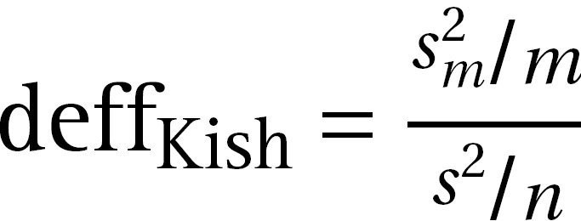
Analysis of Complex Sample Data
Overview: How we plan to manage the course
Lecture & discussion
  Principles
  Preparation
  Analysis
  Design
    Weighting
    Strata
    Clusters
    Nonlinear statistics
    Variance estimation
    Design effects
    Multiple imputation
Notes:
2005 CP: In last bullet uses word “design” instead of “surveys”

Slide 45
Design effects - 1
The design effect for a mean (or proportion) from a cluster sample selection is
where is the average cluster size
and roh the within cluster homogeneity among elements

Slide 46
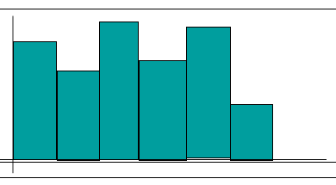
Design effects - 2

Slide 47
Design effects - 3
For cross classes, and
But for domains, and

Slide 48
Design effects - 4
The design effect requires, of course, an estimate of the sampling variance under assumptions of SRS
For the mean, the SRS sampling variance can be computed as
or

Slide 49
Design effects - 5
For the difference of cross-class means, the SRS sampling variance can be computed as
which is something of a puzzle – how can there be covariance between cross-classes?
Still, the sampling variance of the difference involves the variances as computed before …
and the computation of a covariance

Slide 50
Design effects - 6
In particular, the covariance involves four terms, four covariances that are combinations of numerators and denominators of the two ratio means:

Slide 51
Design effects - 7
The variances of these cross-class differences can also be computed with repeated replication differences
Let denote the vector of cross-class means, and let denote the vector of cross-class means for the r^{th} replicate.
Then

Slide 52
Design effects - 8
Then for we have
This approach can be generalized to a vector of cross-class means and linear contrast A

Slide 53
Design effects - 9
The design effect for a difference between cross-class means is
In general, since
From empirical investigation

Slide 54
Design effects - 10
The following results illustrate the effects of complex sample survey data on estimation. The illustration is taken from an analysis of a national survey of health and economic and social well being, the American’s Changing Lives (ACL) survey.
The ACL sample design was stratified multistage and estimated computed using SAS “SURVEY” procedures.

Slide 55
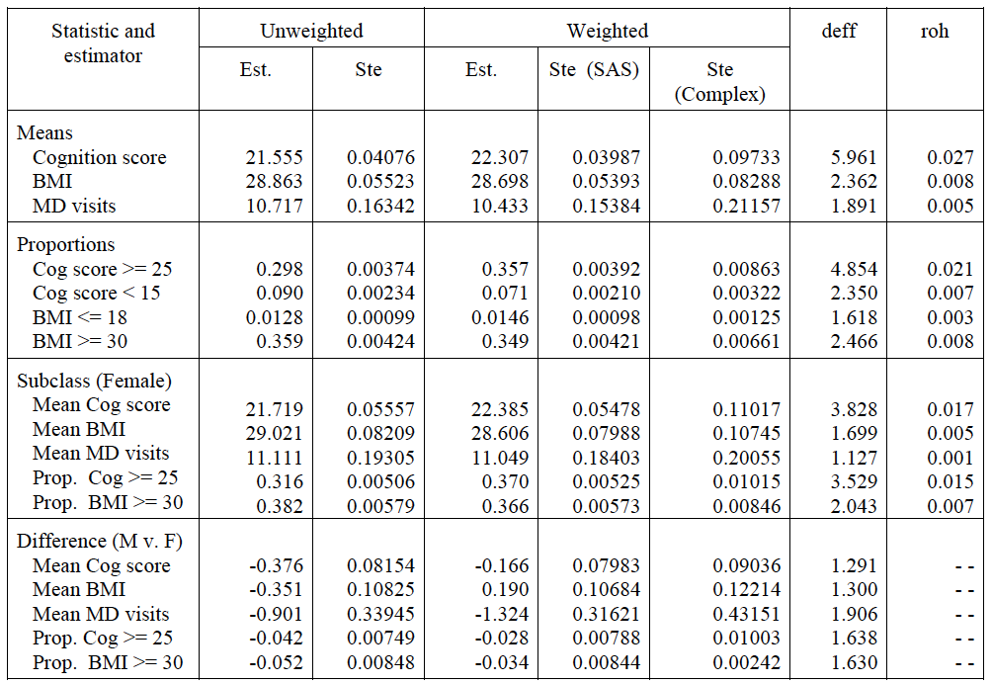
Design effects - 11

Slide 56
Design effects - 12
Now consider the bivariate regression of Y on X,

Slide 57
Design effects - 13
The weighted least squares estimator is
with sampling variance
and predicted value

Slide 58
Design effects - 14
For multiple regression of Y on a set of p predictors

Slide 59
Design effects - 15
… with weighted least squares estimate
The corresponding weighted least squares estimate of the sampling covariance matrix is

Slide 60
Design effects - 16
Hypothesis testing for parameters is conducted using t- and F-test statistics. For a single parameter under SRS,
where t_{j} is distributed as a t-random variable with n – p degrees of freedom.

Slide 61
Design effects - 17
For multiple parameter hypothesis tests
where A is a q x p matrix of constants and k a q x 1 vector of constants, again under SRS,
is distributed at an F random variable with k and n – q degrees of freedom.

Slide 62
Design effects - 18
Alternatively, for large samples the Taylor series expansion approximation
is under distributed as a random variable with q degrees of freedom

Slide 63
Design effects - 19
Under stratified multistage probability samples with H strata and a PSU’s,

Slide 64
Design effects - 20
Repeated replication procedures with

Slide 65
Design effects - 21

Slide 66
Design effects - 22
For complex sample survey data, hypothesis testing for a single parameter uses
which under is distributed as a t-random variable with a – H – 1 degrees of freedom

Slide 67
Design effects - 23
  and for multi-parameter hypothesis tests for complex samples
is under distributed as a -random variable with q degrees of freedom, while
is under distributed as an F-random variable with q and (a – H) – q degrees of freedom

Slide 68
Design effects - 24
  Or, for for multi-parameter hypothesis tests for complex samples and repeated replication,
is under distributed as a -random variable with q degrees of freedom, while
is under distributed as an F-random variable with q and (a – H) – q degrees of freedom

Slide 69
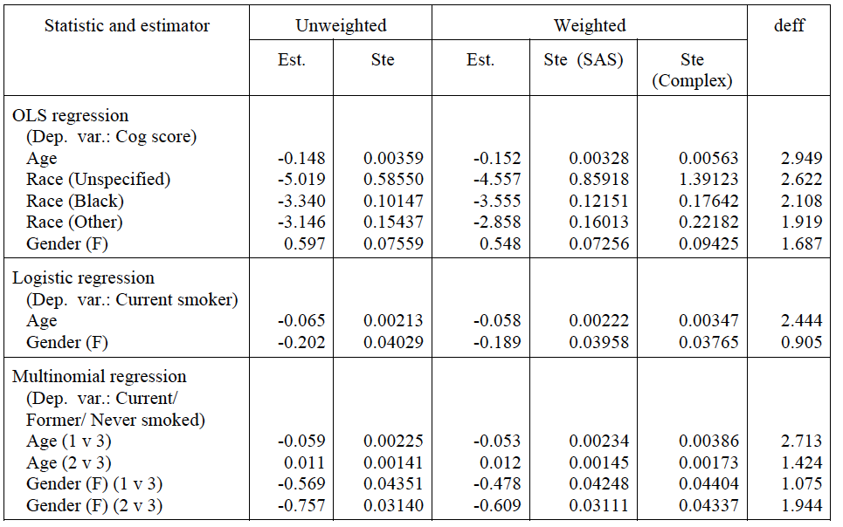
Design effects - 25

Slide 70
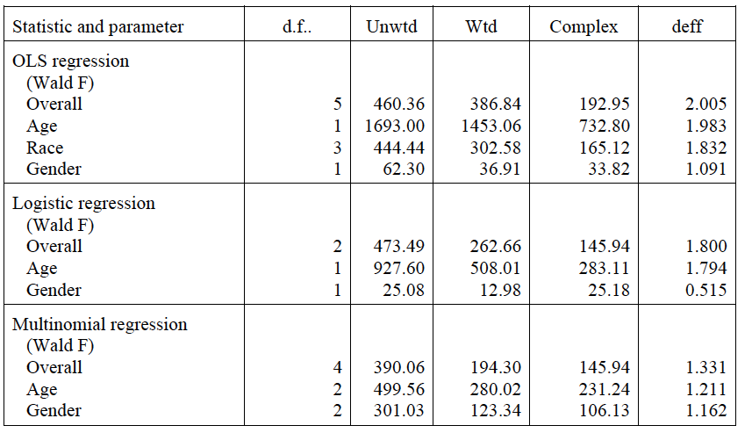
Design effects - 26

Slide 71
Analysis of Complex Sample Data
Overview: How we plan to manage the course
Lecture & discussion
  Principles
  Preparation
  Analysis
  Design
    Weighting
    Strata
    Clusters
    Nonlinear statistics
    Variance estimation
    Design effects
    Multiple imputation
Notes:
2005 CP: In last bullet uses word “design” instead of “surveys”

Slide 72
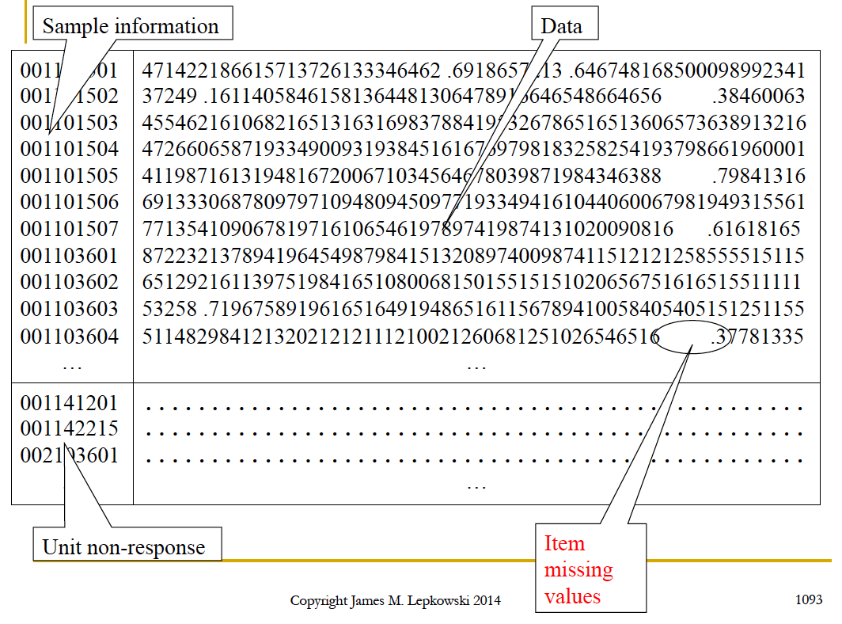

Slide 73
Multiple imputation - 1
Divide variables into group of q with no missing values
… and p with missing values
Notes:
The imputation procedure used was one developed by Raghunathan et al., and implemented through freeware available from the University of Michigan’s Survey Research Center online.
The basic algorithm is built around Generalized Linear Regression, allowing for the handling of continuous, categorical, count, and limited outcomes. The imputation attempts to preserve the covariance structure of the data overall through the use of regression models for each variable requiring imputation.
So, for example, the data contain a total of p + q variables, y-1, … , y-1 with no missing values and z-1, …, z-p with one or more missing values.
The process begins with one of the latter variables, fitting a linear regression using the q variables with no missing values as predictors among cases with no missing values for variable z-1.

Slide 74
Multiple imputation - 2
Strategy: “fix” item missing data
  Identify all missing values for a given variable,
    Don’t knows
    Refusals
    Interviewer errors
  “Replace” missing value with imputed value,
There are deterministic approaches and stochastic approaches

Slide 75
Multiple imputation - 3
Types of imputations
  Complete Case Analysis (deterministic)
  Mean value imputation (deterministic)
  Mean imputation with random residual (stochastic)
  Sequential hot deck imputation (stochastic)
  Hierarchical imputation (stochastic)
  Deterministic regression imputation
  Stochastic regression imputation
  Sequential regression imputation

Slide 76
Multiple imputation - 4
Complete case analysis
Equivalent to mean value imputation: replace missing value with mean of responding cases for the variable
  Compute mean (median, mode) of responding cases
  Replace all missing values for variable with respondent mean:
Distorts distribution, with “spike” at one value
  Mean value plus random residual:

Slide 77
Multiple imputation - 5
Class mean: replace missing values with mean for a ‘class’ the missing case belongs to
  Reduces distortion to distribution
Class mean plus stochastic element: add random residual to class mean value
  Select residual from empirical or theoretical distribution

Slide 78
Multiple imputation - 6
Sequential hot deck: Sort data by predictors of value to be imputed
  Retain last non-missing value, and impute to next missing value
  Draw non-missing value randomly within imputation class
  See illustration
Problems
  Multiple donation
  Weak within group correlations
  Sort boundaries

Slide 79
i | Gender | Educ | Reported family income | Hot Value | Imputation flag | Final value
1 4 2 3 7 8 5 6 16 15 17 18 19 22 13 14 21 20 | M M M M M M M M F F F F F F F F F F | 9 11 12 12 12 12 16 16 10 12 12 12 12 12 14 15 15 18 | 23 43 35 42 75 88 28 31 35 30 67 56 72 66 | 51 23 23 23 43 35 42 75 88 88 28 31 35 30 30 67 56 72 | 0 1 1 0 0 0 0 0 1 0 0 0 0 1 0 0 0 0 | 23 23 23 43 35 42 75 88 88 28 31 35 30 30 67 56 72 66

Slide 80
Multiple imputation - 8
Hierarchical hot deck: Flexible match
  Group respondents and non-respondents into classes
  Select donor at random within class
  Collapse classes to achieve match
Improved donor and recipient match
Reduced multiple donations

Slide 81
Multiple imputation - 9
Gender | Education
 | <12 |  | 12 |  | >12
 | r | m | r | m | r | m
Male | 23 | […] | 43 35 42 | […] | 75 88
Female |  | […] | 28 31 35 | […] | 67 56 66

Slide 82
Multiple imputation - 10
Regression imputation: Generalization of mean value methods
  Estimate model among respondents …
Add a random residual …
  Select value from
  Sequential hot deck or flexible match are a special case of the regression imputation

Slide 83
Multiple imputation - 11
Sequential regression imputation (chained equations)
Extension of regression imputation
  Impute using regression imputation
Most survey data sets have multiple variables that need to be imputed.
  Continuous, categorical, count, etc.
Adapt model to account for type of variable being imputed
  Linear, logisitic, multinomial logit, Poisson, etc.

Slide 84
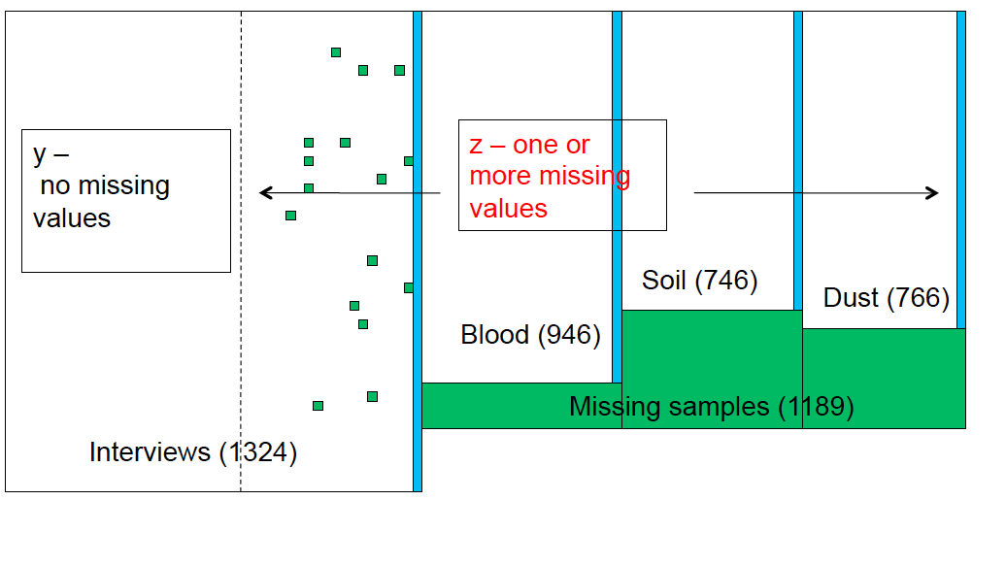
Multiple imputation - 12

Slide 85
Multiple imputation - 13
Sequential regression imputation estimation method, Cycle 1, Step 1
Choose a variable with missing values, say , and regress it on the q variables with no missing values:
Replace missing values with regression imputed value:
Notes:
The imputation procedure used was one developed by Raghunathan et al., and implemented through freeware available from the University of Michigan’s Survey Research Center online.
The basic algorithm is built around Generalized Linear Regression, allowing for the handling of continuous, categorical, count, and limited outcomes. The imputation attempts to preserve the covariance structure of the data overall through the use of regression models for each variable requiring imputation.
So, for example, the data contain a total of p + q variables, y-1, … , y-1 with no missing values and z-1, …, z-p with one or more missing values.
The process begins with one of the latter variables, fitting a linear regression using the q variables with no missing values as predictors among cases with no missing values for variable z-1.

Slide 86
Multiple imputation - 14
For example,
Notes:
The imputation procedure used was one developed by Raghunathan et al., and implemented through freeware available from the University of Michigan’s Survey Research Center online.
The basic algorithm is built around Generalized Linear Regression, allowing for the handling of continuous, categorical, count, and limited outcomes. The imputation attempts to preserve the covariance structure of the data overall through the use of regression models for each variable requiring imputation.
So, for example, the data contain a total of p + q variables, y-1, … , y-1 with no missing values and z-1, …, z-p with one or more missing values.
The process begins with one of the latter variables, fitting a linear regression using the q variables with no missing values as predictors among cases with no missing values for variable z-1.

Slide 87
Multiple imputation - 14
Choose the next variable with missing values,
Regress on the q variables with no missing values AND on the imputed :
Impute
This is sequential or chained regression
Notes:
From the fitted regression model, all missing values for z-1 are predicted, and replaced. The prediction includes the addition of a randomly chosen residual (Normal with mean zero but variance equal to the square of the standard error of the regression) and a perturbation of the estimated coefficients to account for the posterior distribution of the coefficients themselves (Normal with mean beta-hat-j and variance the square of the standard error of the coefficient). Thus, imputed values are subject to multiple sources of variation corresponding to prediction in multiple regression.
Next, z-2 is regressed on the q y’s and z-1. Again, the fitted model is used to generate predicted or imputed values for z-2.

Slide 88
Multiple imputation - 15
Repeat this process for remaining p – 2 variables needing imputation --
Regress on the q variables with no missing values AND on the already imputed :
  AND impute
Notes:
And the process continues, using the q y’s and each of the z’s that have already been imputed.

Slide 89
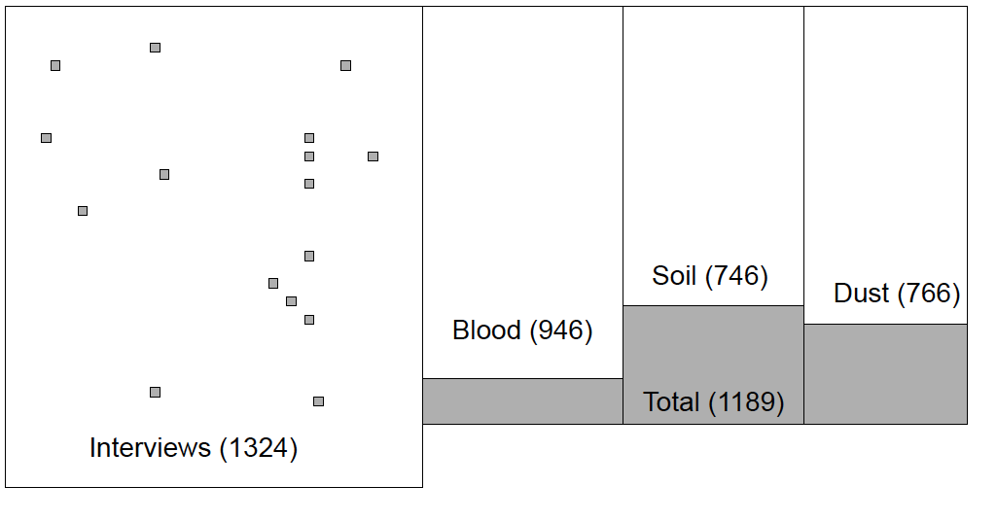
Multiple imputation - 16

Slide 90
Multiple imputation - 17
There is an ‘order’ effect due to this process – the particular order in which the z’s are imputed
Extend the imputation method to Cycles 2, 3, …
  Repeat imputation using all variables, including those already imputed, as predictors
Notes:
The values are re-imputed in cycles 2 to C, where typically C = 5 cycles are needed to eliminate order effects. In these cycles, all q plus p-1 variables available are used to predict each z-i.
These five cycles are then repeated for a second time, generating in the end a second imputed value for each case with an item missing value for a given variable.

Slide 91
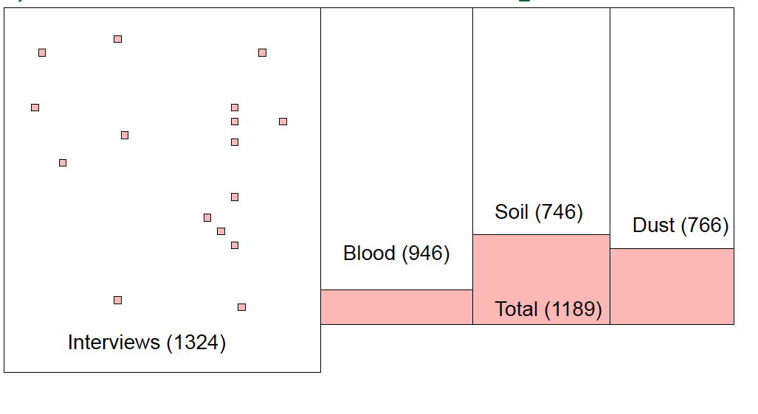
Multiple imputation - 18

Slide 92
Multiple imputation - 19
Multiple imputation
Imputed values have variability, as predicted values
  Repeat Cycles 1-5(?) for same variables to generate a second set of imputed values
  Repeat these cycles multiple times, say m = 25
Notes:
The process continues until a set of m, say 5, imputed values are generated for each case. The final data set is produced in a replicated set of five data sets. Thus, for the UMDES data, the final multiply imputed data set had a total of 5 x 1324 = 6620 cases. Most values are, of course, repeated in each data set. It is only the imputed values that differ between data sets.
Estimation consists of computing values from all 6620 cases …

Slide 93
Multiple imputation - 19
Imputation adds variance to estimates
May be viewed as two-phase sampling
Under-estimate variances using imputed data sets, because of larger sample sizes
Multiply impute
  Create multiple data sets (at least 5), each imputed separately
  This is a Bayesian procedure, so you select values from the posterior distribution
  Imputing multiple times allows you to adequately account for the variance from imputation

Slide 94
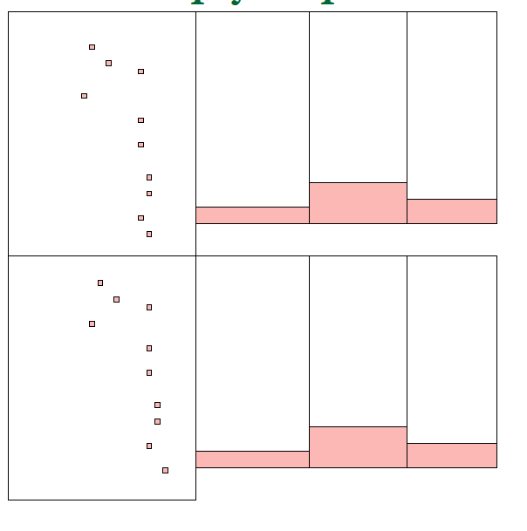
Multiple imputation - 20

Slide 95
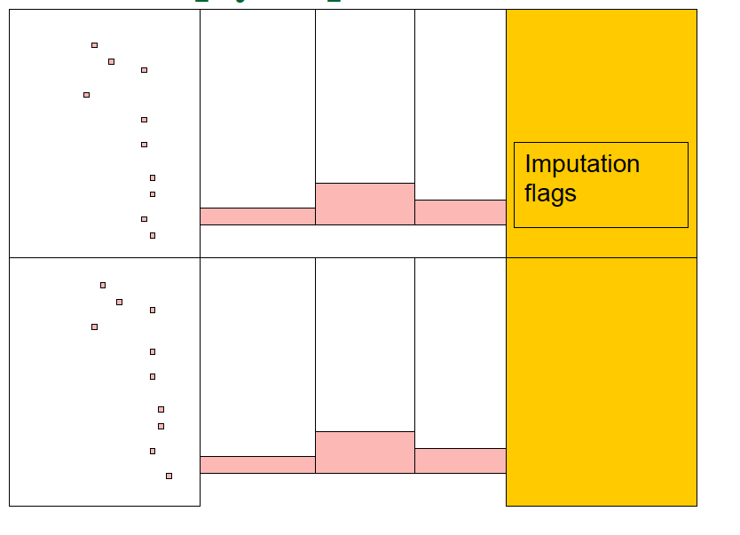
Multiple imputation - 21

Slide 96
Multiple imputation - 22
Estimation
Compute estimated values for study variables as an average of values across multiple imputations
Notes:
We treat each multiply imputed data set as a ‘case’ of imputation. We will average across ‘cases’ …

Slide 97
Multiple imputation - 23
Compute variance of estimates as sum: within and between imputed data set variances --
Notes:
… and compute standard errors based on the sum of two components of variance, that within each data set (based on 1324 cases) and that between each data set (or variance among five different values of an estimate computed from the five data sets separately).
Further, the UMDES design employed stratification, clustering, and weights. Survey estimates account for all these factors, plus the multiple imputation of item missing values.

Slide 98
Multiple imputation - 24
Variable | Mean, reported values | Mean, imputed values | Mean, all values
Body mass index | 28.39 | 29.61 | 28.42
Years eating fish caught from Tittabawassee River | 5.06 | 8.91 | 5.26
Deer meals from Tittabawassee River eaten in last five years | 2.35 | 3.23 | 2.60
Serum TEQ (ppt) | 32.4 | 30.9 | 32.1
Notes:
In particular, UMDES item missing data …
Few missing values for most items
Questions requiring recall over many years in “event history sequences” had more missing items
Family income missing for almost 10% of sample persons
Missing blood, dust, and soil values for 5-15% of those refusing to provide samples
Item missing values among responding persons
Few values missing for any one item
More values for event history items
Multivariate models suffered substantial loss of cases
While there were item missing values, in the context of a multiple predictor model, the cumulative effect of item missing values was considerable. In preliminary analyses more than one-third of the interviews could be lost because of item missing values on questionnaire, soil, or dust values.
The figure illustrates the nature of the imputation, and it’s impact on overall estimates.

Slide 99
Multiple imputation - 25
Missing data in surveys
  Unit or total
  Item
Compensation for missing data
  Ignoring or deleting
  Weighting
  Imputation
    Sequential regression
    Multiple imputation (estimate prediction variance)
Compute variance of estimates as sum: within and between imputed data set variances
Notes:
… and compute standard errors based on the sum of two components of variance, that within each data set (based on 1324 cases) and that between each data set (or variance among five different values of an estimate computed from the five data sets separately).
Further, the UMDES design employed stratification, clustering, and weights. Survey estimates account for all these factors, plus the multiple imputation of item missing values.

Slide 100
Multiple imputation - 26
Sequential regression, summary
  Do regressions to impute missing data, adding stochastic choice of coefficients and residuals
  Start with the variable with the least missing data
    Use an appropriate regression form (e.g., logistic regression for binary data)
  Use imputed values from that variable to impute the next
  Keep going until you have gone through the entire data set
  When all of the variables have been imputed, start over, retaining the previously imputed values
  Cycle through the data set at least 5 times
Multiple imputation, summary: repeated the sequential regression multiple time, say m times
Easily implemented using IVEWare (Raghunathan, et al.)
  http://www.isr.umich.edu/src/smp/ive/

Slide 101
Analysis of Complex Sample Data
Overview: How we plan to manage the course
Lecture & discussion
  Principles
  Preparation
  Analysis
  Design
Summary
Notes:
2005 CP: In last bullet uses word “design” instead of “surveys”

Slide 102
Analysis of Complex Sample Data
Overview: How we plan to manage the course
Lecture & discussion
  Principles
    Sampling distributions
    Design based inference
  Preparation
  Analysis
  Design
Summary
Notes:
2005 CP: In last bullet uses word “design” instead of “surveys”

Slide 103
Analysis of Complex Sample Data
Overview: How we plan to manage the course
Lecture & discussion
  Principles
  Preparation
  Analysis
  Design
Summary
Notes:
2005 CP: In last bullet uses word “design” instead of “surveys”

Slide 104
Analysis of Complex Sample Data
Overview: How we plan to manage the course
Lecture & discussion
  Principles
  Preparation
    Documentation
    Software selection
    Sampling factor evaluation
    Descriptive analysis
  Analysis
  Design
Summary
Notes:
2005 CP: In last bullet uses word “design” instead of “surveys”

Slide 105
Analysis of Complex Sample Data
Overview: How we plan to manage the course
Lecture & discussion
  Principles
  Preparation
  Analysis
  Design
Summary
Notes:
2005 CP: In last bullet uses word “design” instead of “surveys”

Slide 106
Analysis of Complex Sample Data
Overview: How we plan to manage the course
Lecture & discussion
  Principles
  Preparation
  Analysis
  Design
Summary
Notes:
2005 CP: In last bullet uses word “design” instead of “surveys”

Slide 107
Analysis of Complex Sample Data
Overview: How we plan to manage the course
Lecture & discussion
  Principles
  Preparation
  Analysis
    Categorical Data
    Model specification
    Linear regression
    Logistic regression
  Design
Summary
Notes:
2005 CP: In last bullet uses word “design” instead of “surveys”

Slide 108
Analysis of Complex Sample Data
Overview: How we plan to manage the course
Lecture & discussion
  Principles
  Preparation
  Analysis
  Design
Summary
Notes:
2005 CP: In last bullet uses word “design” instead of “surveys”

Slide 109
Analysis of Complex Sample Data
Overview: How we plan to manage the course
Lecture & discussion
  Principles
  Preparation
  Analysis
  Design
    Weighting
    Strata
    Clusters
    Nonlinear statistics
    Variance estimation
    Design effects
    Multiple imputation
Summary
Notes:
2005 CP: In last bullet uses word “design” instead of “surveys”

