Slide 1
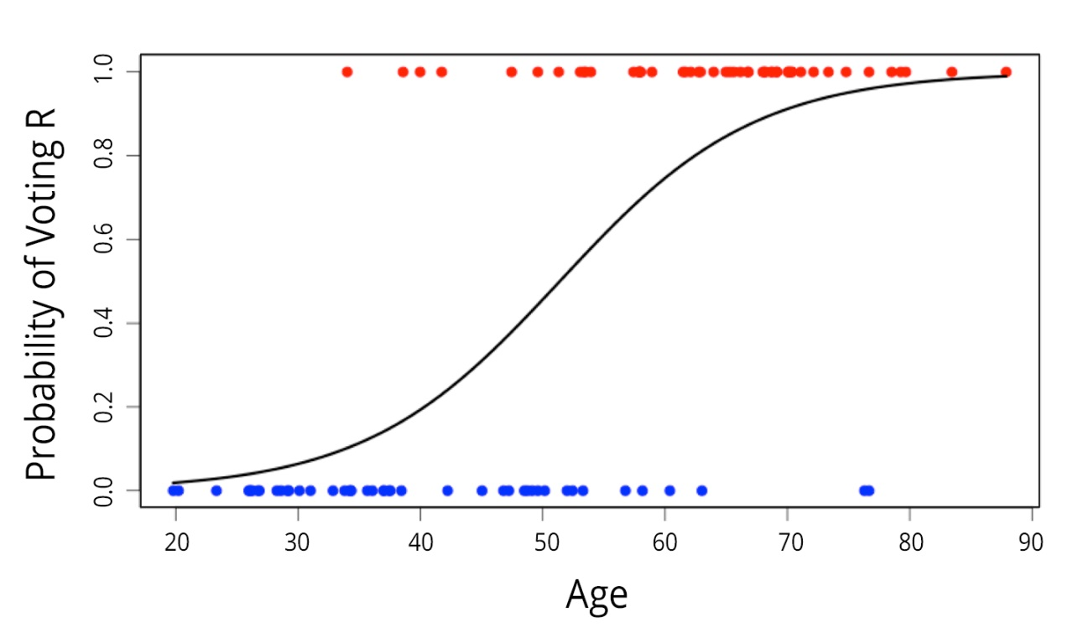
Analysis of Complex Sample Data
Overview: How we plan to manage the course
Lecture & discussion
  Principles
  Preparation
  Analysis
    Categorical data
    Model specification
    Linear regression
    Logistic regression
  Design
Notes:
2005 CP: In last bullet uses word “design” instead of “surveys”

Slide 2
Logistic regression - 1
Logistic regression is used to model outcomes with a discrete number of categories: binary (yes/no), nominal (marital status), ordinal scales (self rated health)
  Only binary outcomes here
A linear regression approach will not work because the outcome is restricted to either a 0 or 1 value
The model that is used is nonlinear in the outcome, but linear in the regression parameters

Slide 3
Logistic regression - 2
When y is a binary variable with possible values 0 and 1 (y = {0,1}), E(y | x) is the conditional probability that y = 1 given the covariate vector x.
Why not use this approach with a binary outcome?
  The dependent variable y follows a binomial distribution—a severe violation of the Normality and homogeneity of variances assumption
  A naive linear regression model does not accurately capture the relationship between y and x—it may produce predicted values that are outside the permissible range of 0 to 1

Slide 4
Logistic regression - 3
Naïve Use of Linear Regression for a
Binary Dependent Variable.
1
ŷ = π(x)
0
0
50
100
150
200

Slide 5
Logistic regression - 4
Alternatives …
  Identify a non-linear function of that yields a fitted regression model that is linear in the coefficients for the model covariates, x.
  Ideally, the function should also yield predicted values in the range between 0 and 1
  Two common link functions are used for binary survey variables:
    Logit
    Probit

Slide 6
Logistic regression - 5
For a logistic regression model, the link function is the logit:

Slide 7
Logistic regression - 6
The initial example illustrates the use of CSLOGISTIC with just one predictor, i.e. MDE predicted by gender (SEX)
This simple example will serve as a link between the CSFREQUENCIES analysis done previously and the CSLOGISTIC regression with 1 predictor
The 2nd example will build on this simple logistic model and add other meaningful predictors of MDE such as age, education, and alcohol dependence

Slide 8
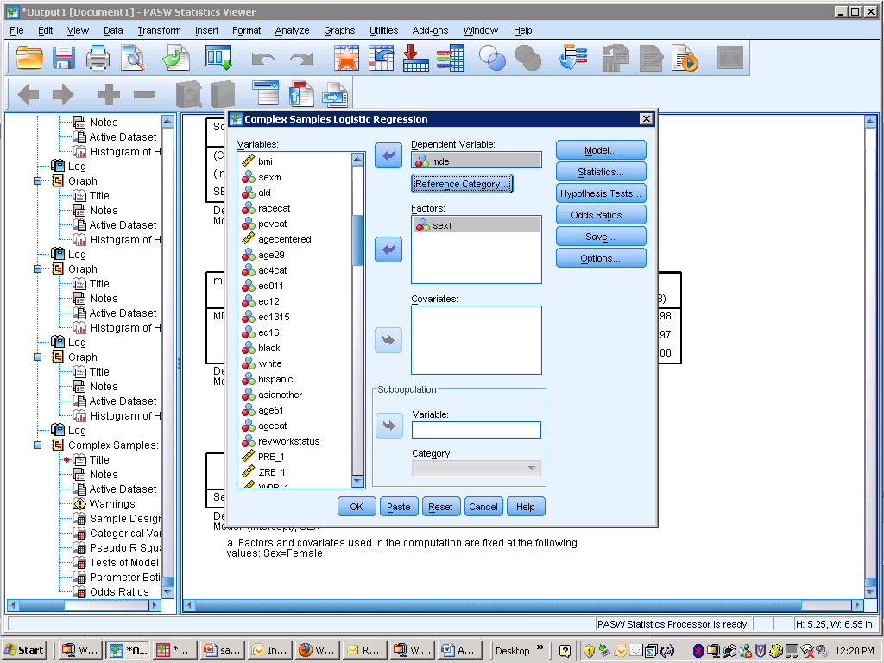
Logistic regression - 7

Slide 9
Logistic regression - 8
* Complex Samples Logistic Regression.
CSLOGISTIC mde(LOW) BY SEX
/PLAN FILE='F:\NCES_training_2010\ncsr_part2_weight.csaplan'
/MODEL SEX
/INTERCEPT INCLUDE=YES SHOW=YES
/STATISTICS PARAMETER EXP SE TTEST
/TEST TYPE=ADJF PADJUST=LSD
/ODDSRATIOS FACTOR=[SEX(1)]
/MISSING CLASSMISSING=EXCLUDE
/CRITERIA MXITER=100 MXSTEP=5 PCONVERGE=[1E-006 RELATIVE] LCONVERGE=[0] CHKSEP=20 CILEVEL=95
/PRINT SUMMARY VARIABLEINFO SAMPLEINFO.

Slide 10
Logistic regression - 9

Slide 11
Logistic regression – 10
The output shows that the overall prevalence of MDE is 19.2% (weighted with the Part 2 weight) and the sample is 53% female and 47% male (previous slide)
The sex (SEX) predictor significantly predicts MDE with an adjusted F value of 44.3 and a p value of .000.
The parameter estimates show the estimate for sex=1 or males with the reference group being females. The exp(B) is the exponent of the parameter and is less than one indicating that men have log odds of .618 of having MDE as compared to women
The Odds Ratios were specified in the options of CSLOGISTIC and show the OR for female v. males (different than the model parameters!)

Slide 12
Logistic regression – 11
The overall prevalence of MDE is 19.2% (weighted with the Part 2 weight) and the sample is 53% female and 47% male
SEX significantly predicts MDE with an adjusted F value of 44.3 and a p-value of .000.
The parameter estimates show the estimate for sex=1 or males with the reference group being females. The exp(B) is the exponent of the parameter and is less than one indicating that men have odds .618 of having MDE compared to women
The Odds Ratios were specified in the options of CSLOGISTIC and show the OR for female v. males

Slide 13
Logistic regression - 12
We are using the Part 2 weight since we will soon add more predictors from the 2nd part of the NCS-R survey.
The simple logistic regression model is the equivalent to a 2 by 2 frequency table of binary variables (to match this output)

Slide 14
Logistic regression - 13
The next example uses the same outcome of MDE but is predicted by sex, age (4 categories), alcohol dependence (0,1), and education (4 categories)
Bivariate testing of each predictor is done first (look for significance of < .25 for inclusion in final model) and each is significant.
Our final model will include sex, education, age and alcohol dependence.

Slide 15
Logistic regression - 14

Slide 16
Logistic regression - 15
* Complex Samples Logistic Regression.
CSLOGISTIC mde(LOW) BY ag4cat
/PLAN FILE='F:\NCES_training_2010\ncsr_part2_weight.csaplan'
/MODEL ag4cat
/INTERCEPT INCLUDE=YES SHOW=YES
/STATISTICS PARAMETER EXP SE TTEST
/TEST TYPE=ADJF PADJUST=LSD
/MISSING CLASSMISSING=EXCLUDE
/CRITERIA MXITER=100 MXSTEP=5 PCONVERGE=[1E-006 RELATIVE] LCONVERGE=[0] CHKSEP=20 CILEVEL=95
/PRINT SUMMARY VARIABLEINFO SAMPLEINFO.

Slide 17
Logistic regression - 16
This syntax is altered only for predictor of interest
The Part 2 weight is used
The adjusted F-test is requested for model parameter tests,
Statistics requested are parameters, exponentiated parameters, SE’s, and t-tests
Other options under the /print command provide sample and factor variable information

Slide 18
Logistic regression - 17

Slide 19
Logistic regression - 18

Slide 20
Logistic regression - 19
The parameter estimates table shows the betas, TSL SE’s, parameter significance stat, and exp(B) or Odds Ratios.
For each factor variable, the highest category is omitted and the results are compared to that reference group.
For ALD the OR shows the reference of 1 …
Testing of interactions was done but not presented here -- but elsewhere showed no significant interactions.

Slide 21
Logistic regression - 20
Conclusions:
  The odds of having had a major depressive episode at some point in the lifetime are 4.24 times higher when a person has had a diagnosis of alcohol dependence at some point in their lifetime (adjusting for age, sex, education, and marital status)
  Those in age groups 2 and 3 (30-44 and 45-59 yrs) have odds 2.3 times larger than the odds of MDE of those in the oldest age group

Slide 22
Logistic regression - 21
Age as a factor variable allows observation of nonlinear relationships between age and MDE
Adjusted versus unadjusted OR’s – what do we learn from a comparison?
Other interesting analyses such as subpopulations?
Other possible predictors of MDE? Additional disorders or demographic characteristics?

Slide 23
Logistic regression - 22
This last analysis is a logistic regression of ALD predicted by age in the subpopulation of white men.
In order to do this type of analysis create an indicator variable of 1=white men 0=not white men
Make sure to examine a frequency table of the indicator variable before doing the regression
  There are 1,968 white men and 3,724 non white/men in the Part 2 sample of 5,692

Slide 24
Logistic regression - 23

Slide 25
Logistic regression - 24
* Complex Samples Logistic Regression.
CSLOGISTIC ald(LOW) BY ag4cat
/PLAN FILE='F:\NCES_training_2010\ncsr_part2_weight.csaplan'
/DOMAIN VARIABLE=white_men(1.0000)
/MODEL ag4cat
/INTERCEPT INCLUDE=YES SHOW=YES
/STATISTICS PARAMETER EXP SE TTEST
/TEST TYPE=F PADJUST=LSD
/ODDSRATIOS FACTOR=[ag4cat(HIGH)]
/MISSING CLASSMISSING=EXCLUDE
/CRITERIA MXITER=100 MXSTEP=5 PCONVERGE=[1e-006 RELATIVE] LCONVERGE=[0] CHKSEP=20 CILEVEL=95
/PRINT SUMMARY CLASSTABLE VARIABLEINFO SAMPLEINFO.

Slide 26
Logistic regression - 24

Slide 27
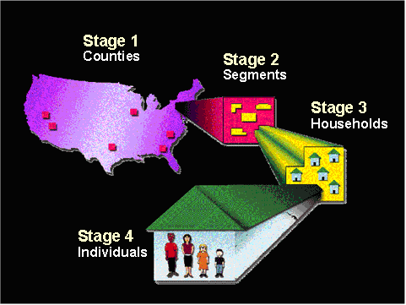
Analysis of Complex Sample Data
Overview: How we plan to manage the course
Lecture & discussion
  Principles
  Preparation
  Analysis
  Design
    Weighting
    Strata
    Clusters
    Nonlinear statistics
    Variance estimation
    Design effects
    Multiple imputation
Notes:
2005 CP: In last bullet uses word “design” instead of “surveys”

Slide 28
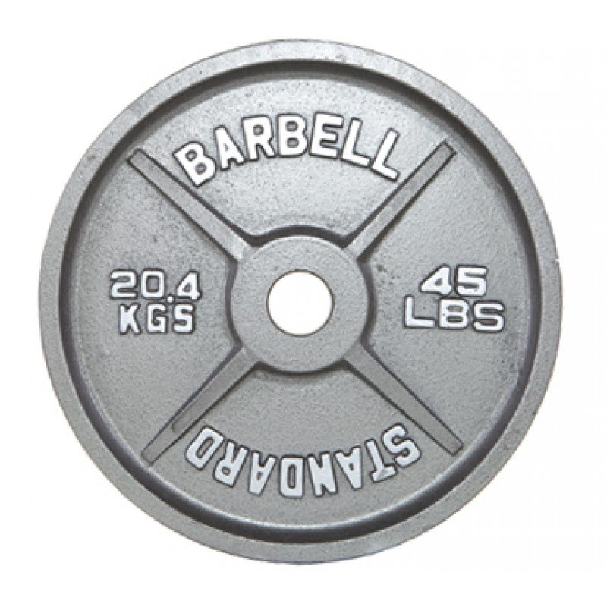
Analysis of Complex Sample Data
Overview: How we plan to manage the course
Lecture & discussion
  Principles
  Preparation
  Analysis
  Design
    Weighting
    Strata
    Clusters
    Nonlinear statistics
    Variance estimation
    Design effects
    Multiple imputation
Notes:
2005 CP: In last bullet uses word “design” instead of “surveys”

Slide 29

1 Population
Probability sampling principles

Slide 30
1 Population
e
Probability sampling principles

Slide 31

1 Population
2 Frame
e
Probability sampling principles

Slide 32

1 Population
2 Frame
e
3 Sample
Probability sampling principles

Slide 33

1 Population
2 Frame
s
3 Sample
4 Estimate
Probability sampling principles

Slide 34

1 Population
2 Frame
s
3 Sample
3 Sample
3 Sample
4 Estimate
4 Estimate
4 Estimate
Probability sampling principles

Slide 35
1 Population
2 Frame
3 Sample
s
4 Estimate
5 Sampling distribution
3 Sample
3 Sample
3 Sample
4 Estimate
4 Estimate
4 Estimate
Probability sampling principles

Slide 36
1 Population
2 Frame
3 Sample
s
4 Estimate
5 Sampling distribution
6 Standard error
3 Sample
3 Sample
3 Sample
4 Estimate
4 Estimate
4 Estimate
Probability sampling principles

Slide 37
1 Population
2 Frame
3 Sample
s
4 Estimate
5 Sampling distribution
6 Standard error
3 Sample
3 Sample
3 Sample
7 Confidence interval
4 Estimate
4 Estimate
4 Estimate
Probability sampling principles

Slide 38
Weighting - 1
Weights common in survey practice
  *Within household selection*
  *Duplication of elements on the frame*
  “Over-” or “under-sampling”
  Nonresponse
  Poststratification
Recover population (or frame) distribution of elements:
Weighting principles
Notes:
New title

Slide 39
Weighting - 2
3 Sample
N
2 Frame
Notes:
2006 SI CP: Added labels

Slide 40
Weighting - 3
n
f = n/N
3 Sample
N
2 Frame
Notes:
2006 SI CP: Added labels

Slide 41
Weighting - 4
n
f = n/N
F = N/n
3 Sample
N
N
2 Frame
1 Population
Notes:
2006 SI CP: Added labels

Slide 42
Weighting - 5
n
f = n/N
F = N/n
3 Sample
N
N
2 Frame
1 Population
Notes:
2006 SI CP: Added labels

Slide 43
Weighting - 6
n
f = n/N
F = N/n
3 Sample
N
N
2 Frame
1 Population
Notes:
2006 SI CP: Added labels

Slide 44
Weighting - 7
As long as the sampling is epsem …
Then
From N = 2,000 adults, select n = 20 with epsem
Each adult represents themselves and 99 others
Weighting principles
Notes:
2006 SI CP: Has less text… does not say “for all i=1,2….N)” or “…and measure a characteristic Y for each:…”

Slide 45
Weighting - 8
But the mapping may not be equal for every element – a non-epsem design
Then
A weighted estimator is required:
The unweighted mean is a special case of the weighted -- when the weights are constant, they cancel
Weighting principles
Notes:
2006 CP: Less text, missing equation where f=N/n=100.

Slide 46
Weighting – 9
“Over-” & “under- sampling”
The basic approach: weight by
  Counting a sample element times
Consider the following population distribution for 10th grade students in the U.S.
Divided into two groups, 10th graders in schools with a high proportion receiving Free or Reduced Price Lunches (High) and those in low proportion schools (Low)
Weighting for “over-” & “under-sampling”
Notes:
2006 CP – Diff title. Old title - Weighting for Unequal Probabilities of Selection. Less text.

Slide 47
Weighting – 10
Proportionate allocation
Group | N | n | Sampling rate | Weight A | Weight B
High Low | 800,000 3,200,000 | 2,400 9,600 | 1/333.33 1/333.33 | 333.33 333.33 | 1 1
Total | 4,000,000 | 12,000 | 1/333.33 | 333.33 | 1
Weighting for “over-” & “under-sampling”
Notes:
2006 SI cp: Diff page order. Less text

Slide 48
Weighting - 11
This is an allocation of sample across the strata that is called proportionate.
Proportionate allocation has equal probabilities in each group
Some investigators might prefer that the distribution in the sample be an equal sample size across the two groups:
Weighting for “over-” & “under-sampling”
Notes:
2006 Si cp: Less text than 2005. Does not include….n=1---, an equal probability selection…

Slide 49
Weighting – 12
Equal sample size allocation
Group | N | n | Sampling rate | Weight A | WeightB
High Low | 800,000 3,200,000 | 6,000 6,000 | 1/133.33 1/533.33 | 133.33 533.33 | 1 4
Total | 4.000,000 | 12,000 | 1/333.33 | -- | --
Weighting for “over-” & “under-sampling”
Notes:
2006 SI cp: Diff page order. Less text

Slide 50
Weighting - 13
The equal allocation would be used for comparing the two groups
The proportionate allocation would be used to represent the population
Consider the consequences of the equal allocation when estimating a mean test score among 10th graders, averaging across samples from the two groups:
Weighting for “over-” & “under-sampling”
Notes:
- 2006 SI cp: Diff page order

Slide 51
Weighting – 14
Mean score, proportionate
Group | Mean test score | Proportionate allocation |  | Weights
 |  | n | Mean test score | A | B
High Low | 63 83 | 2,400 9,600 | 63 83 | 333.33 333.33 | 1 1
Total | 79 | 12,000 | 79 | 333.33 | 1
Weighting for “over-” & “under-sampling”
Notes:
- 2006 SI cp: Diff page order

Slide 52
Weighting – 15
Equal sample size allocation
Group | Mean test score | Dispro-portionate allocation |  | Weights |  | Weighted estimate
 |  | n | Mean test score | A | B
High Low | 63 83 | 6,000 6,000 | 63 83 | 133.33 533.33 | 4 1 | (6,000)(4)(63) (6,000)(1)(83)
Total | 79 | 12,000 | 73 | -- | -- | 79

Slide 53
Weighting – 16
Restoring the balance
Weights will restore the population distribution:
Weighting for “over-” & “under-sampling”
Notes:
Does not include text Factor B.

Slide 54
Weighting – 17
Weighting for nonresponse
Suppose that not everyone in the sample of 12,000 drawn from the two groups responded
Ignoring nonresponse may produce biased estimates
Weighting for nonresponse
Notes:
2006 SI cp: Does not include page 103 equations and text from 2005 cp where the weight of Latinos of 1.5 = .02 etc.

Slide 55
Weighting - 18
n
f = n/N
F = N/n
3 Sample
N
N
2 Frame
1 Population
Notes:
2006 SI CP: Added labels

Slide 56
Weighting - 19
p = r/n
f = n/N
r
n
3.1 Respondents
3 Sample
N
2 Frame
Notes:
2006 SI CP: Added labels

Slide 57
Weighting - 20
p = r/n
p⁻¹ = n/r
f = n/N
r
n
3.1 Respondents
3.2 Weighted Respondents
3 Sample
N
2 Frame
Notes:
2006 SI CP: Added labels

Slide 58
Weighting – 21
Weighting for nonresponse
Biased estimates may be produced when averaging across potentially disproportionately-distributed groups
Consider the disproportionate equal sample size allocation for 10th grade students
Suppose, that the response rate across 10th grade student location (urban, rural school) differs:
Weighting for nonresponse
Notes:
2006 SI cp: Does not include page 103 equations and text from 2005 cp where the weight of Latinos of 1.5 = .02 etc.

Slide 59
Weighting – 22
Differential nonresponse rates
Group | n | r | Mean test score | Weight? | Weighted estimate
Urban Rural | 6,000 6,000 | 5,280 4,080 | 82 76 | ? ? | ? ?
Total | 12,000 | 800 | ? | ? | ?
Weighting for nonresponse
Notes:
2006 SI cp: Does not include page 105 equations and text from 2005 cp / Income Total?????

Slide 60
Weighting – 23
Nonresponse weights
Compute response rates in each group
Adjust the base weights (those computed to compensate for unequal probabilities of selection) for nonresponse – a product of weights
Assumption: data is missing at random (MAR)
Response rate in each group is a “sampling rate” under the MAR assumption
Weighting for nonresponse
Notes:
2006- less text, varies

Slide 61
Weighting – 24
Nonresponse adjustment
FRPL | Location
Low High | Urban Rural Urban Rural | 4 4 1 1 | 4,320 960 3,360 720 | 0.80 0.80 0.70 0.70 | 1.25 1.43 1.25 1.43 | 5.00 5.72 1.25 1.43
 | Total |  | 9,360 | 0.78
Weighting for nonresponse

Slide 62
Weighting – 25
Other adjustment techniques
Weighting classes: cross-classification of multiple variables
  Choice of variables: stepwise regression, ‘effect sizes’
  Choose variable related both the “propensity” and the variables (“prediction”)
Logistic regression
  Using good propensity/prediction variables, estimate logistic regression model for response
  Inverse of predicted probabilities as the weight
Weighting for nonresponse
Notes:
2006- less text, varies

Slide 63
Weighting – 26
Poststratification
Poststratification is used to make the weighted sample distribution conform to a known population distribution
Typically poststratification adjusts the nonresponse adjusted weights
Suppose that family type (single parent, other) is not known in advance for each sample 10th grade student, but is only obtained in data collection
Poststratification
Notes:
Lacks formulas

Slide 64
Weighting – 27
Poststratification
Suppose that family type (single parent, other) is not known in advance for each sample 10th grade student, but is only obtained in data collection
Suppose also that from recent Census data the proportion of 10th grade students’ living with a single parent was tabulated
Poststratification
Notes:
Lacks formulas

Slide 65
Weighting – 28
p = r/n
p⁻¹ = n/r
f = n/N
r
n
3.1 Respondents
3.2 Weighted Respondents
3 Sample
N
2 Frame
Notes:
2006 SI CP: Added labels

Slide 66
Weighting – 29
p = r/n
p⁻¹ = n/r
W_{g}= P_{g}/p_{g}
f = n/N
r
n
3.1 Respondents
n
3 Sample
3.2 Weighted Respondents
5.1 Predicted Population
N
N
2 Frame
Notes:
2006 SI CP: Added labels

Slide 67
Weighting – 30
Poststratification adjustment
Family Type
Single parent Other | 1,872 7,488 | 0.2 0.8 | 1,200,000 2,800,000 | 0.3 0.7 | 1.500 0.875
Total | 9,360 | 1.0 | 1,500,000 | 1.000 | --
Poststratification
Notes:
2006 SI cp – lacks text, numbers vary.

Slide 68
Weighting – 31
A final weight
In poststratification, the weights for the individuals in groups are adjusted up or down to obtain the distribution of the sum of weights that corresponds to the population distribution
The final weight is an adjustment of the baseline weight for nonresponse and poststratification:
Poststratification
Notes:
-

Slide 69
Group
FRPL Low Urban Single parent Other Rural Single parent Other | 864 3,456 192 768 | 4 x 1.25 x 1.500 = 7.500 4 x 1.25 x 0.875 = 4.375 4 x 1.43 x 1.500 = 8.580 4 x 1.43 x 0.875 = 5.005
FRPL Low Urban Single parent Other Rural Single parent Other | 672 2,688 144 576 | 1 x 1.25 x 1.500 = 1.875 1 x 1.25 x 0.875 = 1.094 1 x 1.43 x 1.500 = 2.145 1 x 1.43 x 0.875 = 1.251
Total | 9,360
Notes:
2006 SI cp: Lacks equation, numbers vary, missing column

Slide 70
Weighting – 32
Extensions of poststratification
As for nonresponse adjustments, cross-classify multiple variables to form more poststrata
  Maintain “adequate” poststratum cell sizes
  External data for cross-classified data limited
Consider raking ratio adjustment
  Using “marginal distributions” rather than “joint” (fully cross-classified) distributions
  External data more readily available
  Model: no interaction among marginal distributions
Poststratification
Notes:
2006 SI cp: New title,less text, diff setup.

Slide 71
Weighting – 33
Potential increase in variance
Part of the controversy concerns the effect of weights on sampling variance
Poststratification
Notes:
2006 SI cp: New title,less text, diff setup.

Slide 72
Weighting – 34
1+L
For the final weights in the 10th grader sample,
The potential increase is due to the combination of weighting class size and the variation of the weights across classes
Trimming is used to reduce this variation
Poststratification
Notes:
2006 SI cp: New title,less text, diff setup.

Slide 73
Weighting - 35
In complex samples, probabilities of selection & weights can vary by strata & clusters
  h denotes stratum
  denotes cluster
  denotes element within cluster
  denotes probability of selecting element within cluster in a stratum
Compensatory weight: the inverse

Slide 74

Analysis of Complex Sample Data
Overview: How we plan to manage the course
Lecture & discussion
  Principles
  Preparation
  Analysis
  Design
    Weighting
    Strata
    Clusters
    Nonlinear statistics
    Variance estimation
    Design effects
    Multiple imputation
Notes:
2005 CP: In last bullet uses word “design” instead of “surveys”

Slide 75
Stratification - 1
Procedure
  Form strata, and say they each have elements
  Take independent selections of within each
  Compute an estimate for stratum h,
  Compute an estimate that combines the results across strata,
    where
Probability sampling principles

Slide 76
Stratification -2
Formation of strata
Best advice is to make the strata internally homogeneous
OR the strata should differ as much as possible from each other – have big differences among their means
Advantages:
  Gains in precision
  Administrative convenience
  Guaranteed representation of important domains
  Acceptability/credibility
  Flexibility
Probability sampling principles

Slide 77
Stratification – 3
An example
Population | Stratum 1 FRPL | Stratum 2 No FRPL
Size N 4,000,000 | 800,000 | 3,200,000
Variance 360 | 400 | 225
Mean 75 | 55 | 80

Slide 78
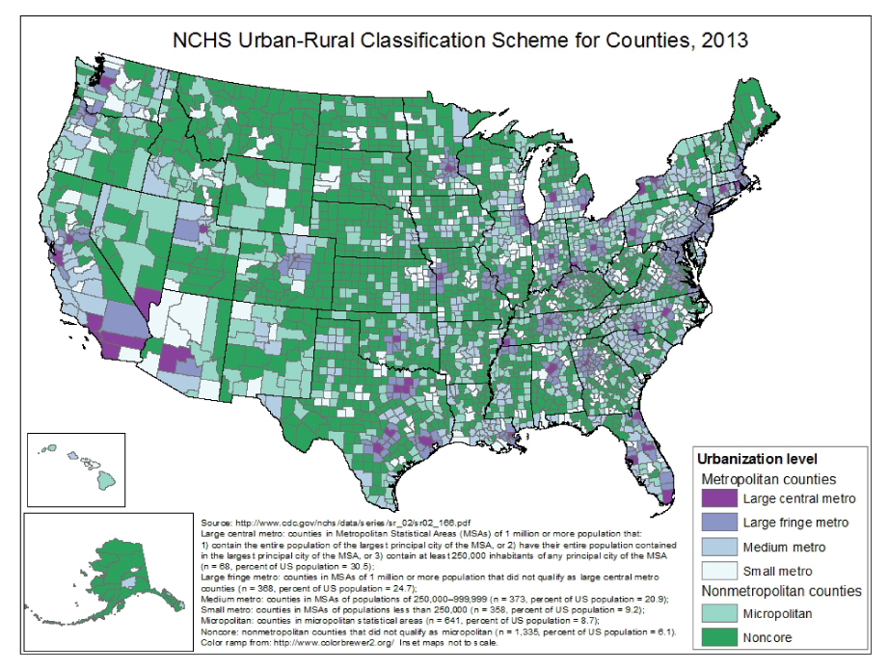

Slide 79
Stratification – 4
At population level,
At the sample level,

Slide 80
Stratification – 5
Variances are combined across strata …

Slide 81
Stratification – 6
The stratum level weights can be expressed as element level weights:
… because …
Notes:
Each element is thus weighted by the inverse of its probability of selection. If proportionate allocation is used, all the
w sub {hi} are the same, and we don't need to use a weighted sample mean.

Slide 82
Stratification – 7
When weighting at the element level, the stratified sampling variances become a sum of variances (not a weighted sum):

Slide 83
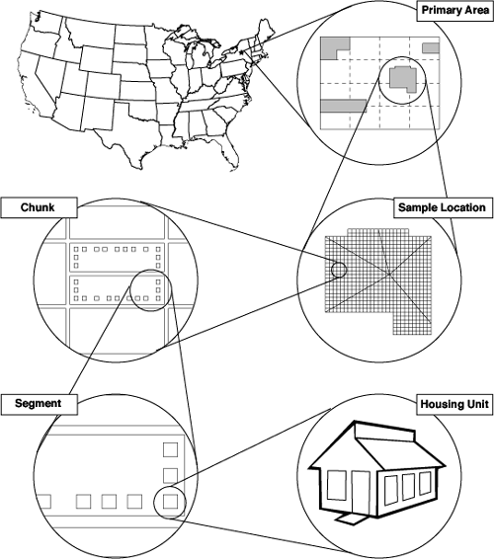
Analysis of Complex Sample Data
Overview: How we plan to manage the course
Lecture & discussion
  Principles
  Preparation
  Analysis
  Design
    Weighting
    Strata
    Clusters
    Nonlinear statistics
    Variance estimation
    Design effects
    Multiple imputation
Notes:
2005 CP: In last bullet uses word “design” instead of “surveys”

Slide 84
Cluster sampling - 1
Many populations are widely distributed geographically.
  We cannot afford visits to n units drawn randomly from the entire area.
Cluster sampling reduces the cost of data collection:
  Sample schools and children within them
  Sample blocks and households within them
304
Notes:
304

Slide 85
Cluster sampling -2
Cluster sampling is also useful when the sampling frame lists clusters and not elements.
  In such cases, select clusters and list elements in selected clusters from which a sample of elements can be drawn
Clusters are often naturally occurring units, facilitating sample selection.
305
Notes:
305

Slide 86
Cluster sampling -3

Slide 87
Cluster sampling – 4 (SRS!)

Slide 88
Cluster sampling -5

Slide 89
Cluster sampling - 6
SRS of a = 10 school classrooms from A = 1000 and examine the immunization history b = 24 children in the selected classrooms
  N = A B = (1000)(24) = 24,000
  n = a x b = 240
  Classrooms: clusters or primary sampling units (PSU’s).
  Proportion of children immunized:
309
Notes:
309

Slide 90
Cluster sampling - 7
Adding up numerators, 160 immunized children in a = 10 sample classrooms
  Overall proportion is
  If SRS instead, same overall proportion …
    With familiar sampling variance
310
Notes:
310

Slide 91
Cluster sampling - 8
Here, though, selected a equal-sized clusters from A, and B students from B,
Randomized selection is at classroom level
Consider then the classroom clusters
This also changes how sampling variance is computed:
Here f = a/A, and
311
Notes:
311

Slide 92
Cluster sampling - 9
For this particular sample, we have
312
Notes:
312

Slide 93
Cluster sampling - 10
Here
This is observed again & again – for same sample size, cluster samples have larger sampling variances
Summary statement:

Slide 94
Cluster sampling - 11
The source of this increase in variance is two-fold:
  How many elements are chose per cluster
  How similar elements are within clusters
Revised summary of cluster sampling effect:

Slide 95
Cluster sampling - 12
(although generally)
If -- the cluster sample is the equivalent of SRS of size
If deff = b and -- the cluster sample is equivalent to an SRS of a elements

Slide 96
Cluster sampling - 13
One of the factors in the design effect for cluster sampling then is the degree of homogeneity of elements in clusters
In survey estimation, this homogeneity is estimated from the design effect directly:

Slide 97
Cluster sampling - 14
Return to sample of 10 school classrooms from 1,000, with each classroom having exactly 24 children
Here the intra-class correlation estimate is roh = 0.088
Effective sample size

Slide 98
Cluster sampling - 15
Consider alternative values of homogeneity roh
What would homogeneity within clusters (heterogeneity among) look like?

Slide 99
Cluster sampling - 16
And homogeneity within & heterogeneity among?

Slide 100
Cluster sampling - 17
Conclusions?
  Cluster sampling increases the variance of estimates
    The increase depends on the degree to which elements within clusters resemble one another … for the variable under study
    And it depends on how large the clusters are ... how many elements are selected per cluster on average
Variance estimation needs to take cluster sampling into account

Slide 101

Analysis of Complex Sample Data
Overview: How we plan to manage the course
Lecture & discussion
  Principles
  Preparation
  Analysis
  Design
    Weighting
    Strata
    Clusters
    Nonlinear statistics
    Variance estimation
    Design effects
    Multiple imputation
Notes:
2005 CP: In last bullet uses word “design” instead of “surveys”

Slide 102
Non-linear statistics - 1
Population clusters are unequal in size
Size variation in population clusters passed on to sample clusters
Lose control of sample size
  Difficult to obtain sample of a fixed target size
  Variation in size occurs across the sampling distribution
  Variation in size now needs to be part of variance estimation, even for a simple mean
Notes:
Now that we have also covered a variety of sample designs, it is useful to return to the topic.

Slide 103
Non-linear statistics - 2
Sample size is a random variable
  is no longer appropriate
  A ratio mean is needed

Slide 104
Non-linear statistics - 3
Recall also that probabilities of selection can vary by stratum (h), cluster ( ), and element ( ) --
Compensatory weight:
And compensatory estimate:

Slide 105
Non-linear statistics - 3
Composed of two linear statistics:

Slide 106
Non-linear statistics - 3
Also consider ratios of two variables:

Slide 107
Non-linear statistics - 3
There are contrasts of subpopulation estimates as well:

Slide 108
Non-linear statistics - 4
Two principle problems with ratio means:
  Biased for the overall population mean
  The variance of the ratio mean is not known exactly (except for some special designs)
Fortunately, the bias is relatively small, under certain common conditions
Estimating the variance is more challenging

Slide 109
Non-linear statistics - 5
For means, proportions, & ratios …
Use

Slide 110
Non-linear statistics - 6
There are many other non-linear statistics computed from complex sample data
  Linear regression coefficients
  Poisson regression coefficients
  Logistic regression coefficients
  Survival analysis hazard ratios & coefficients
  Structural equation coefficients
Taylor series linearization can be used for all of these to obtain variance estimates

Slide 111
Non-linear statistics - 7
In each case, variance estimates are composed of multiple terms
  Ratio mean: three terms, two variances and a covariance
  “Bivariate” regression coefficient: 10 terms, four variances and six covariances
Added complexity to variance estimation

