Slide 1
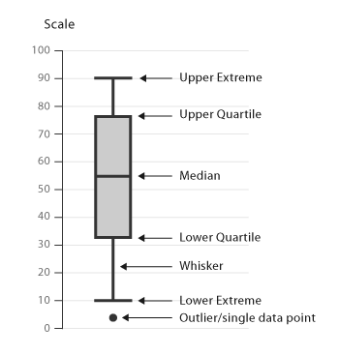
Analysis of Complex Sample Data
Overview: How we plan to manage the course
Lecture & discussion
  Principles
  Preparation
    Survey documentation
    Software selection
    Sampling factor evaluation
    Descriptive analysis
  Analysis
  Design
Notes:
2005 CP: In last bullet uses word “design” instead of “surveys”

Slide 2
Descriptive analysis - 1
Descriptive & regression analyses in the CS module
Means and totals (for continuous and binary variables) & standard errors,
  Confidence intervals
  Design effects
  Tests of differences in means
Graphical tools
  Weighted bar charts or plots
  Weighted graphs: CS plan specified

Slide 3
Descriptive analysis - 2
Read the data set into PASW
Menus:
  Analyze → Descriptive statistics → Descriptives
  Select among two NCS-R weight variables
    NCSRWTSH (Part 1 or “Short” Form)
    NCSRWTLG (Part 2 or “Long” Form)
  Options tab allows selection of desired output

Slide 4
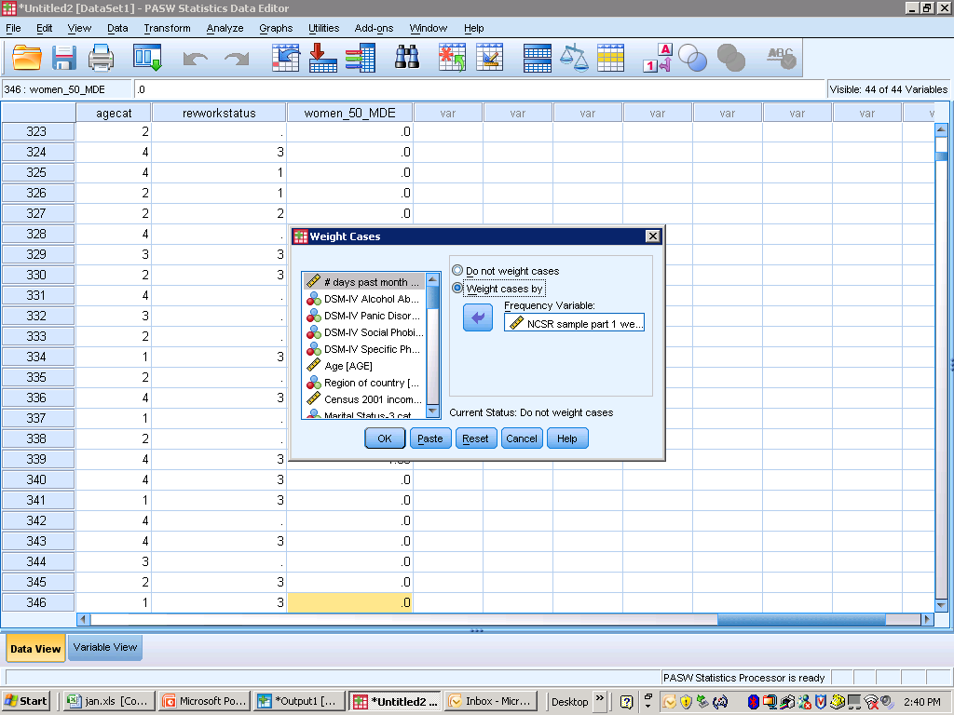
Descriptive analysis - 3

Slide 5
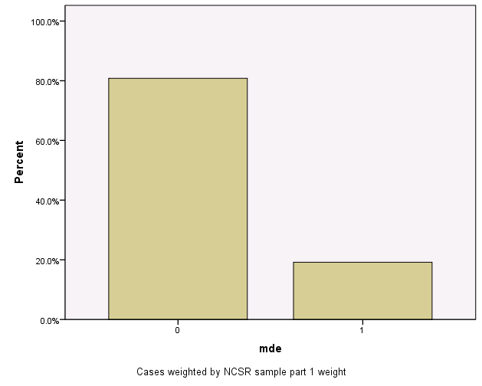
Descriptive analysis - 4
WEIGHT BY NCSRWTSH.
GRAPH
/BAR(SIMPLE)=PCT BY mde.
Weighted percentages for MDE (0,1)
Nearly 20% responded yes (1)

Slide 6
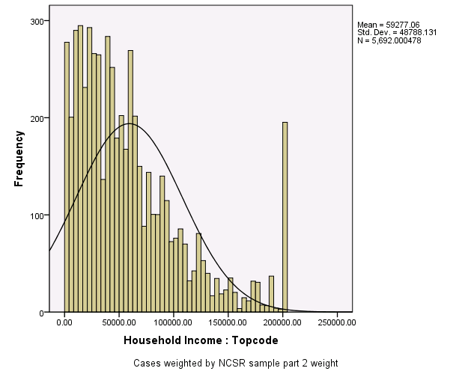
Descriptive analysis - 5
GRAPH
/HISTOGRAM(NORMAL)=HHINC.

Slide 7
Descriptive analysis - 5
Weighted (Part 2 weight) histogram --income in Part 2 only
Part 2 weight positive for 5,692 cases:
Warning # 3211
On at least one case, the value of the weight variable was zero, negative, or missing. Such cases are invisible to statistical procedures and graphs which need positively weighted cases, but remain on the file and are processed by non-statistical facilities such as LIST and SAVE.

Slide 8
Descriptive analysis - 6
HH Income histogram has a “Normal” distribution superimposed
Underlying distribution is “non-Normal” --many values between 0 and $60,000
Spike at topcode of $200,000

Slide 9
Descriptive analysis - 7
Description of the binary (yes/no) variable MDE, Major Depressive Episode
Menus: Analyze → Complex Samples → Descriptives
  Complex design weighted mean & standard error
  Taylor Series Linearization method to estimate standard error

Slide 10
Descriptive analysis - 8
“Describe central tendencies of a variable of interest in a sample population”
Note that the mean is calculated taking the strata and SECU’s into account

Slide 11
Descriptive analysis - 9
Taylor Series Linearization method used to estimate the sampling variance
  Can be used for variables that are binary (0,1), continuous (1 to 2000), or interval (1,2,3,4)

Slide 12
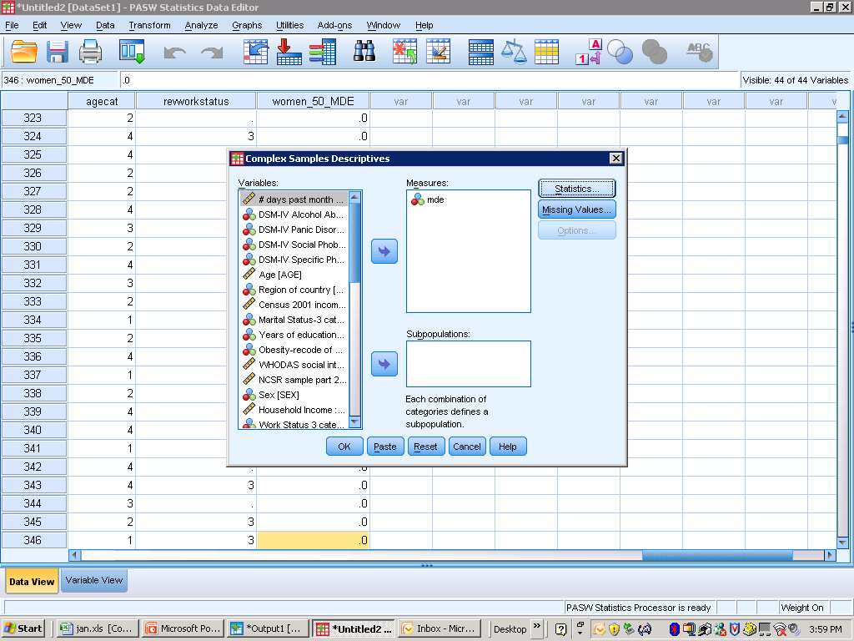
Descriptive analysis - 10

Slide 13
Descriptive analysis - 11
CSDESCRIPTIVES
/PLAN FILE='F:\NCES_training_2010\ncsr_part1_weight.csaplan'
/SUMMARY VARIABLES=mde
/MEAN
/STATISTICS SE CIN(95)
/MISSING SCOPE=ANALYSIS CLASS MISSING=EXCLUDE.
Univariate Statistics
Estimate SE 95% CI Lower Upper
Mean mde .19 .005 .18 .20

Slide 14
Descriptive analysis - 12
Comparison: correct weight without complex sample factors
Mean estimate (.19) unchanged, but the standard error smaller (.004 v .005)
DESCRIPTIVES VARIABLES=mde
/STATISTICS=MEAN MIN MAX SEMEAN.
Descriptive Statistics
N Minimum Maximum Mean Std. Error
Mde 9282 0 1 .19 .004
Valid N (listwise) 9282

Slide 15
Descriptive analysis - 13
* Complex Samples Descriptives.
CSDESCRIPTIVES
/PLAN FILE='F:\NCES_training_2010\ncsr_part2_weight.csaplan'
/SUMMARY VARIABLES=HHINC
/MEAN
/STATISTICS SE DEFF CIN(95)
/MISSING SCOPE=ANALYSIS CLASSMISSING=EXCLUDE.

Slide 16
Descriptive analysis - 14
CS Module with clusters generally results in standard errors that are larger than those from a simple random sample
The “design effect” describes the impact of the complex sample design on precision
Confidence intervals calculated are generally wider due to the larger standard errors
Examine “design effects” at the end of the seminar

Slide 17
Descriptive analysis - 15
Binary variable of the type 0/1 (0=no, 1=yes): estimation of a single proportion
Apply the ratio estimator to the binary variable to estimate the proportion of 1’s (or yes) in the population

Slide 18
Descriptive analysis - 16
Consider two types of totals:
  Weighted totals for binary variables -- estimate of the number of people with a given attribute (for example, disease or not)
  Weighted totals for continuous variables --population aggregate (for example, food expenditure or household income in last year HH income)

Slide 19
Descriptive analysis - 17
Total estimate:
  Complex sample design with stratification, clustering, and weighting:

Slide 20
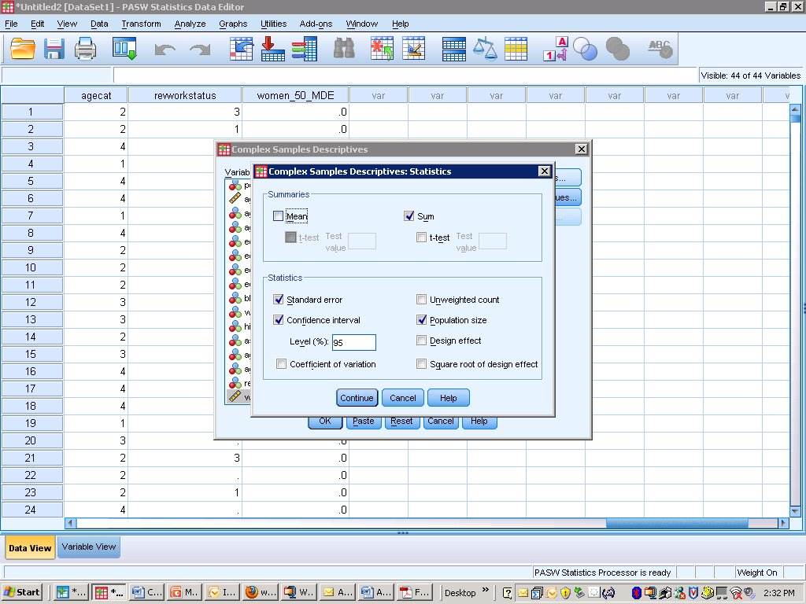
Descriptive analysis - 18

Slide 21
Descriptive analysis - 19
To obtain a total rather than a mean, use the “sum” option in CSDESCRIPTIVES
Analysis variable of interest: Household Income
The mean box could also be checked for both a mean and sum in the output
Options: SE, CI, Population Size
Standard errors account for the weights and complex sample design

Slide 22
Descriptive analysis - 20
* Complex Samples Descriptives.
CSDESCRIPTIVES
/PLAN FILE='F:\NCES_training_2010\ncsr_part2_weight.csaplan'
/SUMMARY VARIABLES=HHINC
/SUM
/STATISTICS SE POPSIZE CIN(95)
/MISSING SCOPE=ANALYSIS CLASSMISSING=EXCLUDE.

Slide 23
Descriptive analysis - 21
Estimate of the total dollars HH income for population based on the sample of 5,692 Part 2 respondents
$ amounts: $337,000,000.00
  Standard error: $14,783,400.00
  Similar conversion for CI’s

Slide 24
Descriptive analysis - 22
Other descriptive statistics:
  Ratio of linear variables (for example, expenditure to income)
  Quantiles or percentiles (not possible in PASW in this version)
  Correlations between linear variables (for example, expenditure to income)
  Scatter plots
Refer to Heeringa, West, & Berglund, Applied Survey Data Analysis, 2010, Chapman Hall, for analysis examples of some of these techniques

Slide 25
Descriptive analysis - 23
Subpopulation means/proportions -- use a subpopulation indicator for inclusion
Important distinction: unconditional or conditional
  Unconditional – read all cases but include only subpopulation in analysis
  Conditional – read only subpopulation cases
Failure to include the full complex sample array presents incomplete sample design factors to CS module for analysis

Slide 26
Descriptive analysis - 24
Example: Means analysis of Alcohol Dependence (ALD) among women 50 years of age & older who have MDE
Use the “subpopulation” option in the CSDESCRIPTIVES command dialog window
May be strata or clusters with no women 50 years of age & older with MDE
  Subpopulation option includes all such strata & clusters – unconditional approach
  “Filter” for such women is “conditional”

Slide 27
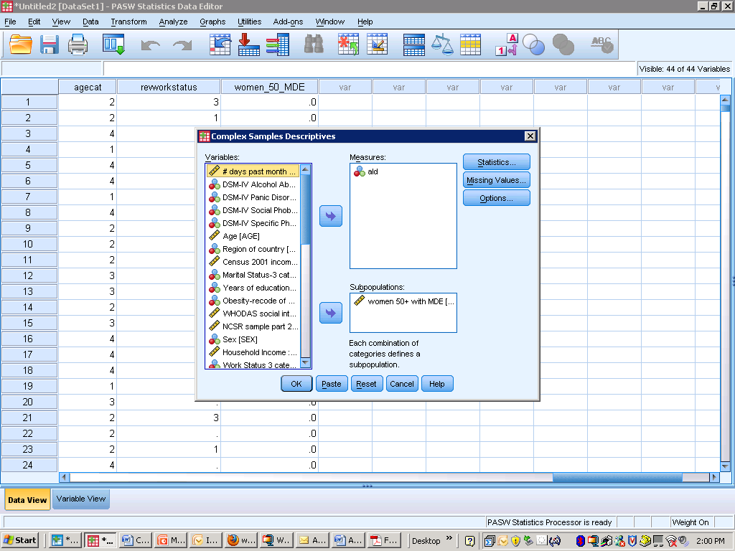
Descriptive analysis - 25

Slide 28
Descriptive analysis - 26
* Complex Samples Descriptives.
CSDESCRIPTIVES
/PLAN FILE='F:\NCES_training_2010\ncsr_part1_weight.csaplan'
/SUMMARY VARIABLES=ald
/SUBPOP TABLE=women_50_MDE DISPLAY=LAYERED
/MEAN
/STATISTICS SE CIN(95)
/MISSING SCOPE=ANALYSIS CLASSMISSING=EXCLUDE.

Slide 29
Descriptive analysis - 27
Mean ALD higher among women 50+ years of age with MDE (.06)
Standard errors: .013 versus .003

Slide 30
Descriptive analysis - 28
* Complex Samples Descriptives.
CSDESCRIPTIVES
/PLAN FILE='F:\NCES_training_2010\ncsr_part1_weight.csaplan'
/SUMMARY VARIABLES=ald
/SUBPOP TABLE=women_50_MDE DISPLAY=LAYERED
/MEAN
/STATISTICS SE POPSIZE CIN(95)
/MISSING SCOPE=ANALYSIS CLASSMISSING=EXCLUDE.
“POPSIZE” provides sample size -- check that the entire sample is used in the analysis.

Slide 31
Descriptive analysis - 29
POPSIZE option gives weighted sample sizes for each subpopulation, totaling to full 9,282.

Slide 32
Descriptive analysis - 29
Is difference between subpopulation means statistically significant?
  0.05 v. 0.06 -- how to test this difference?
CSDESCRIPTIVES does not offer an easy way to do this test
  Possible to do with the CSGLM command
  Linear functions and tests shown next in the linear regression section

Slide 33

Analysis of Complex Sample Data
Overview: How we plan to manage the course
Lecture & discussion
  Principles
  Preparation
  Analysis
    Categorical data
    Model specification
    Linear regression
    Logistic regression
  Design
Notes:
2005 CP: In last bullet uses word “design” instead of “surveys”

Slide 34
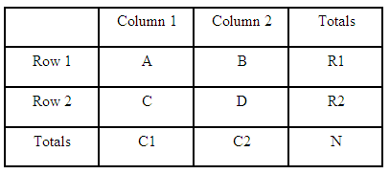
Analysis of Complex Sample Data
Overview: How we plan to manage the course
Lecture & discussion
  Principles
  Preparation
  Analysis
    Categorical data
    Model specification
    Linear regression
    Logistic regression
  Design
Notes:
2005 CP: In last bullet uses word “design” instead of “surveys”

Slide 35
Categorical Data - 1
Nominal
  Categories are labels, no metric implied (e.g., Gender, Region)
Ordinal
  Categories imply ordered metric. e.g., binary (yes, no), education, grouped underlying continuous (age brackets)
Counts
  Special case of ordinal
  Exact metric, discrete events, occurrences

Slide 36
Nominal Categorical Data: NCS-R Weighted Distribution of U.S. Adults by Employment Category
Categorical Data - 2

Slide 37
Ordinal Categorical Data: HRS 2006, Weighted Distribution Self-rating of Health Status
Categorical Data - 3

Slide 38
Count Data: HRS 2006, Falls in the Past 24 Months
Categorical Data - 4

Slide 39
Categorical Data - 5
Univariate estimates and graphical analysis
Univariate Tests (e.g., H₀: p=p₀)
Bivariate and Multi-way Tables
Loglinear Models (see Agresti, 2002)
Logistic, Probit, CLL Models
Poisson, Negative Binomial and other GLMs
(see ASDA Chapter 9)

Slide 40
Categorical Data - 6
Univariate Methods
  Graphical display of data
  Primarily estimation of proportions and functions of proportions
  Ordinal, count – descriptive statistics for continuous variables used with caution
  Estimation of p, standard errors, CIs
  Goodness of fit tests

Slide 41
Estimated distribution: U.S. Adults by Hypertension Status (Source: NHANES 2005-06)
Categorical Data - 7

Slide 42
Categorical Data - 8
Univariate Analysis
  Estimation of simple proportions:
  A proportion is simply the mean of y = {0,1}

Slide 43
Categorical Data - 9
Univariate Analysis
  Taylor series linearized variance of simple proportions:
  Confidence intervals: asymptotic normal method (assume asymptotic normality of sampling distributions)

Slide 44
Categorical Data - 10
Univariate Analysis: Multinomial
  Estimation follows for binary proportions:

Slide 45
Categorical Data - 11
Univariate Analysis: Multinomial
  Variance estimation by Taylor series linearization or Replication
  Goodness of Fit Hypothesis test

Slide 46
Estimated distribution: Hypertension Status by Gender (Source: NHANES 2005-06)
Categorical Data - 12

Slide 47
NCS-R: MDE x Gender, Weighted Estimates of Total Proportions
Categorical Data - 13
 | MDE=NO (0) | MDE=YES (1) | Total
MEN (A)
WOMEN (B)
Total

Slide 48
Categorical Data - 14

Slide 49
Categorical Data - 15
The logistic regression (or Probit, CLL) model framework can be used analyze categorical data when one variable can be designated as the dependent variable and other variables as explanatory or predictor variables.
Many times we are interested only in investigating associations between a set of categorical variables.
A common approach is to compute a chi-square statistic under the null hypothesis, and fail to reject the null hypothesis if this chi-square statistic is within the range of values that would be expected.

Slide 50
Categorical Data - 16
Chi-square Tests: Pearson and Likelihood Ratio
  The chi-square test statistic is a measure of distance between the expected and observed counts in cells.
  Pearson
  Likelihood Ratio
  If the observed data are consistent with the null hypothesis, then we would expect this distance measure (the test statistic) to be small.

Slide 51
Categorical Data - 16
Adjusting for Design Effects
  How to incorporate the design features into this analysis?
  Since ignoring the design features (weighting) can introduce bias in the estimated proportions that goes into making the Chi-square statistics, the above analysis is not valid.
Two approaches:
  Fellegi (JASA, 1980) corrects the SRS Chi-square statistic.
  Rao-Scott (1984, Biometrika), Rao-Thomas (1987)

Slide 52
Categorical Data - 17
Rao-Scott Method
  Use the weighted proportions in the construction of Chi-square statistics.
  Develop an approximate F-reference distribution for determining a p-value.
  This is analytically complicated and requires computation of generalized design effects.
  These are the eigenvalues of the “design effect” matrix for the proportions used to compute the Chi-square statistic.
  Most software packages enabling analysis of complex sample survey data have implemented this approach.

Slide 53
Rao-Scott Generalized Design Effect
Categorical Data - 18

Slide 54
Categorical Data - 19
Design-adjusted X² Test Statistics
  First order correction (SAS system default):
  GDEFF: the mean of the eigenvalues, or the “average design effect” (see ASDA, p. 166)

Slide 55
Categorical Data - 20
Design-adjusted X² Test Statistics
  Second order correction
  Stata system default, SAS V9.3 option:

Slide 56
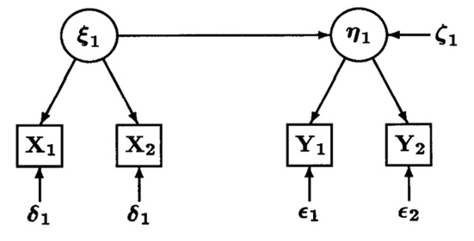
Analysis of Complex Sample Data
Overview: How we plan to manage the course
Lecture & discussion
  Principles
  Preparation
  Analysis
    Categorical data
    Model specification
    Linear regression
    Logistic regression
  Design
Notes:
2005 CP: In last bullet uses word “design” instead of “surveys”

Slide 57

Model specification - 2
Correlation
163
Notes:
163

Slide 58

Model specification - 3
Correlation
Regression
164
Notes:
164

Slide 59
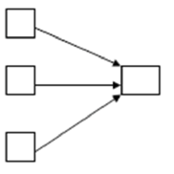
Model specification - 4
Correlation
Regression
Multiple regression
165
Notes:
165

Slide 60
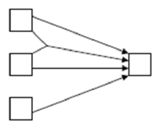
Model specification - 5
Multiple regression, effect modification
166
Notes:
166

Slide 61
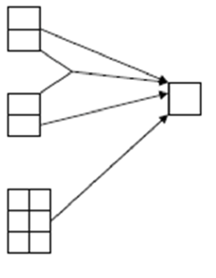
Model specification - 6
Multiple regression, effect modification
Multiple regression, categorical (dummy variable) predictors
167
Notes:
167

Slide 62
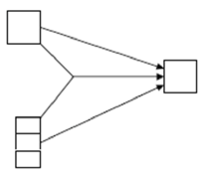
Model specification - 7
Multiple regression, ANCOVA
168
Notes:
168

Slide 63
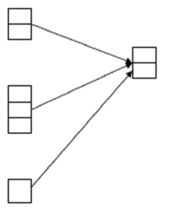
Model specification - 8
Multiple regression, ANCOVA
Logistic regression
169
Notes:
169

Slide 64
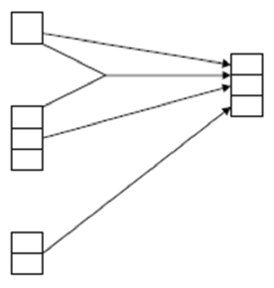
Model specification - 9
Ordered logistic regression
170
Notes:
170

Slide 65
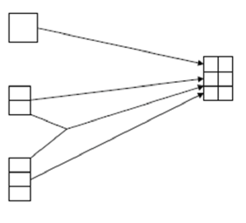
Model specification - 10
Multinomial logistic regression
171
Notes:
171

Slide 66
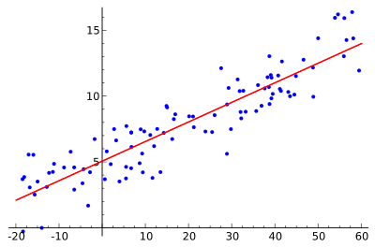
Analysis of Complex Sample Data
Overview: How we plan to manage the course
Lecture & discussion
  Principles
  Preparation
  Analysis
    Categorical data
    Model specification
    Linear regression
    Logistic regression
  Design
Notes:
2005 CP: In last bullet uses word “design” instead of “surveys”

Slide 67
Linear regression – 1
Linear regression examines the relationship between dependent and independent variables
  y represents the outcome/dependent variable
  x represents the independent variable

Slide 68
Linear regression – 2
The regression relationship among the observed values of y and x is expressed as
Here are model parameters
And is an error term
The error term represents the difference between the observed value of y and its conditional expectation under the model,

Slide 69
Linear regression – 3
Assumptions:
  The model for E(y | x) is linear in the parameters;
  Correct model specification –the model includes the effects (predictors) of the true model under which the data were generated
  E(ε_{i} | x_{i}) = 0, the expected value of the residuals given the predictor variable values is equal 0
  Var(ε_{i} | x_{i}) constant
  Normality of residuals, the residuals are independently and identically distributed (i.i.d.) with mean 0 and constant variance;
  Cov(ε_{i}, ε_{j} | x_{i}, x_{j}) = 0, i ≠ j, residuals are uncorrelated

Slide 70
Linear regression – 4
What is the overall point of the modeling for survey data?
  Weighted, design-based estimation of a regression allows unbiased inferences concerning the regression relationship as it exists within the finite population
Use of the CSGLM allows incorporation of the weights & complex sample design factors in estimation

Slide 71
Linear regression – 5
Four basic steps
  Specification
  Estimation
  Evaluation (diagnostics)
  Inference.
These steps apply to all types of regression models, not just linear regression with continuous response variables

Slide 72
Linear regression – 6
Step 1
  Model based on subject matter knowledge and empirical investigation of the data
  Specific aims of the analysis determine choice of dependent variable, y, and one or more independent variables, x
  Scientific knowledge & prior thought about relationships should form the basic of the model

Slide 73
Linear regression – 7
Step 2:
  Computation of estimates of the regression parameters in the specified model
  Mathematical methods not presented in detail
  For now consider only the ordinary least squares method
  Estimate the unknown regression parameters by minimizing the residual sum of squares (SSE)

Slide 74
Linear regression – 8
Differences between SRS and CS estimation:
  Parameters in complex data are estimated using weights
  The parameter estimate is expected change in response variable y for a one-unit change in x
  Standard errors will be under-estimated unless design factors incorporated in the estimation
  Taylor Series Linearization method used in PASW CS module
  The formulae for variance estimates is beyond the scope of this training

Slide 75
Linear regression – 9
Step 3:
  Examine explained variance and goodness of fit, such as Rsquared
    Proportion of variance in the dependent variable explained by the regression
  Residual diagnostics
    Homogeneity of variance
    Normality of the Residual Errors
    Outliers and influence statistics

Slide 76
Linear regression – 10
Step 4:
  Infer the conditional distribution of y given the predictor variables x.
  Hypothesis tests concerning the parameters, from tests for a single parameter to tests for multiple regression parameters

Slide 77
Linear regression – 11
Step 4 continued:
  F-tests for hypotheses about multiple parameters simultaneously
  In the complex sample survey data, these tests adapted to the complex design factors
  Wald test statistics replace the overall and partial F-tests.
  Under the null hypothesis H₀: B = 0, the Wald test statistic follows an F distribution with p numerator df – but denominator df determined by design factors

Slide 78
Linear regression – 12
Hosmer & Lemeshow (2000) recommend a very good approach to careful model building
  Exploratory bivariate analyses
    Two-sample t-tests, chi-square tests, tests of correlations, one-way analysis of variance
    Identify candidate predictors with a significant relationship with the response variable.
  Include only those predictor variables that are scientifically relevant
    And have a bivariate statistical significance p < 0.25
  Consider variable selection techniques (e.g., backward selection) with discretion.

Slide 79
Linear regression – 13
  Be wary of multicollinearity introduced by including strongly correlated predictor variables in the same model
    Has the potential to inflate the standard errors of parameter estimates
  Verify the importance of the predictor variables retained in the model using t-tests for individual coefficients and Wald tests for multiple coefficients

Slide 80
Linear regression – 14
  Examine the forms of the predictor variables:
    If categorical, are sample sizes in each category large enough to use the categories as they are in the model?
    If they are continuous, do they have linear relationships with the response variable?
    Residual diagnostics are useful as a part of this step.
  Consider adding scientifically relevant interactions between the predictor variables to the model, one at a time
    Do not retain them if they are not significant.
  If any continuous or ordinal predictor has a large number of zeroes, include an indicator variable that is equal to 1 for non-zero values and 0 for zero values in the model

Slide 81
Linear regression – 15
Two examples:
  Linear regression of HH Income predicted by BMI (both are continuous variables)
  Multiple regression with BMI predicted by categorical marital status and education level, the 2nd set closely follows the Hosmer and Lemeshow steps previously outlined
Use the CSGLM command with options and saved statistics for model diagnostics

Slide 82
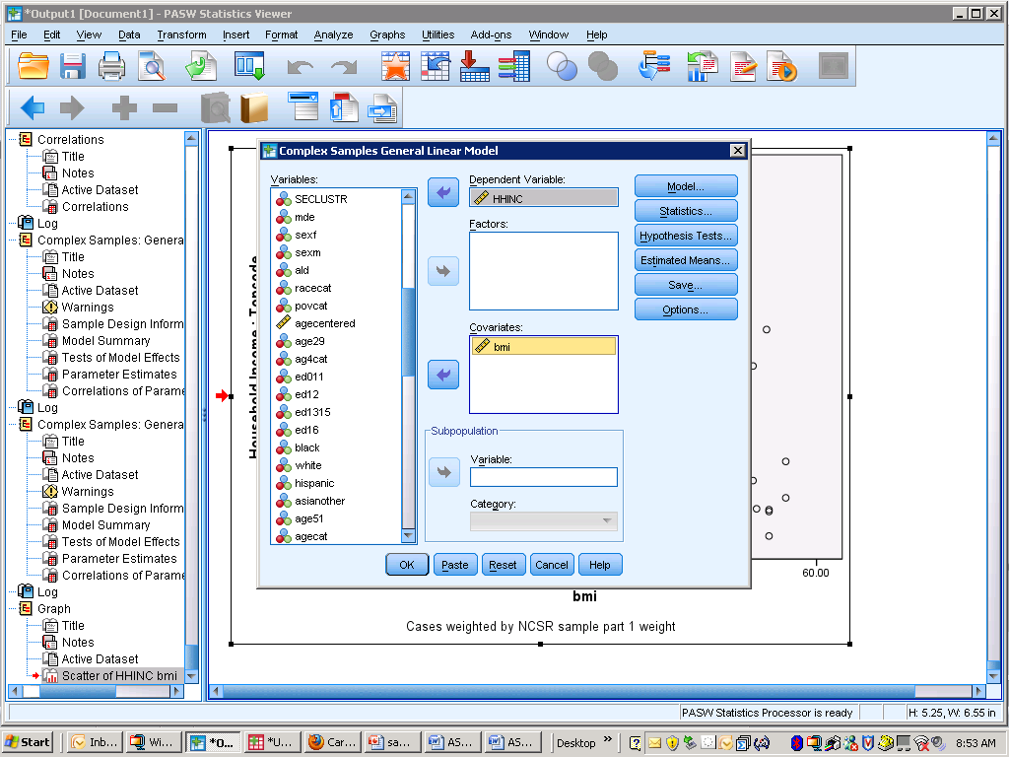
Linear regression – 16

Slide 83
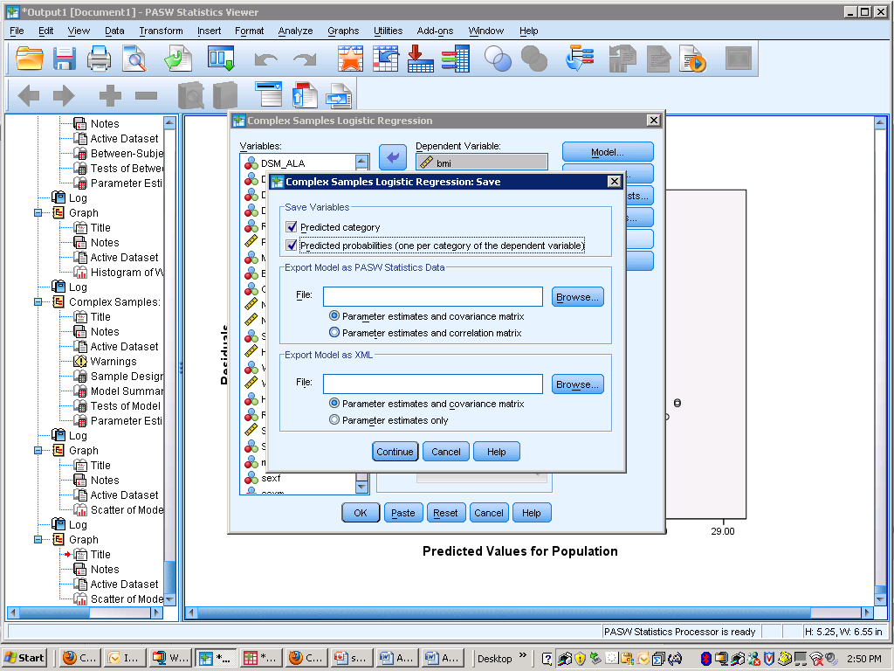
Linear regression – 17

Slide 84
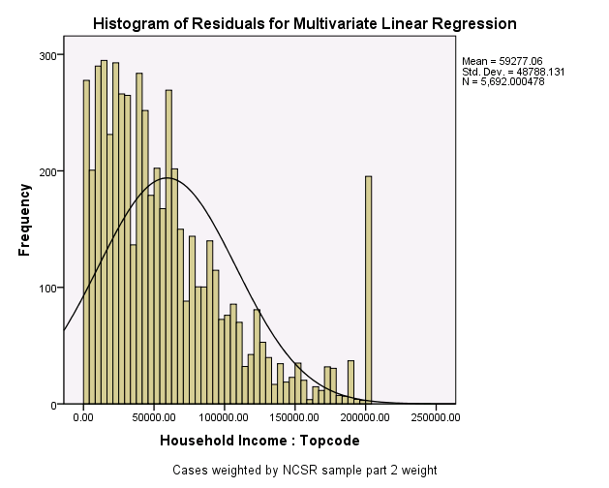
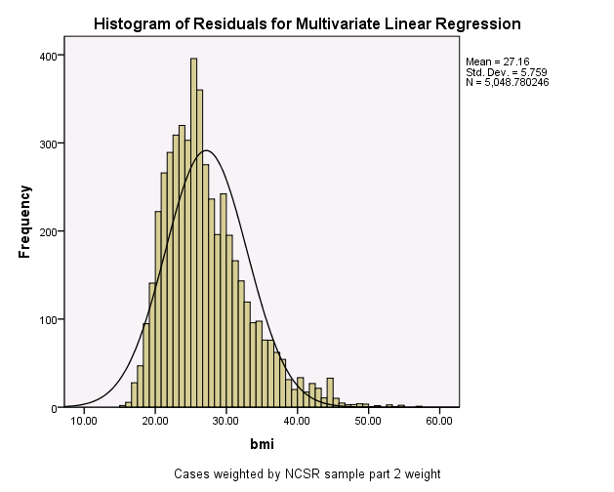
Linear regression – 18
HH Income
BMI (Body Mass Index)
Notes:
Make a note of how the HH income is not normally distributed, may want to do a log transform of it. Show how to do this informally.

Slide 85
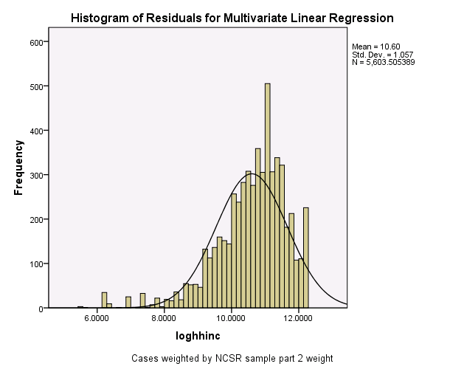
Linear regression – 18
Ln(HHINC) transformation
A one-unit change in a given predictor variable will multiply the expected response by exp(B₁)
Not using this transformation, but may want to consider it if the dependent variable is non-normal.

Slide 86
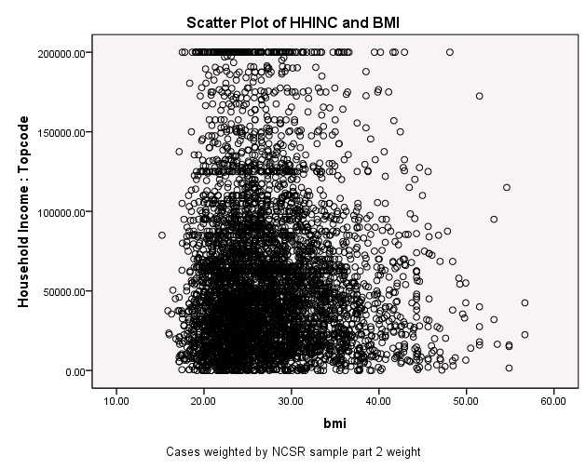
Linear regression – 19
  WEIGHT BY NCSRWTLG.
  GRAPH
  /SCATTERPLOT(BIVAR)=bmi WITH HHINC
  /MISSING=LISTWISE
  /TITLE='Scatter Plot of HHINC and BMI'.
Negative relationship between HHINC and BMI

Slide 87
Linear regression – 19
* Complex Samples General Linear Model.
CSGLM HHINC WITH bmi
/PLAN FILE='F:\samoa_training_2010\ncsr_part2_weight.csaplan'
/MODEL bmi
/INTERCEPT INCLUDE=YES SHOW=YES
/STATISTICS PARAMETER SE TTEST
/PRINT SUMMARY SAMPLEINFO
/TEST TYPE=F PADJUST=LSD
/SAVE PRED RESID
/MISSING CLASSMISSING=EXCLUDE
/CRITERIA CILEVEL=95.

Slide 88
Linear regression – 20
CSGLM model with HHINC as the dependent variable and BMI as the independent or “covariate” variable
/SAVE PRED RESID subcommand saves the predicted values and residuals for subsequent use
HHINC WITH BMI indicates use of the continuous predictor BMI, when we use categorical predictors this syntax will change slightly

Slide 89
Linear regression – 20

Slide 90
Linear regression – 21
Sample design information table:
  n=5099 (some missing data on the dependent or independent variables)
  The degrees of freedom 42 (84-42) for hypothesis testing
Wald F = 3.813 (sig. =.058) with df1=1 (BMI) and df2 =42 for the complex sample design factors

Slide 91
Linear regression – 22
Additional output:
  R-square
  R Square values are often quite small in social science research, even with many predictors, due to human behavior being quite variable

Slide 92
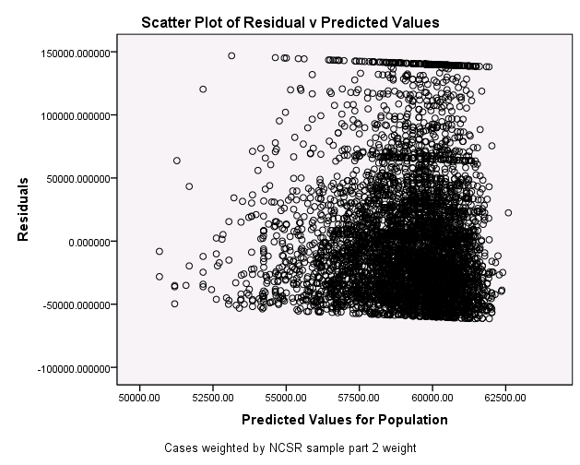
Linear regression – 23

Slide 93
Linear regression – 24
GRAPH
/SCATTERPLOT(BIVAR)=Predicted_7 WITH Residual_7
/MISSING=LISTWISE
/TITLE='Scatter Plot of Residual v Predicted Values'.
Scatter above and below 0 (no difference between predicted and observed Y)
Need a histogram of the residuals to examine if they are normally distributed (one of the model assumptions)
Use the graph (legacy dialogs) select histogram and the residual as the variable to graph, and check the box for a normal curve superimposition

Slide 94
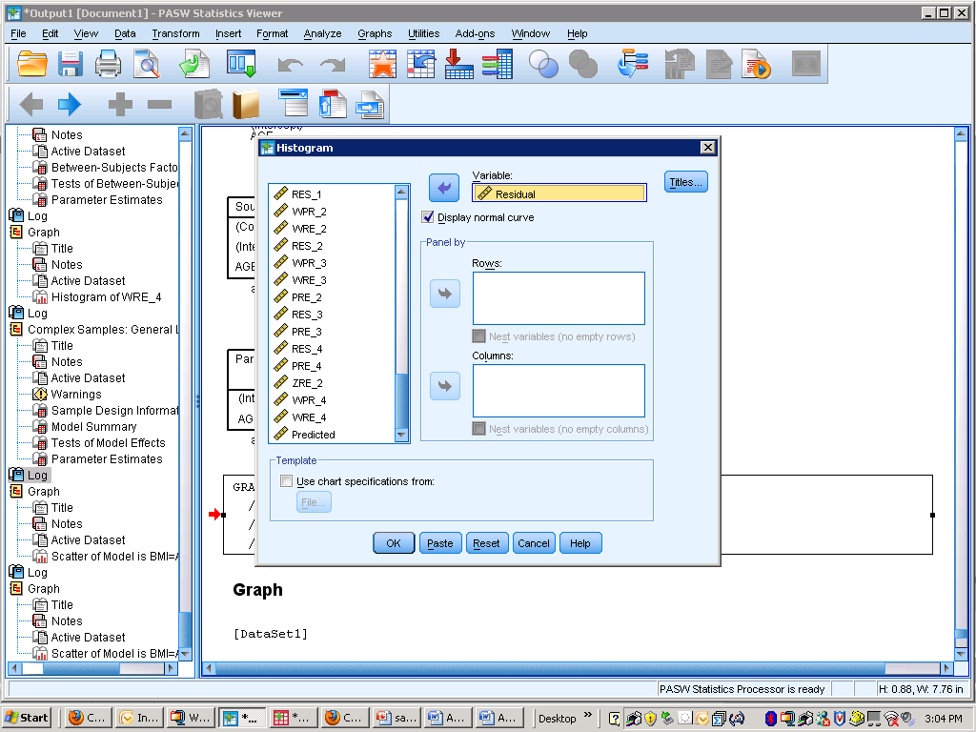
Linear regression – 25

Slide 95
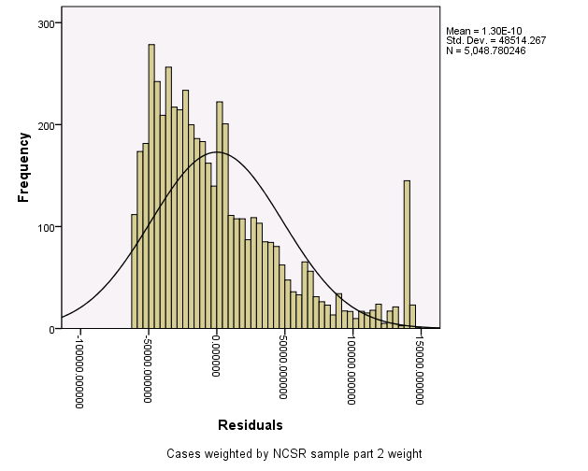
Linear regression – 26

Slide 96
Linear regression – 27
The histogram of residuals (observed Y minus predicted Y from model) shows a non-normal distribution when compared to the normal curve superimposed.
The residual statistics are displayed in the upper right corner by default (mean, standard deviation, and n)
Given that the residuals are not normally distributed, consider a dependent variable transformation or re-specification of the model.

Slide 97
Linear regression – 28
The next example illustrates use of “factor” or categorical predictors with the dependent variable of BMI and includes more than one predictor (multiple regression)
Following the recommended Hosmer and Lemeshow steps for model fitting and evaluation
Continuous BMI predicted by age in 4 categories and sex

Slide 98
Linear regression – 29
Conduct exploratory bivariate analyses to identify candidate predictors with have a significant relationship with the response variable
Etc.

Slide 99
Linear regression – 30

Slide 100
Linear regression – 31
* Complex Samples General Linear Model.
CSGLM bmi BY ag4cat
/PLAN FILE='F:\NCES_training_2010\ncsr_part2_weight.csaplan'
/MODEL ag4cat
/INTERCEPT INCLUDE=YES SHOW=YES
/STATISTICS PARAMETER SE TTEST
/PRINT SUMMARY VARIABLEINFO SAMPLEINFO
/TEST TYPE=F PADJUST=LSD
/MISSING CLASSMISSING=EXCLUDE
/CRITERIA CILEVEL=95.
Both sets of predictors meet the cutoff of < .25 for inclusion in the model (ag4cat =.000, sex = .000)
The syntax for each model is the same except for the predictor used

Slide 101
Linear regression – 32
Once the significance of the predictors is established, then run the model with all predictors in at the same time
This is the multivariate regression step (syntax next page)
The subcommand /print….gives the factor cell sizes to make sure they are large enough

Slide 102
Linear regression – 33
* Complex Samples General Linear Model.
CSGLM bmi BY ag4cat SEX
/PLAN FILE='F:\NCS_training_2010\ncsr_part2_weight.csaplan'
/MODEL ag4cat SEX
/INTERCEPT INCLUDE=YES SHOW=YES
/STATISTICS PARAMETER SE TTEST
/PRINT SUMMARY VARIABLEINFO SAMPLEINFO
/TEST TYPE=F PADJUST=LSD
/SAVE PRED RESID
/MISSING CLASSMISSING=EXCLUDE
/CRITERIA CILEVEL=95.

Slide 103
Linear regression – 34

Slide 104
Linear regression – 35
* Complex Samples General Linear Model.
CSGLM bmi BY ag4cat SEX
/PLAN FILE='F:\NCS_training_2010\ncsr_part2_weight.csaplan'
/MODEL ag4cat SEX
/INTERCEPT INCLUDE=YES SHOW=YES
/STATISTICS PARAMETER SE TTEST
/PRINT SUMMARY VARIABLEINFO SAMPLEINFO
/TEST TYPE=F PADJUST=LSD
/SAVE PRED RESID
/MISSING CLASSMISSING=EXCLUDE
/CRITERIA CILEVEL=95.

Slide 105
Linear regression – 36

Slide 106
Linear regression – 36
Age groups are compared to the highest group of 60+ (4)
Reference group for sex is female
Men (sex=1) have .582 of a point increase in BMI when compared to women, holding all other predictors constant at zero.
Those in the youngest age group (18-29) have a 1.627 lower BMI compared to those 60+ (holding all other predictors constant).

Slide 107
Linear regression – 37

Slide 108
Linear regression – 38
There is a test of the significance of sex*ag4cat using the adjusted F test in CSGLM.
  The adjusted F test provides a 2nd order correction for use with complex sample survey data
This step should be done during the model building phase
The Adjusted F test for the interaction of age*sex is not significant (.08) and we can remove the interaction term from the model.

Slide 109
Linear regression – 39
* Complex Samples General Linear Model.
CSGLM bmi BY ag4cat SEX
/PLAN FILE='F:\NCES_training_2010\ncsr_part2_weight.csaplan'
/MODEL ag4cat*SEX ag4cat SEX
/INTERCEPT INCLUDE=YES SHOW=YES
/STATISTICS PARAMETER SE TTEST
/PRINT SUMMARY VARIABLEINFO SAMPLEINFO
/TEST TYPE=ADJF PADJUST=LSD
/SAVE PRED RESID
/MISSING CLASSMISSING=EXCLUDE
/CRITERIA CILEVEL=95.

Slide 110
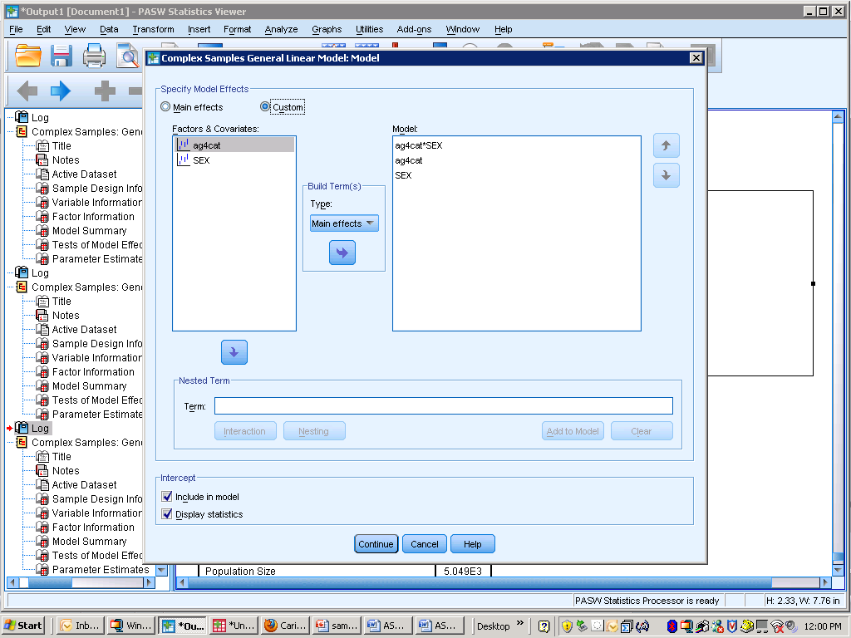
Linear regression – 40

Slide 111
Linear regression – 41

Slide 112
Linear regression – 42
* Complex Samples General Linear Model.
CSGLM bmi BY ag4cat SEX
/PLAN FILE='F:\NCES_training_2010\ncsr_part2_weight.csaplan'
/MODEL ag4cat SEX
/INTERCEPT INCLUDE=YES SHOW=YES
/STATISTICS PARAMETER SE TTEST
/PRINT SUMMARY VARIABLEINFO SAMPLEINFO
/TEST TYPE=F PADJUST=LSD
/SAVE PRED RESID
/MISSING CLASSMISSING=EXCLUDE
/CRITERIA CILEVEL=95.

Slide 113
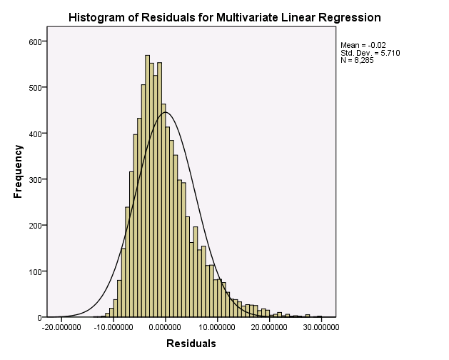
Linear regression – 42

Slide 114
Linear regression – 42
The histogram of residuals shows a nearly normal distribution
Good model fit
Perhaps further model exploration and refinement and/or transformations are needed

