Slide 1


A four-day short course sponsored by the
Social & Economic Survey Research Institute
Qatar University
Analysis of Complex Sample Data
Lecture Notes
Jim Lepkowski
Pat Berglund
Institute for Social Research
University of Michigan
October 10-13, 2016

Slide 2

Analysis of Complex Sample Data
Overview: How we plan to manage the course
Notes:
2005 CP: In last bullet uses word “design” instead of “surveys”

Slide 3
Analysis of Complex Sample Data
Overview: How we plan to manage the course
Lecture & discussion
  Principles: Things that make complex sample data complex
  Preparation: Four investigations that need to be done before analyzing complex sample survey data
  Analysis: Four problems in the analysis of complex sample survey data
  Design: How design & implementation of complex designs affect analysis
Computing laboratory
Notes:
2005 CP: In last bullet uses word “design” instead of “surveys”

Slide 4
Analysis of Complex Sample Data
Overview: How we plan to manage the course
Lecture & discussion
  Principles: Things that make complex sample data complex
  Preparation: Four investigations that need to be done before analyzing complex sample survey data
  Analysis: Four problems in the analysis of complex sample survey data
  Design: How design & implementation of complex designs affect analysis
Computing laboratory
Notes:
2005 CP: In last bullet uses word “design” instead of “surveys”

Slide 5
Analysis of Complex Sample Data
Overview: How we plan to manage the course
Lecture & discussion
  Principles: Things that make complex sample data complex
  Preparation: Four investigations that need to be done before analyzing complex sample survey data
  Analysis: Four problems in the analysis of complex sample survey data
  Design: How design & implementation of complex designs affect analysis
Computing laboratory
Notes:
2005 CP: In last bullet uses word “design” instead of “surveys”

Slide 6
Analysis of Complex Sample Data
Overview: How we plan to manage the course
Lecture & discussion
  Principles: Things that make complex sample data complex
  Preparation: Four investigations that need to be done before analyzing complex sample survey data
  Analysis: Four problems in the analysis of complex sample survey data
  Design: How design & implementation of complex designs affect analysis
Computing laboratory
Notes:
2005 CP: In last bullet uses word “design” instead of “surveys”

Slide 7
Analysis of Complex Sample Data
Overview: How we plan to manage the course
Lecture & discussion
  Principles: Things that make complex sample data complex
  Preparation: Four investigations that need to be done before analyzing complex sample survey data
  Analysis: Four problems in the analysis of complex sample survey data
  Design: How design & implementation of complex designs affect analysis
Computing laboratory
Notes:
2005 CP: In last bullet uses word “design” instead of “surveys”

Slide 8
Analysis of Complex Sample Data
Overview: How we plan to manage the course
Lecture & discussion
  Principles: Things that make complex sample data complex
  Preparation: Four investigations that need to be done before analyzing complex sample survey data
  Analysis: Four problems in the analysis of complex sample survey data
  Design: How design & implementation of complex designs affect analysis
Computing laboratory
Notes:
2005 CP: In last bullet uses word “design” instead of “surveys”

Slide 9
Analysis of Complex Sample Data
Overview: How we plan to manage the course
Lecture & discussion
  Principles: Things that make complex sample data complex
  Preparation: Four investigations that need to be done before analyzing complex sample survey data
  Analysis: Four problems in the analysis of complex sample survey data
  Design: How design & implementation of complex designs affect analysis
Computing laboratory
Notes:
2005 CP: In last bullet uses word “design” instead of “surveys”

Slide 10
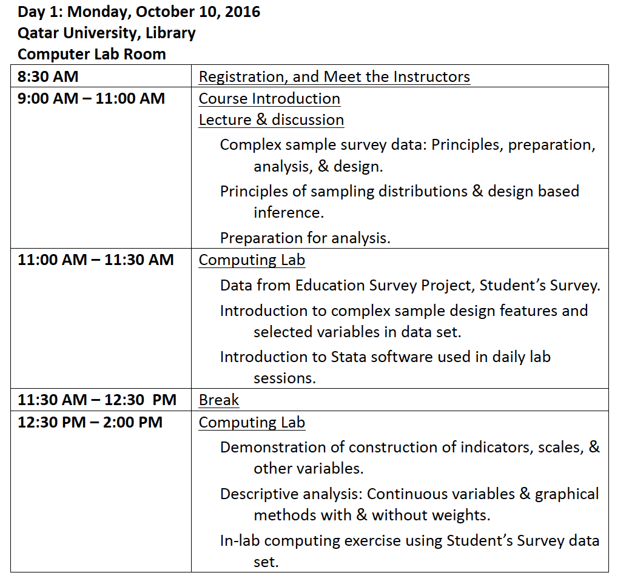
Analysis of Complex Sample Data

Slide 11
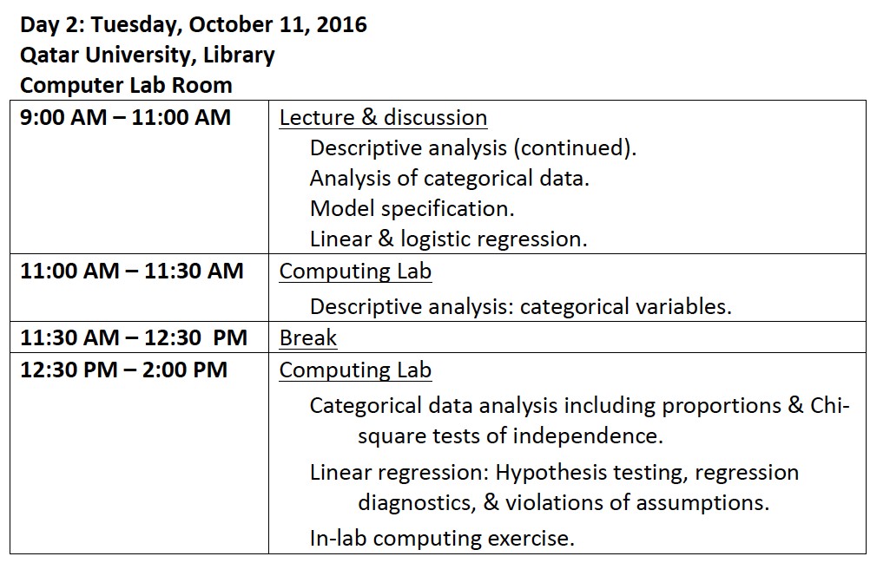
Analysis of Complex Sample Data

Slide 12
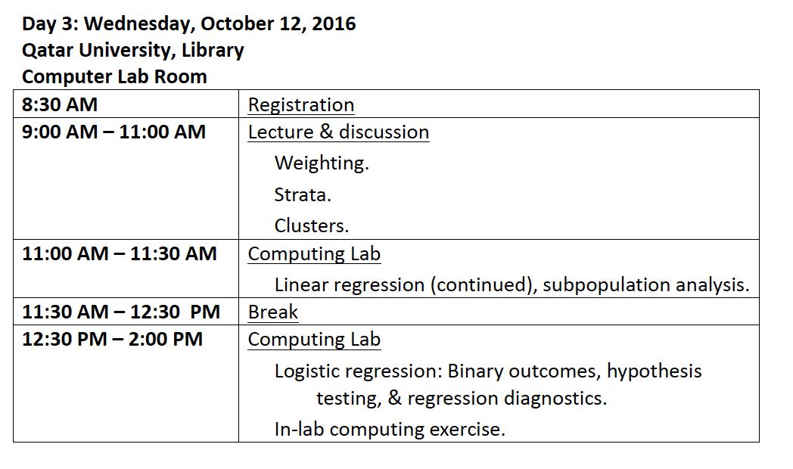
Analysis of Complex Sample Data

Slide 13
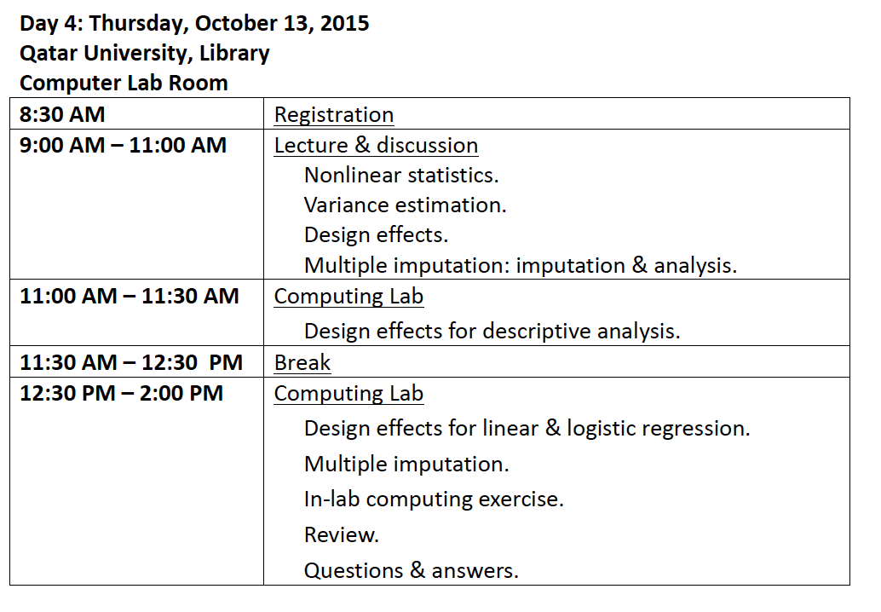
Analysis of Complex Sample Data

Slide 14

Analysis of Complex Sample Data
Overview: How we plan to manage the course
Lecture & discussion
  Principles
  Preparation
  Analysis
  Design
Notes:
2005 CP: In last bullet uses word “design” instead of “surveys”

Slide 15
Analysis of Complex Sample Data
Overview: How we plan to manage the course
Lecture & discussion
  Principles
    Sampling distributions: simple
    Design based inference: simple
    Sampling distributions: complex
    Design based inference: complex
  Preparation
  Analysis
  Design
Notes:
2005 CP: In last bullet uses word “design” instead of “surveys”

Slide 16
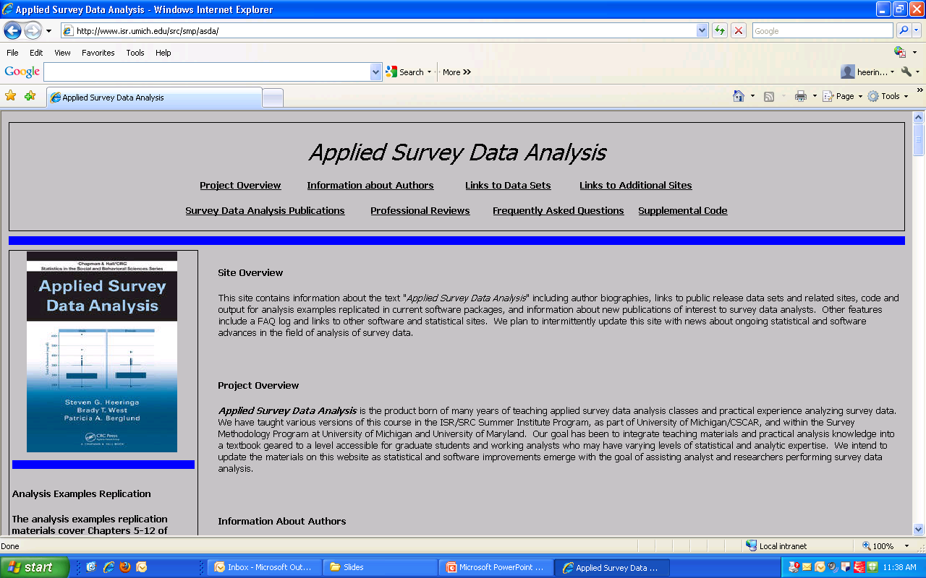
Principles – 1
Analysis of Complex Sample Survey Data

Slide 17
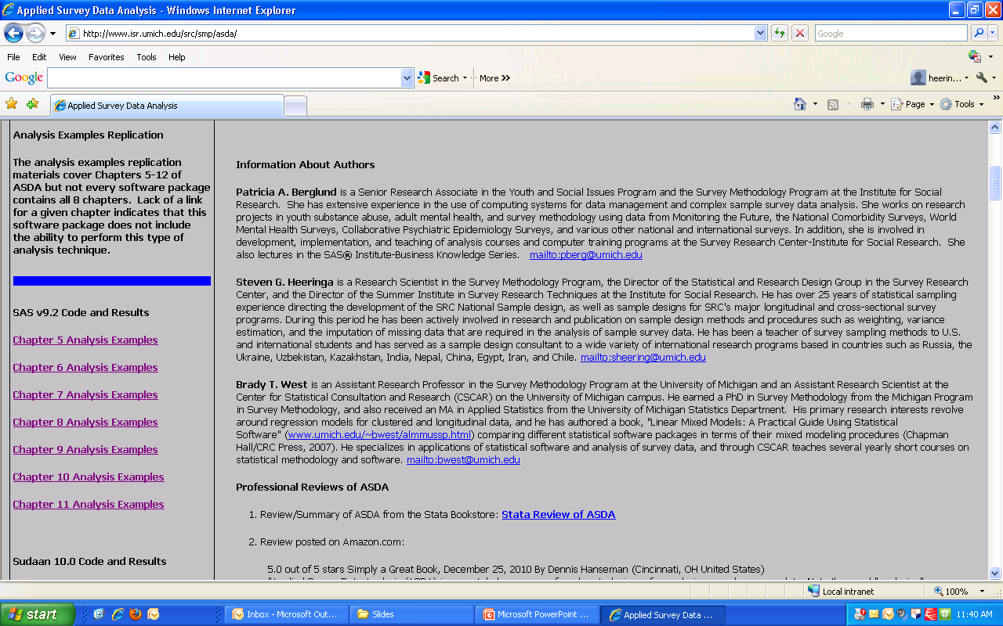
Principles – 2
Analysis of Complex Sample Survey Data

Slide 18
Principles – 3
Complex Sample Survey Data
What is complex sample survey data?
  In simple sample survey data (SRS)
    Each element has same chance of selection
    No strata
    No clusters
    Fixed sample size
    Linear estimators
    No missing data – no nonresponse
  Complex samples: at least one of these
In simple case, quality of data (standard errors) are determined by sample size

Slide 19
Principles – 4
Complex Sample Survey Data
In complex samples, several things change:
  Estimation methods (formula)
  Some features tend to decrease standard errors (increase quality for same cost)
  Other features increase standard errors
    But if cost is reduced, one can actually have cheaper surveys with much smaller standard errors (better quality)

Slide 21
Principles – 6
Why complex sample survey data?
Benefits
  Strata: reduce standard errors
  Strata: control of sample design features
    Strata of particular interest in sample
    Oversample relatively small groups: sample size
  Clusters: reduce cost
Unavoidable features
  Nonresponse
  Nonlinear estimation

Slide 22
Principles – 7
Variance Estimation
Complex sample survey design requires special approach to variance estimation
The variances computed using an SRS approach under-estimate variance
By not incorporating complex sample design factors, analyst risks over-stating the statistical significance of the results
We will learn how to correct variance over-estimation

Slide 23
Principles – 8
Key Information
Focus on “design-based” approach
  Weights
  “Design Variables”
    Cluster/SECU (Sampling Error Computing Unit)/PSU (Primary Sampling Unit)
    Strata
  These variables provided by the project data producers
Consider also nonlinear estimators, variance estimation, & imputation for missing data

Slide 24
Principles – 9
Example simple selection
The following table (3 pages) lists the salaries of N = 370 faculty at a university in 2016.
For each faculty member there is a
  sequence number & an ID
  division, rank, & sex
The 2015-2016 salary is shown for purposes of estimation – in practice, it’s unknown, what we want to measure
Notes:
2005 CP: Slightly different wording, n instead of N. 1997 date added. Dates changed from 1993-94 to 1996-7.

Slide 25
Notes:
Tables in a different order. Random table not last. Random table not last. 2006 CP: Retyped table placed after random digits table

Slide 26
Notes:
Tables in a different order. Random table not last. 2006 CP: Retyped table placed after random digits table

Slide 27
Notes:
2006 CP: Retyped table placed after random digits table

Slide 28
Principles - 13
Select a simple random sample of n = 20 from the list.
Use the accompanying table of random numbers to select the sample objectively
Compute the sample mean
Notes:
Last bullet does not say random. Missing explanation paragraphs about Sample.

Slide 29
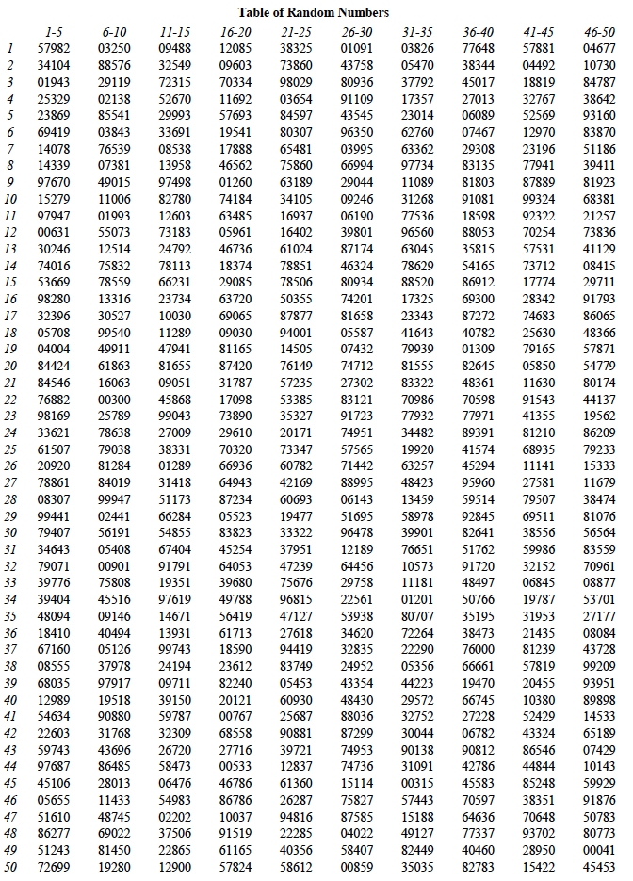
Notes:
Tables in a different order. Random table not last. 2005 CP: Has Faculty Salary lists before Random Digit Lists. 2006 CP: Retyped table placed before faculty salaries table

Slide 30
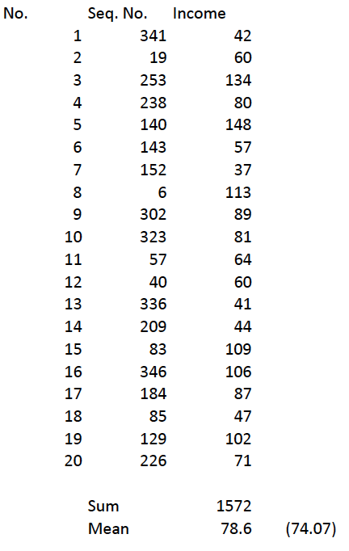
Principles – 15
One possible sample

Slide 31
Principles – 16
Population data
The population of N = 370 faculty salaries has the following properties:

Slide 32
Principles – 17
Standard errors
For a SRS of n = 20,

Slide 33
Principles – 18
95% Confidence interval
For a SRS of n = 20,

Slide 34
Principles – 19
3 elements of design based inference

Slide 35

1 Population
Probability sampling principles

Slide 36
1 Population
e
Probability sampling principles

Slide 37

1 Population
2 Frame
e
Probability sampling principles

Slide 38
Notes:
Tables in a different order. Random table not last. Random table not last. 2006 CP: Retyped table placed after random digits table

Slide 39

1 Population
2 Frame
e
3 Sample
Probability sampling principles

Slide 40
Notes:
Tables in a different order. Random table not last. 2005 CP: Has Faculty Salary lists before Random Digit Lists. 2006 CP: Retyped table placed before faculty salaries table

Slide 41
Principles – 26
One possible sample

Slide 42

1 Population
2 Frame
e
3 Sample
4 Estimate
Probability sampling principles

Slide 43
Principles – 28
Sample mean
The means differ because they come from different samples, and the salaries differ across the sample elements in the two samples.
Since each mean is based on a sample, and not a census, it will not be equal to the overall population mean, nor will means from different samples be equal to one another.

Slide 44

1 Population
2 Frame
s
3 Sample
3 Sample
3 Sample
4 Estimate
4 Estimate
4 Estimate
Probability sampling principles

Slide 45
1 Population
2 Frame
3 Sample
s
4 Estimate
5 Sampling distribution
3 Sample
3 Sample
3 Sample
4 Estimate
4 Estimate
4 Estimate
Probability sampling principles

Slide 46
1 Population
2 Frame
3 Sample
s
4 Estimate
5 Sampling distribution
3 Sample
3 Sample
3 Sample
4 Estimate
4 Estimate
4 Estimate
Probability sampling principles

Slide 47
1 Population
2 Frame
3 Sample
s
4 Estimate
5 Sampling distribution
3 Sample
3 Sample
3 Sample
6 Standard error
4 Estimate
4 Estimate
4 Estimate
Probability sampling principles

Slide 48
Principles – 33
Standard errors
For a SRS of n = 20,

Slide 49
1 Population
2 Frame
3 Sample
s
s
4 Estimate
5 Sampling distribution
3 Sample
3 Sample
3 Sample
6 Standard error
7 Confidence interval
4 Estimate
4 Estimate
4 Estimate
Probability sampling principles

Slide 50
Principles – 36
95% Confidence interval
For a SRS of n = 20,

Slide 52
1 Population
2 Frame
e
Probability sampling principles

Slide 53
1 Population
2 Frame
e
3 Sample
3 Sample
Probability sampling principles

Slide 54
1 Population
2 Frame
s
3 Sample
3 Sample
4 Estimate
4 Estimate
Probability sampling principles

Slide 55
1 Population
2 Frame
s
5 Sampling distribution
3 Sample
3 Sample
4 Estimate
4 Estimate
Probability sampling principles

Slide 56
1 Population
2 Frame
5 Sampling distribution
s
6 Standard error
3 Sample
3 Sample
4 Estimate
4 Estimate
Probability sampling principles

Slide 57
1 Population
2 Frame
5 Sampling distribution
s
6 Standard error
7 Confidence interval
3 Sample
3 Sample
4 Estimate
4 Estimate
Probability sampling principles

Slide 58
Stratification

Slide 59
Stratification
Clustering

Slide 60
Stratification
Clustering
Weightingng

Slide 61

Analysis of Complex Sample Data
Overview: How we plan to manage the course
Lecture & discussion
  Principles
  Preparation
  Analysis
  Design
Notes:
2005 CP: In last bullet uses word “design” instead of “surveys”

Slide 62
Analysis of Complex Sample Data
Overview: How we plan to manage the course
Lecture & discussion
  Principles
  Preparation
    Survey documentation
    Software selection
    Sampling factor evaluation
    Descriptive analysis
  Analysis
  Design
Notes:
2005 CP: In last bullet uses word “design” instead of “surveys”

Slide 63

Analysis of Complex Sample Data
Overview: How we plan to manage the course
Lecture & discussion
  Principles
  Preparation
    Survey documentation
    Software selection
    Sampling factor evaluation
    Descriptive analysis
  Analysis
  Design
Notes:
2005 CP: In last bullet uses word “design” instead of “surveys”

Slide 64
Survey Documentation - 1
Review survey documentation
Identify weights & select suitable weights for analysis
Examine weight distribution
Identify stratification & cluster variables
Examine distribution of cases across strata and clusters
Prepare PASW CS Plan

Slide 65
Survey Documentation - 2
National Comorbidity Survey - Replication
Mental illness and related topics
2001-2003 multi-stage area probability sample
n=9282 for Part 1
Major Depressive Episode/Disorder, General Anxiety Disorder
Socio-demographic measures (sex, race, etc.)

Slide 66
Survey Documentation - 3
Public release through the University of Michigan (www.icpsr.umich.edu/cpes)
Element of the Collaborative Psychiatric Epidemiology Studies (CPES)
NCS-R and NCS-1
  Carried out a decade after the original NCS-1
  Repeats NCS-1 questions
  Expands diagnostic criteria to the Diagnostic and Statistical Manual - IV (DSM-IV), 1994.

Slide 67
Survey Documentation - 4
The NCS-R administered to persons aged 18 or older residing in households in the coterminous United States.
Institutionalized in prisons, jails, nursing homes, and long-term medical or dependent care facilities excluded.
Military personnel in civilian housing included.
Persons able to respond in English.

Slide 68
Survey Documentation - 5
Cross-sectional – repeated
Major aims
  Investigate time trends
  Expand the assessment in the baseline NCS-1
Two parts
  1: core diagnostic assessment of 9,282 respondents
  2: risk factors, consequences, additional disorders of 5,692 subsample.

Slide 69
Survey Documentation - 6
NCS-R instrument in two parts:
  1: psychiatric diagnosis, pharmacoepidemiology, & socio-demographic characteristics (those not selected to complete Part 2)
  2: additional disorders such as gambling, conduct, ADD as well as social networks, family history, risk factors, & finances

Slide 70
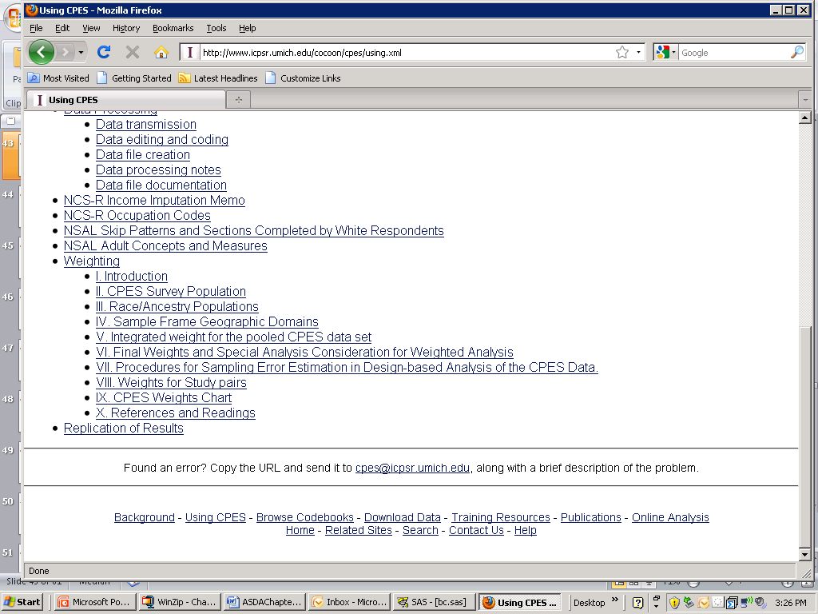
Survey Documentation - 7

Slide 71
Survey Documentation - 8
NCSRWTSH, n=9282 (Part 1 respondents)
NCSRWTLG, n=5692 (Part 2 respondents
Selection:
  Analysis with only P1 variables: NCSRWTSH
  Analysis with only P2 variables: NCSRWTLG
  Analysis with some P1 & some P2 variables: NCSRWTLG

Slide 72

Analysis of Complex Sample Data
Overview: How we plan to manage the course
Lecture & discussion
  Principles
  Preparation
    Survey documentation
    Software selection
    Sampling factor evaluation
    Descriptive analysis
  Analysis
  Design
Notes:
2005 CP: In last bullet uses word “design” instead of “surveys”

Slide 73
Software - 1
Early survey analysis packages assumed SRS
At first, non-package software developed to perform computations for complex designs
  OSIRIS
  SUDAAN
  CARP & Super CARP
All require certain data elements:
  SECU and stratum for all elements
  At least two SECU’s per stratum
  Weights, if required (almost always are …)

Slide 74
Software - 2
SAS V9.3+ PROC SURVEYxxxx commands
STATA v13 svy procedures (www.stata.com)
SUDAAN V11 (www.rti.org/sudaan)
-Stand-alone or SAS-callable
-Large set of PROCS
IBM SPSS® Statistics: Complex Samples Module
  Add-on module, requires SPSS base to run
  Needs to be purchased separately from SPSS base
  Visit http://www.spss.com/ for more information

Slide 75
Software - 3
SAS: The “SURVEY” procedures
PROC SURVEYMEANS
PROC SURVEYREG
PROC SURVEYFREQ (Version 9+)
PROC SURVEYLOGISTIC (Version 9+)
PROC SURVEYPHREG
Stata: The “svy” commands
svyset: define design variables
svydes: describe survey design
svy: mean
svy: regress
many additional “svy” commands

Slide 76
Software - 4
IVEware: SAS-based (macros) or stand-alone
%DESCRIBE (descriptive statistics)
%REGRESS (regression modeling)
%SASMOD (additional SAS procs)
SUDAAN: SAS-based or stand-alone procedures
DESCRIPT
CROSSTAB
REGRESS
LOGISTIC
many others…for more info, visit http://www.rti.org/sudaan/

Slide 77
Software - 5
R Survey Package (http://cran.r-project.org)
  Survey package under Packages menu (Windows) or Packages and Data (Mac)
  svydesign(arguments), svyrepdesign() to specify design and weights
  svymean( ), svytotal(), svyplot()
  svyratio(), svyglm(),svyolr(),svyloglin(),svycoxph()
Others: Mplus (for modeling)

Slide 78
Software - 6
A useful site for reviewing available software, and getting links to software reviews, tutorials, etc., is
http://www.fas.harvard.edu/~stats/survey-soft/survey-soft.html

Slide 79
PASW CS Module - 1
PASW Complex Samples module (CS)
Incorporates weights, stratum, & cluster variables
Analyses:
  Means, totals, ratios
  Frequencies in contingency tables (proportions)
  Linear regression
  Logistic regression

Slide 80
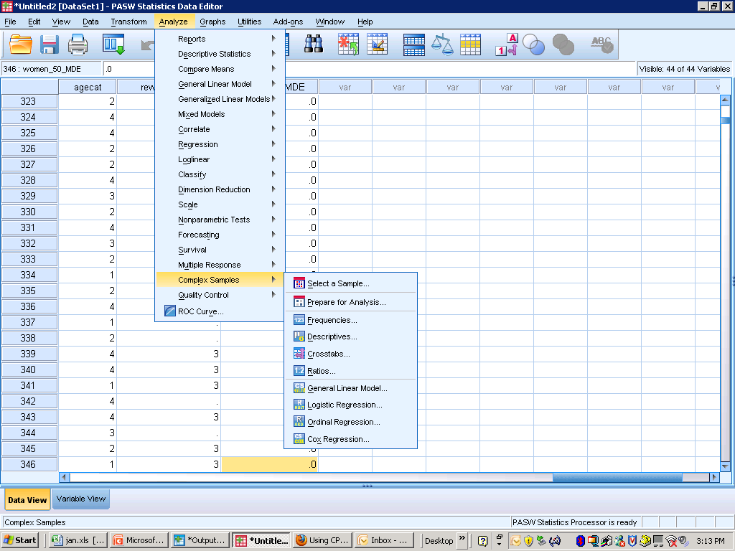
PASW CS Module - 2

Slide 81
PASW CS Module - 3

Slide 82
PASW CS Module - 4

Slide 83
PASW CS Module - 5

Slide 84
PASW CS Module - 6

Slide 85
PASW CS Module - 7

Slide 86
PASW CS Module - 8

Slide 87
PASW CS Module - 9
Plan file declares weights, stratum, & cluster to PASW CS
Must precede analytic technique specification
Plan file can be saved for future use
For the NCS-R data set, prepare two plan files:
  Part 1
  Part 2

Slide 88
PASW CS Module - 10

Slide 89
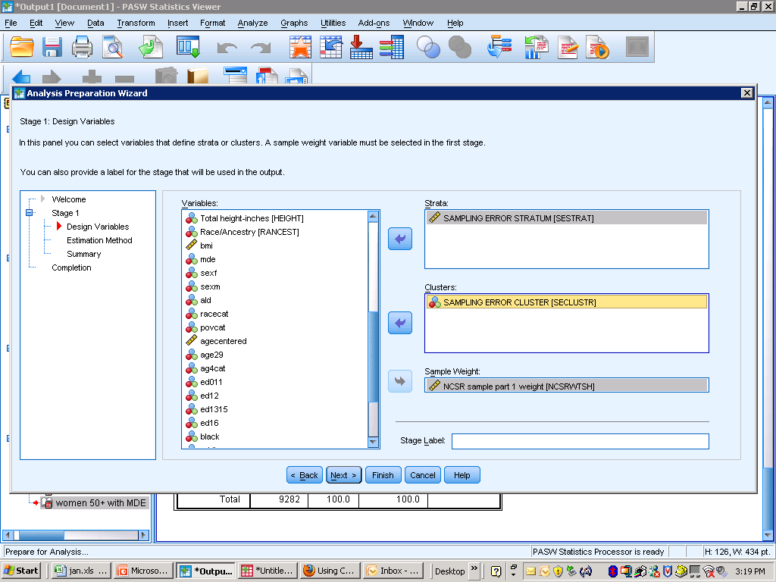
PASW CS Module - 11

Slide 90
PASW CS Module - 12

Slide 91
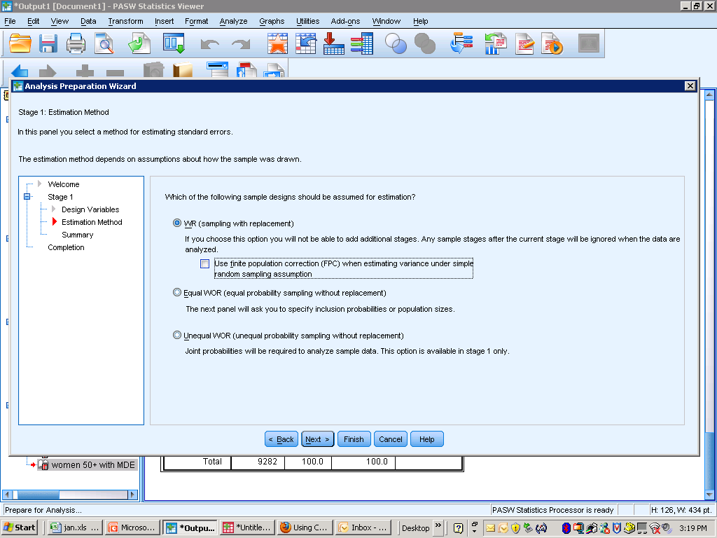
PASW CS Module - 12

Slide 92
PASW CS Module - 13

Slide 93
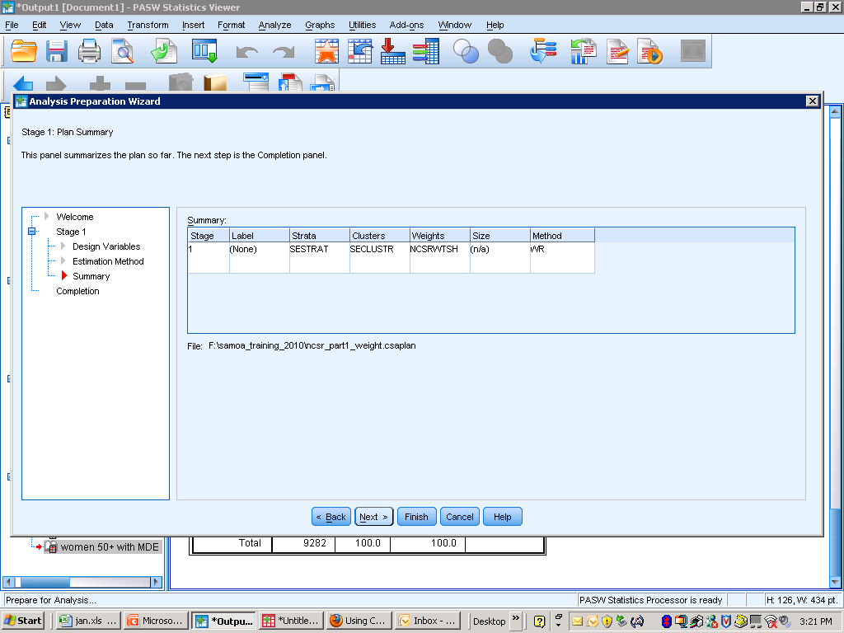
PASW CS Module - 14

Slide 94
PASW CS Module - 15
* Analysis Preparation Wizard.
CSPLAN ANALYSIS
/PLAN FILE='F:\training_2016\ncsr_part1_weight.csaplan'
/PLANVARS ANALYSISWEIGHT=NCSRWTSH
/SRSESTIMATOR TYPE=WR
/PRINT PLAN
/DESIGN STRATA=SESTRAT CLUSTER=SECLUSTR
/ESTIMATOR TYPE=WR.

Slide 95
PASW CS Module - 16
Use Plan File wizard to create a second plan
  Same strata and cluster variables (SESTRAT, SECLUSTR)
  Different weight: NCSRWTLG (Part 2)
Subsequently need to select the correct plan file depending on the variables used

Slide 96
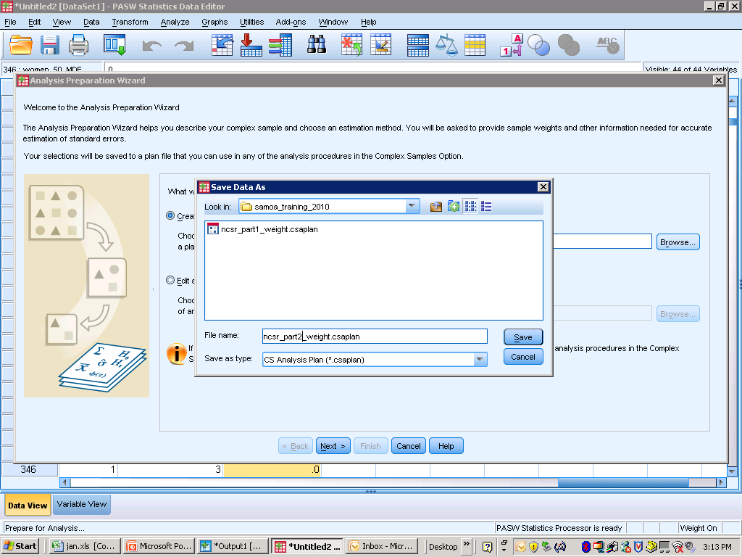
PASW CS Module - 17

Slide 97

Analysis of Complex Sample Data
Overview: How we plan to manage the course
Lecture & discussion
  Principles
  Preparation
    Survey documentation
    Software selection
    Sampling factor evaluation
    Descriptive analysis
  Analysis
  Design
Notes:
2005 CP: In last bullet uses word “design” instead of “surveys”

Slide 98
Sampling Factor Evaluation - 1
Read the data set into PASW
Menu:
  Analyze – descriptive statistics – descriptives
  Select the two NCS-R weight variables
    NCSRWTSH (Part 1 or “Short” Form)
    NCSRWTLG (Part 2 or “Long” Form)
Options tab allows selection of key statistics desired in output

Slide 99
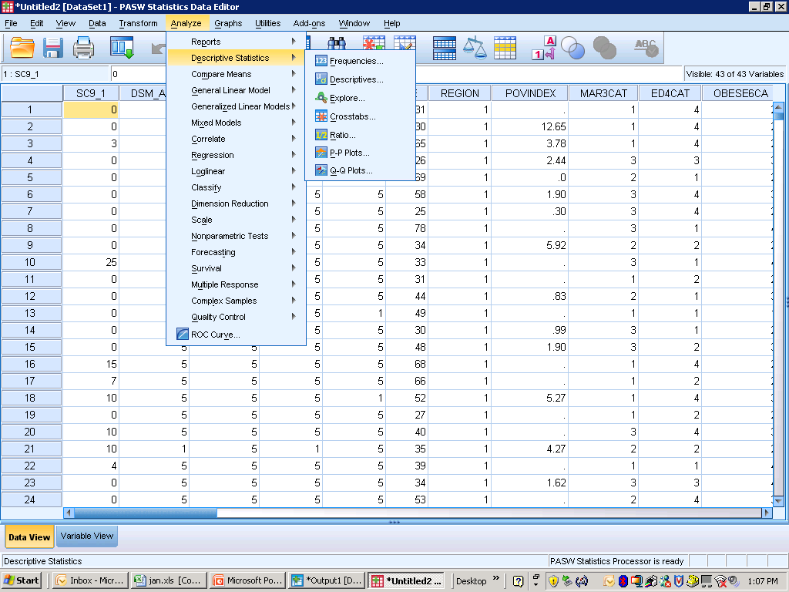
Sampling Factor Evaluation - 2

Slide 100
Sampling Factor Evaluation - 3
DESCRIPTIVES VARIABLES=NCSRWTSH NCSRWTLG
/STATISTICS=MEAN STDDEV RANGE MIN MAX.

Slide 101
Sampling Factor Evaluation - 4

Slide 102
Sampling Factor Evaluation - 5
Two variables in the NCS-R:
  SESTRAT -- NCS-R stratum variable
  SECLUSTR -- NCS-R cluster (SECU)
Examine the distribution of the two variables using a cross-tabulation
Menus
  Analysis → Descriptive Statistics → Frequencies
  Select variables & options desired

Slide 103
Sampling Factor Evaluation - 6

Slide 104
Sampling Factor Evaluation - 7
CROSSTABS
/TABLES=SESTRAT BY SECLUSTR
/FORMAT=AVALUE TABLES
/CELLS=COUNT
/COUNT ROUND CELL.

Slide 105
Sampling Factor Evaluation - 8

Slide 106
Sampling Factor Evaluation - 9
42 strata (SESTRAT)
Two clusters (SECLUST)
Sample evenly distributed:
  84 cells have a very similar number of cases
  Has an impact on accuracy of Taylor series approximation
  Has an impact on standard errors (& design effects)

